Slide 1
Protecting the Environment: A Lesson to be Learned within, “He-y, Come on Ou-t!” by Shinichi Hoshi
Barbara Kolnik
I.S. 126-Albert Shanker School for Visual & Performing Arts

Slide 2
Why is it Important to Protect Our Environment?
(Student Responses)
For further information about Public Policy Analyst click here.

Slide 3
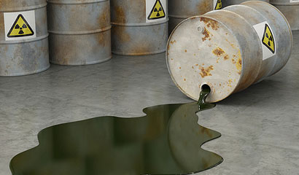
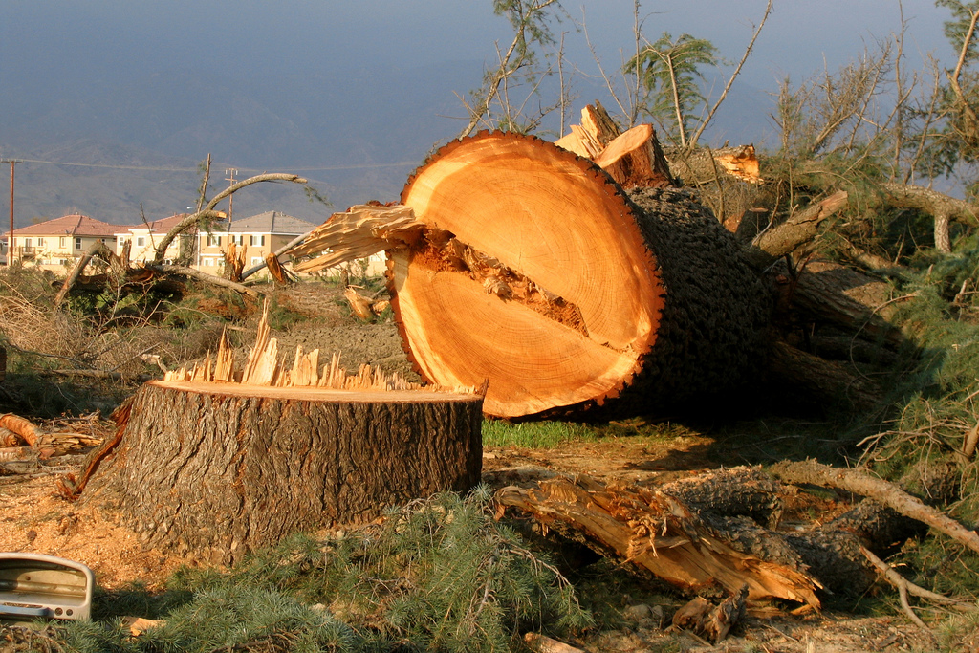
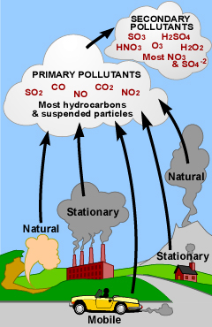
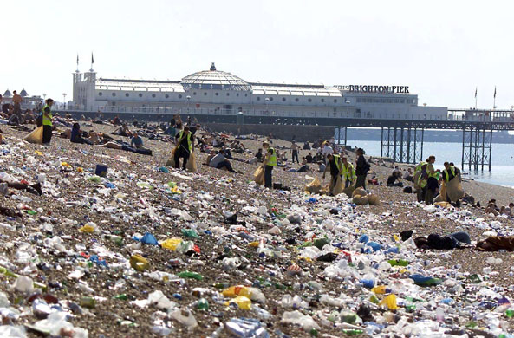
What is considered to be harmful for our environment? Defining the Problem
Identify the environmental dangers above. Is there anything else, that is not shown above that might be harmful to the environment?

Slide 4
Video Response: PPA: Defining the Problem
According to the video below, why is it important to protect our environment?
Watch the Video: Protect the Environment

Slide 5
Textual Connections
What is the policy that has been established within the text? What can you infer to be the future ramifications of such a policy?
Cite evidence from the passage below:
“We’ve got a fabulously deep hole! Scientists say it’s at least five thousand meters deep! Perfect for the disposal of such things as waste from nuclear reactors.” Government authorities granted permission. Nuclear power plants fought for contracts.. The people of the village were a bit worried about this, but they consented when it was explained that there would be absolutely no above-ground contamination for several thousand years and that they would share in the profits.

Slide 6
Contemporary Connections
How does “He-y Come On Ou-t!” compare to events or ideas that have occurred in the United States and the world?
Event/Idea #1
Event/Idea #2

Slide 7
PPA-Developing Solutions Work Time Activity
Select one environmental issue that was discussed within today’s lesson.
Develop an organization that you would create that would attempt to resolve or improve upon your selected issue.
Consider the following facets to include in your organization’s proposal in order to resolve/improve the issue:
Poster Designs
Fundraisers
Service Projects
Special Events

