Slide 1
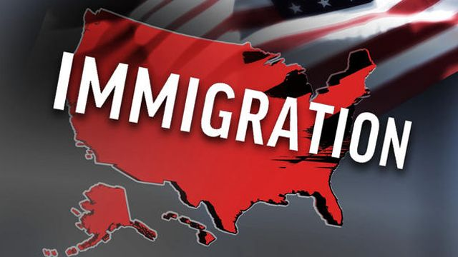
“THERE IS TOO MUCH ILLEGAL
IN THE U.S.”
Teacher: Ms. Earlean Jackson
School: I.S. 126Q
E-mail: ejackson4@schools.nyc.gov
Notes:
Teacher will ask students do they agree or disagree with the title – There is too much illegal immigration in the U.S.

Slide 2
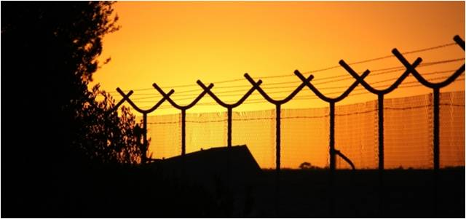
Problem: There is too much illegal immigration in the United States. Step 1 of the PPA: Define the Problem
Illegal immigration continues to be a controversial and divisive topic, not only
here in the United States, but throughout the world. Let’s keep in mind there is
nothing wrong with the idea of immigration. The problem comes when people do
it illegally. Now, let us examine this topic more closely: Let us first, discuss what
exactly is illegal immigration. Then, brainstorm and chart the problems and its
consequences that impact us associated with this very controversial topic.
Many say that the problem lies in the fact that, illegal immigrants are taking from
society without giving anything back in return. Health care, education, and other
areas of public service. They aren’t paying for these things (paying taxes), yet they are
receiving them.
Notes:
Define the following vocabulary words: illegal immigration, illegal immigrant, alien.

Slide 3
What are some of the problems and consequences of illegal immigration?
Problems
High Birth Rates and Overpopulation
Crime/Violence/Robbery/Terrorism
Drugs
Gangs
Smugglers
Language barriers
Undocumented/Identity Theft
Poverty
Homelessness
Depreciated Wages
Off- book jobs
Drunk Driving/Hit and Runs
Uneducated/Lack of Education
Consequences
Closed and Overcrowded Hospitals and Emergency Rooms
Overcrowding and Construction of more Jails and Detention Centers
Border Patrols/Law Enforcement Agents/Fences/Detectors
Cost to pay for Translators
Document Fraud/Deportation
Food Pantries/Welfare Funding
Overcrowding Shelters
High Unemployment
Untaxed Wages
Deaths and Higher Insurance Rates
Overcrowded Classrooms, Schools/Libraries, etc…
Notes:
Class Activity: Cover-up the Consequences and show students only the Problems and have them determine what will be the consequence or outcome of each problem.

Slide 4
What is the evidence of illegal immigration? Step 2 of the PPA: Gather the Evidence
The evidence that illegal immigration is a problem, reflects in
the growing numbers of illegal immigrants founded in the U.S.
The illegal immigrant population of the United States is
estimated to be between 7 and 20 million. The majority of illegal
immigrants are from Mexico.
In a 2011 news story, Los Angeles Times reported that, 11.2
million illegal immigrants living in the U.S. Also, finding that
illegal immigrants were parents of 5.5 million children, 4.5
million of whom were born in the U.S and are citizens.
The estimated cost of harboring illegal immigrants in the United
States is a staggering $113 billion a year – an average of $1,117 for every
“native-headed” household in America – according to a study
conducted by the Federation of American Immigration Reform.
Notes:
Teacher ask students question “Do you know anyone who is an illegal immigrant?” Then illicit answers from students.

Slide 5
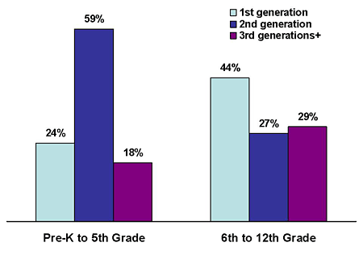
Continued: What is the evidence of illegal immigration?
The single largest cost to the government of illegal immigration, according to the FAIR report, is estimated $52 billion spent on schooling the children of illegal immigrants: “Nearly all those costs are absorbed by the state’s current budget deficit ; in California the additional cost of illegal immigration, $21.8 billion, is $8 billion more than the state’s current budget deficit of $13.8 billion; and New York, the $6.8 billion deficit is roughly two-thirds the $9.5 billion yearly cost of its population.
Question: Now, Turn and Talk in your small groups and discuss with your partners whether or not you think illegal immigration is fair on the U.S economy and explain why?
Notes:
Students can record their responses on paper, can be the start of a good debate essay paper.

Slide 6
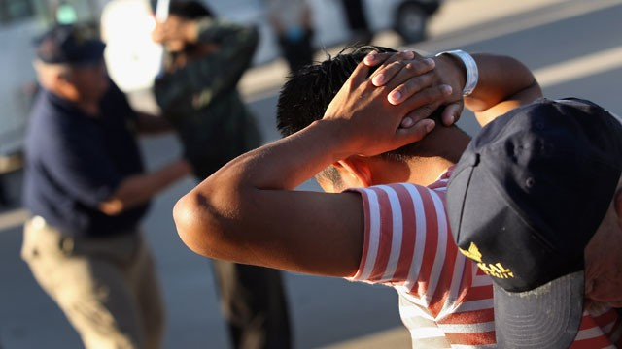
What are the causes of illegal immigration? Step 3 of the PPA: Identify the Causes
Let’s now focus on some of the causes of illegal immigration and why it is
considered a major problem for us here in the U.S.A. Some undocumented
immigrants entered the country illegally and others entered illegally but
overstayed the number of days permitted on their visa or violated the terms
of their permanent resident card or refugee permit.
Regardless, of how a migrant got to their new home country, they decided to
take a risk and move to a foreign country in search of a better life.
Throughout history, there continues to be a myriad of ways that immigrants
cross the border in order to get into the United States. One method is often in
homemade boat or even a tube. Some illicit the assistance of a “coyote” or
smuggler, to help them attempt to illegally cross the border into the
United States.
Notes:
Teacher will ask students what are their thoughts to why people will risk breaking the law and their life to illegally enter the United States.

Slide 7
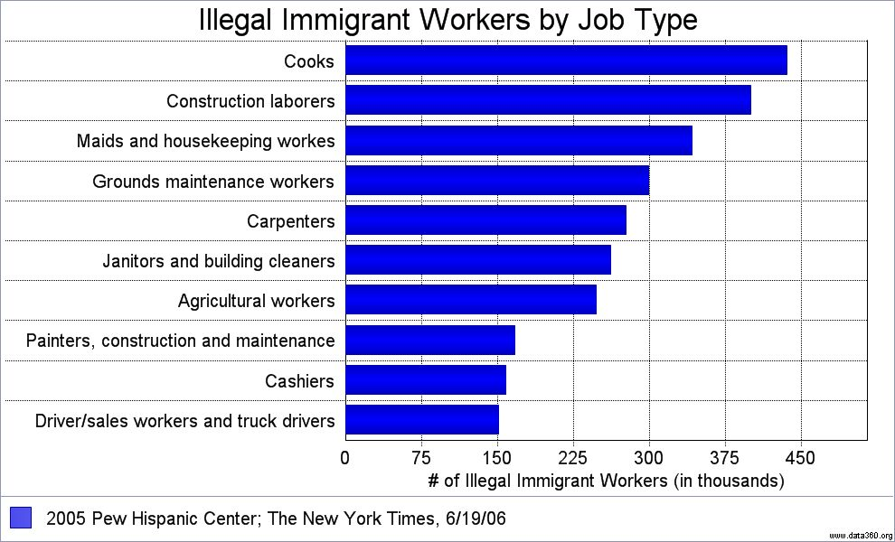
Continued: What are the causes of illegal immigration?
Other illegal immigrants may try to cross the border into the United States by
cramming into shipping containers, trucks, or boxcars, They may be able to payoff corrupt
authority figures in order to gain entry into a specific country. Most will find a way to get to
their destination and oftentimes, may involve grave risk to their life.
Once in the foreign country, illegal immigrants tend to become employed in
what is known as “low skilled jobs.” These jobs are often labor intensive and don’t tend to
attract many employees. In the United States for example, the landscaping and
construction sectors tend to be popular with immigrants as there is generally no
requirement to be fluent in the English language. Other employment sectors that attract
illegal immigrants include restaurants, hospitality, agriculture and domestic service.
Notes:
Teacher will illicit answers from students as they observe the graph.

Slide 8
What are the existing laws/ policies for illegal immigration? Step 4 of the PPA: Examine an Existing Policy
It is illegal to enter the United States without permission. The first time an illegal
immigrant is caught in the U.S. it is a misdemeanor civil offense. After the first offense, being caught a second time is a felony!!!
It is also against the law to overstay a visa issued by the U.S. Government and illegal for
an employer to knowingly hire illegal immigrants.
Here is a compiled list of illegal immigration laws and must be followed:
It is Illegal To Bring Illegal Aliens Into U.S.
It is Illegal To Harbor Illegal Immigrants
It is Illegal To Employ, Recruit, or Refer Illegal Aliens for Jobs
It is Illegal To Forge Documents for Illegal Immigrants or Violate Identity Theft Laws
It is Illegal To Aid or Abet Illegal Immigrants
It is Illegal for Illegal Aliens to Bypass Medical and Physical Exams for Illnesses and Infectious Diseases
It is Illegal for Illegal Immigrants to Possess a Firearm or Ammunition
It is Illegal for Illegal Aliens Deported are ineligible for readmission to U.S.
Notes:
Teacher will explain to students that the illegal immigration policies in place should support the law and vice versa.

Slide 9
What are the current policies for illegal immigration?
In June 2012, President Obama issued a memorandum instructing officers of
the federal government to defer deporting young illegal immigrants who had been
brought here to the U.S. as children. Obama’s new non-deportation policy allows
1.7 million illegal immigrants to apply for the temporary right to live and work in
the United States.
In recent days, Federal immigration officials have released hundreds of
detainees from detention centers around the country in an all out effort to save
money as automatic budget cuts loom in Washington. They must adhere to strict
reporting schedule that include attending appointments at a regional immigration
office as well as wearing electronic monitoring bracelets.
Beginning March 04, 2013, illegal immigrants who can show that time apart
from a U.S. spouse, child or parent would create “extreme hardship” can apply
for legal visas without leaving the U.S.
Notes:
Teacher will discuss with students all the current illegal immigration policies.

Slide 10
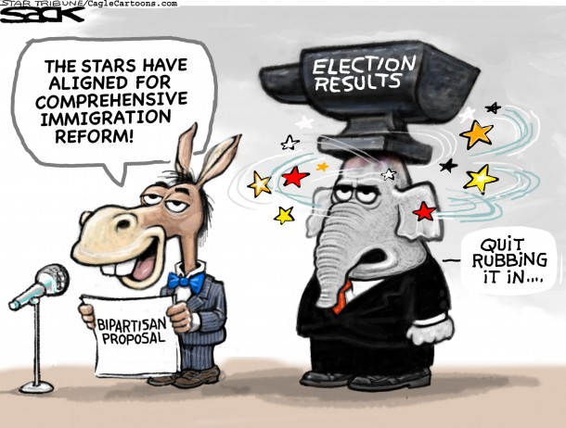
What are some solutions to correct illegal immigration? Step 5 of the PPA: Develop Policy Solutions
What are your thoughts and comments? The answer may lie within the proposed Immigration Reform Bill which includes the following topics:
Increasing Border Control Security – by increasing border control agents, adding more fencing along the U.S. –Mexico border, install more cameras, etc…
Improving Worksite Enforcements – by increasing fines for hiring illegal immigrants, all workers must hold legal status, reduce amt of paperwork, etc…
Guest Workers Programs – by reforming the agricultural & non-agricultural seasonal workers program, extend the work visa eligibility to 3 years
Improve the Current Immigration System – by streamlining the background checks conducted by the FBI, make sure social security credits are not earned
The Naturalization Process – by revising naturalization test, increasing training of immigration coaches, developing web-based learning tools
Notes:
Teacher will allow time for students to construct their own thoughts and opinions.

