Slide 1
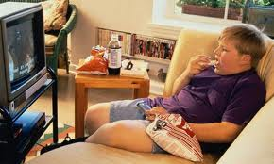
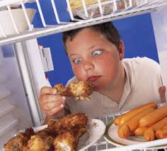
What social issues do you think these children are dealing with?

Slide 2
Defining the Problem
What physical problems arise from childhood obesity?
What emotional problems arise from childhood obesity?
http://www.cdc.gov/healthyyouth/obesity/facts.htm
http://www2.aap.org/obesity/SoundAdvice/audio/Hassink/HassinkComplete.mp3
http://mollenfoundation.org/2011/04/childhood-obesity-emotional-effects-and-sedentary-lifestyles/
http://www.betterhealth.vic.gov.au/bhcv2/bhcarticles.nsf/pages/Obesity_in_children

Slide 3
What is the evidence?
What evidence can be provided to demonstrate the consequences of an inactive and overweight child?
http://www.articledoctor.com/healthcare-systems/arguments-on-childhood-obesity-1207
http://www.ncbi.nlm.nih.gov/pmc/articles/PMC1277961/

Slide 4
What are the causes?
What are the reasons for such a large population of obese children?
http://children.webmd.com/guide/obesity-children
http://childrens.org/health/causes-of-child-obesity/
http://www.rwjf.org/en/research-publications/find-rwjf-research/2009/11/the-negative-impact-of-sugar-sweetened-beverages-on-children-s-h.html
http://www.rwjf.org/en/research-publications/find-rwjf-research/2010/11/fast-food-facts.html

Slide 5
Existing Policies on Obesity
What are some actions taken in the prevention of childhood obesity?
http://www.ncsl.org/issues-research/health/childhood-obesity-2005-policy-options-nutrition.aspx
http://www.obesitycampaign.org/
http://www.letsmove.gov/about

Slide 6
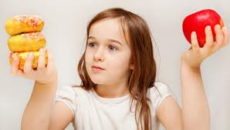
What are the best ways to deal with this issue?
Based on the information you just learned, what are some things we can do to be more aware of the foods we eat and have a more active life style? Answer this question by doing one of the following activities.
Create an educational poster that highlights what you can do to live a healthier life style and the benefits of such a life style.
OR
Write an editorial for the school newspaper persuading students to consider the effects of an active and healthier life style.

