Slide 1
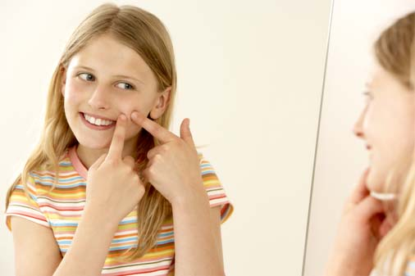
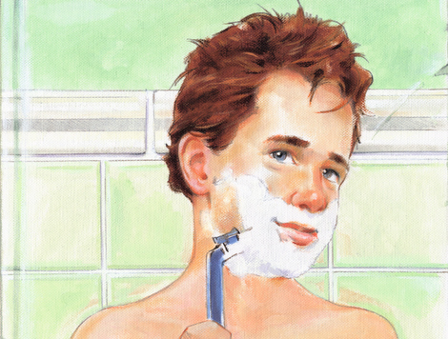
What developmental stage of life do you think these children are going through?

Slide 2
Defining the Problem
Who does puberty effect?
How can puberty effect you?
What are some changes you might experience?
Puberty:
http://kidshealth.org/kid/grow/body_stuff/puberty.html
http://pbskids.org/itsmylife/body/puberty/index.html

Slide 3
Where is the evidence
Is puberty different for boys and girls?
http://www.healthychildren.org/English/ages-stages/gradeschool/puberty/pages/Concerns-Boys-Have-About-Puberty.aspx
http://www.healthychildren.org/English/ages-stages/gradeschool/puberty/pages/Concerns-Girls-Have-About-Puberty.aspx
http://www.healthychildren.org/English/ages-stages/gradeschool/puberty/pages/Stages-of-Puberty.aspx

Slide 4
What are the causes
What is happening to your body?
http://www.healthychildren.org/English/ages-stages/gradeschool/puberty/pages/Whats-Happening-to-my-Body.aspx
http://pbskids.org/itsmylife/body/puberty/article6.html
Boys: http://pbskids.org/itsmylife/body/puberty/article7.html
Girls: http://pbskids.org/itsmylife/body/puberty/article10.html

Slide 5
How do we cope during puberty?
What things can we do to accommodate our changing bodies?
Boys:
http://www.eschooltoday.com/boys-and-puberty/coping-with-puberty.html
Girls:
http://eschooltoday.com/girls-and-puberty/coping-with-puberty.html

Slide 6
What is the best way for you to deal with this problem?
Work with a partner and discuss specific topics that concern you most about puberty, and then come up with ways that you can deal with these problems? Explain how each strategy will help you and why it is important for your health and hygiene during puberty and throughout life?

