Slide 1
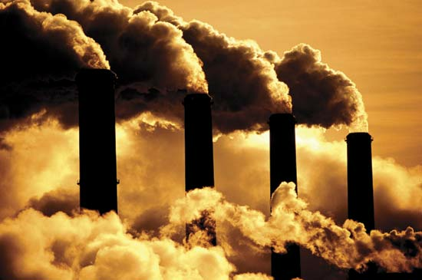
Aim: How do people affect the carbon cycle?
James Bishop Albert Shanker School for Visual and Performing Arts

Slide 2
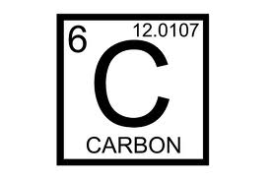
The Carbon Cycle
PPA Step 1
What is Carbon?
What is the Carbon Cycle?
Click Below to find out!
Click me to Find out!

Slide 3
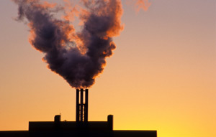
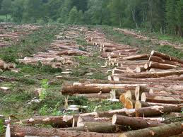
Carbon Emissions
PPA Step 1
Burning Fossil fuels adds carbon dioxide to the atmosphere.
Deforestation of the rainforest Makes it harder for plants to soak up the Carbon Dioxide
Carbon Dioxide in the atmosphere absorbs heat

Slide 4
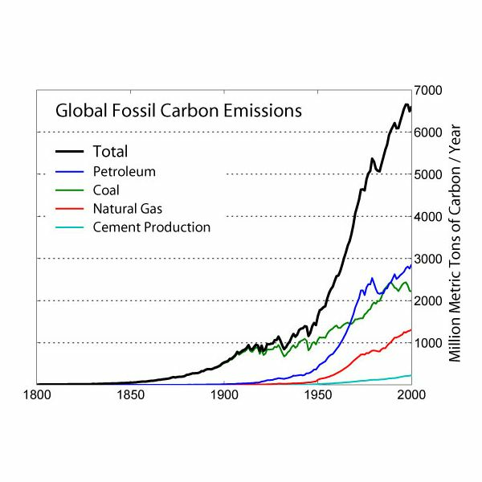
What the problem with carbon dioxide?
PPA Step 2
What does this graph tell you about carbon dioxide emissions?
The amount of CO2 is increasing.
Why is this so bad?
Global Warming or Climate Change
Increased Temperature

Slide 5
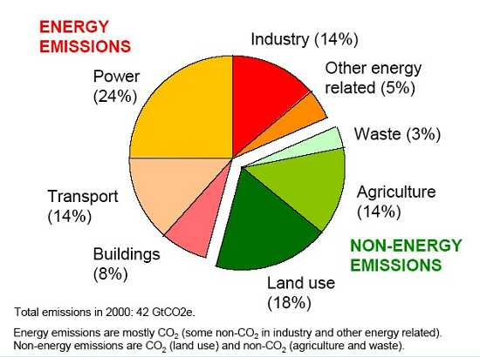
What causes increased carbon emissions?
PPA Step 3
Carbon Emissions come from many different sources.
Identify some of the different sources of carbon emissions in your everyday life.

Slide 6
What are we doing about carbon emissions?
PPA Step 4
The environmental protection agency (EPA) has taken many steps to try and reduce carbon emissions.
Look at the EPA Webpage and find some strategies that they are using to reduce emissions!

Slide 7
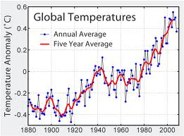
Are out policies working?
PPA Step 4
Evaluate the graph!
Do you think our current policies on carbon emissions are effective? Why?

Slide 8
Sources and Links
http://eo.ucar.edu/kids/green/cycles6.htm
http://wolgemuthe.psd401.net/Global%20sci/06%20-%20earthcycles/lessonplans/06earthcycles13.htm
http://education.jlab.org/itselemental/ele006.html
http://www.epa.gov/climatechange/EPAactivities.html
http://ete.cet.edu/gcc/?/resourcecenter/slideshow/3/1

