Slide 1
Bullying in Schools
By: Ms. Cleo Young
Youngc965@gmail.com
I.S.143

Slide 2
PPA Steps
1. Define the Problem
2. Gather the Evidence
3. Identify the Causes
4. Evaluate an Existing Policy
5. Develop Solutions
6. Select the Best Solution (Feasibility vs. Effectiveness)
http://flippedtips.com/plegal/ppae/ppae3.html

Slide 3
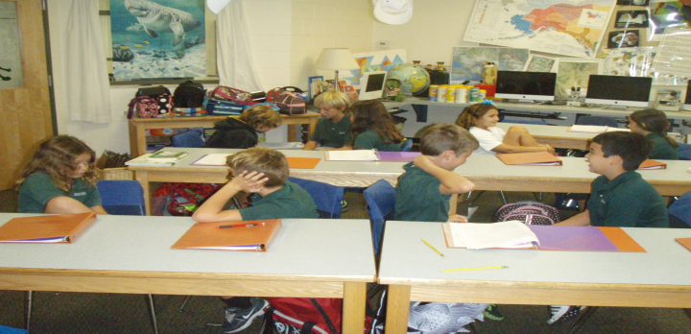
Turn and Talk
Student will turn and talk to their partner by discussing the question below:
Question
Have you ever been a victim of bullying in school or witness someone being bullied in school?
Students will share out their responses to the class

Slide 4
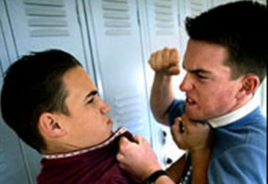
What is bullying?
Definition of Bullying
Bullying is the use of superior strength or influence to intimidate (someone), typically to force him or her to do what one wants. Being bullied can be emotional, verbal, or physical.

Slide 5
Video on Bullying
Students will watch the video and have class discussion

Slide 6
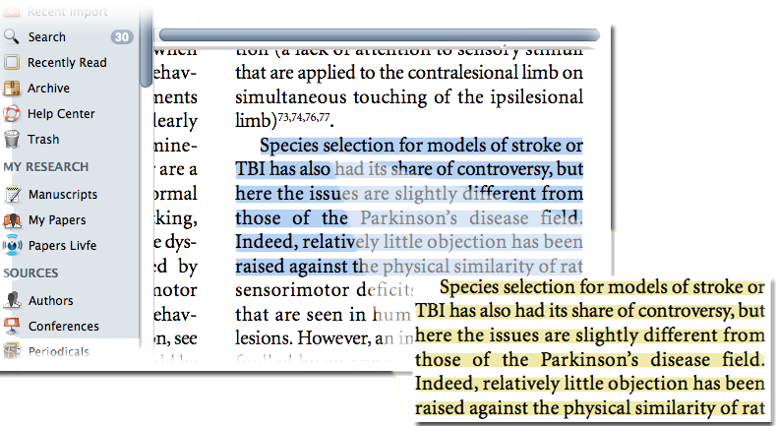
Gathering the Evidence
Based on the lesson and class discussion with a your partner you will research “Bullying in NYC schools”.
You will find two articles and statistics based on the topic.
You will annotate the article identifying the main points and complete a Worksheet given by the teacher.

Slide 7
Identifying the causes of bullying in schools
Students will use the notes from the class discussion, articles and worksheet to help identify the causes of bullying.
Activity
Students will create a poster board with their partner to help promote a non-bullying school environment.

Slide 8
Exit Slip
Students will list two major points from the lesson on a post-it and placed it on the board.

Slide 9
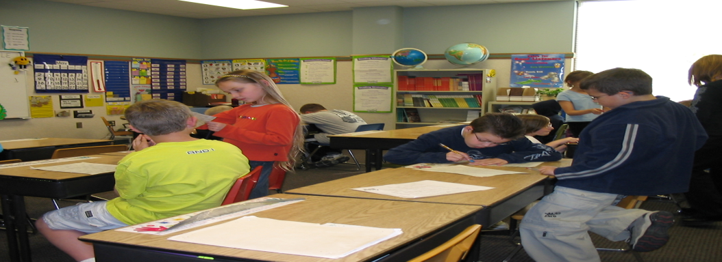
Homework
Students will interview one of their peers who have been a victim of bulling or someone who has been a bully.
Students should hand in at least one typed page to the teacher.

Slide 10
Follow -up
Students will evaluate and interpret school policies around Bullying.

Slide 11
References
www.google.com

