Slide 1
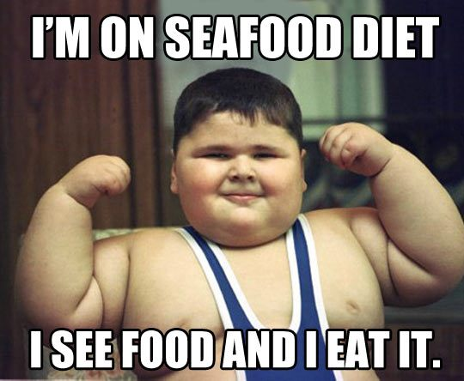
Childhood Obesity in the US
Vasiliki Psiharis
St. Spyridon Parochial School

Slide 2
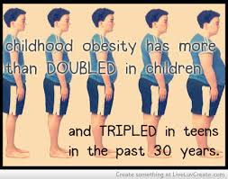
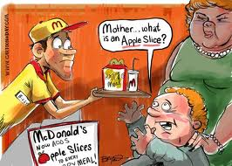
Step 1: Define the Problem
CHILD OBESITY
IN THE US

Slide 3
What is the definition of obesity?
Turn and talk to your partner and discuss what you might think the definition of obesity is.
(Students then share answers with teacher)

Slide 4
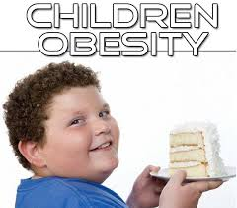
OBESITY
“Obesity is a complex disorder involving an excessive amount of body fat. Obesity isn't just a cosmetic concern. It increases your risk of diseases and health problems such as heart disease, diabetes and high blood pressure.” (http://www.mayoclinic.org/diseases-conditions/obesity/basics/definition/con-20014834)

Slide 5
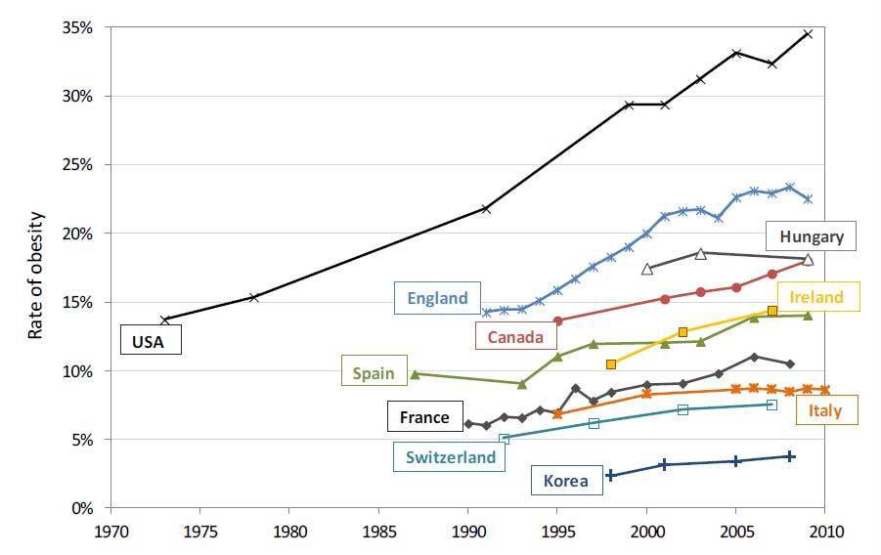
Step 2: Gather the Evidence
http://www.justaddgoodstuff.com/will-us-go-bankrupt-due-to-obesity/#.U_9MnrR8syE

Slide 6
STATISTICS
“Childhood obesity has more than doubled in children and quadrupled in adolescents in the past 30 years.
The percentage of children aged 6–11 years in the United States who were obese increased from 7% in 1980 to nearly 18% in 2012. Similarly, the percentage of adolescents aged 12–19 years who were obese increased from 5% to nearly 21% over the same period.
In 2012, more than one third of children and adolescents were overweight or obese.”
(http://www.cdc.gov/healthyyouth/obesity/facts.htm)

Slide 7
Step 3: Identify the Causes
Turn and talk to your partner about why you think that obesity rates in children are quickly rising? Think about the types of snacks or lunches that you see some of your classmates eating throughout the day. Think about what types of activities you are doing during recess or on the weekends.
Make a list with your partner on a sticky note.
(Students will then come place their sticky notes on our chart paper)

Slide 8
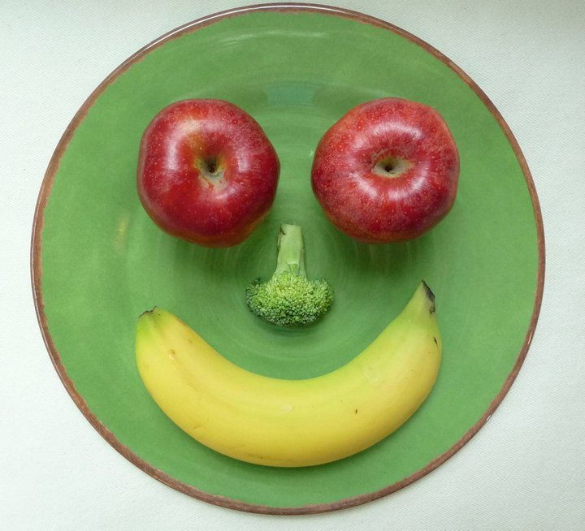
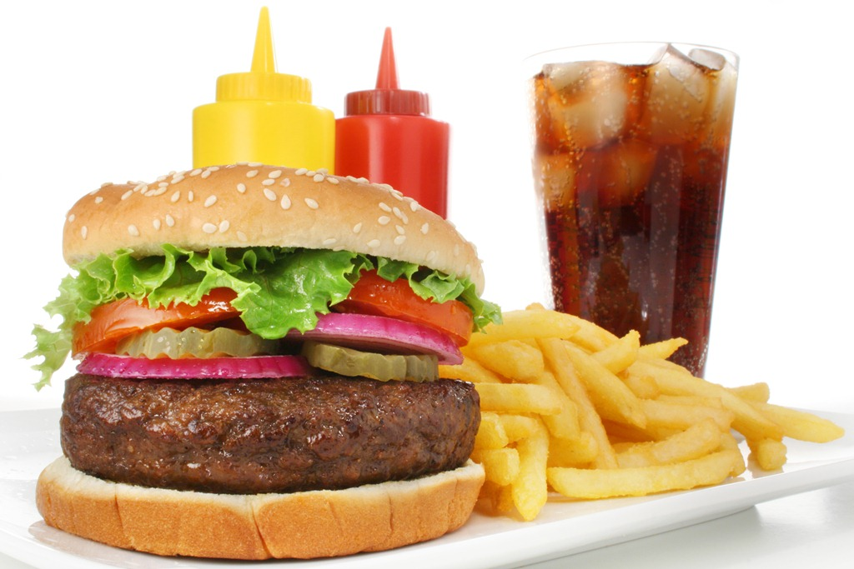
Are You Eating……
THIS OR THIS?

Slide 9
How Active Are You?
Do you play outside?
Do you play video games all day?
OR

Slide 10
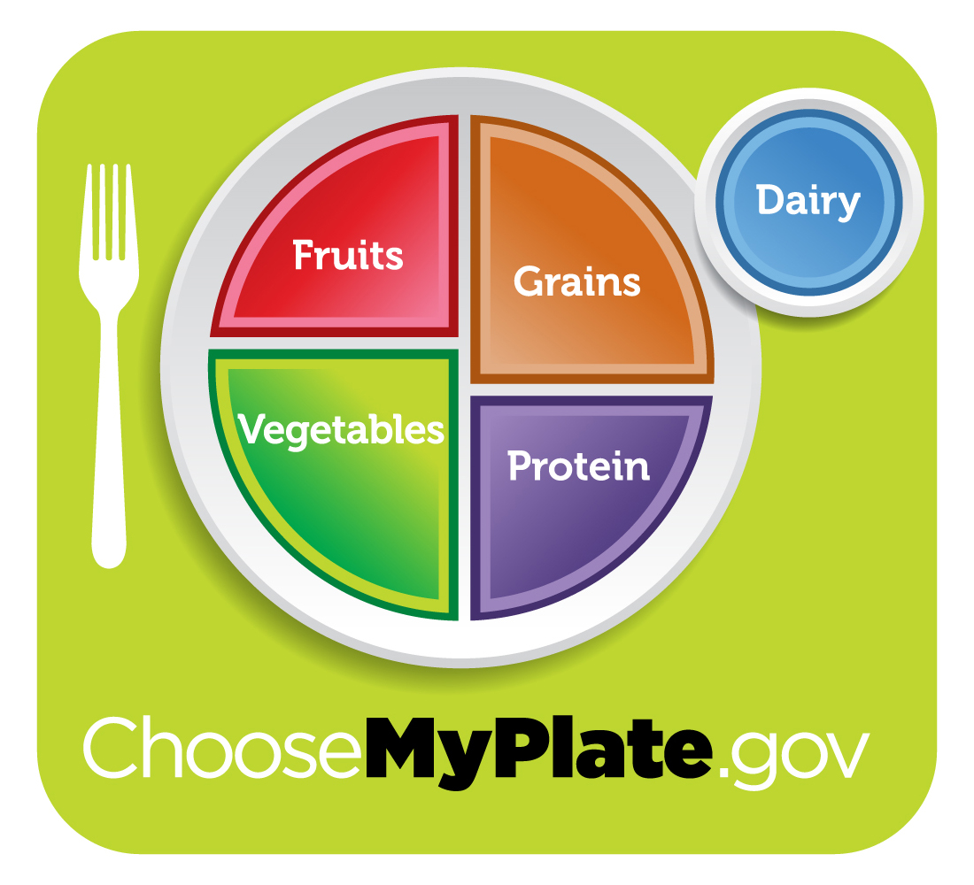
Step 4: Evaluate an Existing Policy
How can we revise our school policy in order to prevent child obesity? Turn and talk to your partner and discuss some ideas.
-Implement a healthy snack policy only!
-Lessons on how to create a healthy snack
-Implement the Michelle Obama, “Let’s Move!” Campaign
-Learn more about MyPlate
-(Insert more of children’s ideas)

Slide 11
Step 5: Develop Solutions
Now, as a class, what are some solutions that can solve child obesity in the US? Let’s think about it…..

Slide 13
Step 6: Select the Best Solution
A: _______________________
B: _______________________
C: _______________________

Slide 14
Homework
Now that we have spoken about Child Obesity in the US please choose 1 out of these 2 options as your homework assignment:
-Create a poster on how to live a healthier lifestyle
OR
-Write a letter to Michelle Obama about your feelings on the Lets Move! Campaign.

