Slide 1
Racism in Art
What is Racism?

Slide 2
What is Racism?
Define
rac·ism noun \ˈrā-ˌsi-zəm also -ˌshi-\
  : poor treatment of or violence against people because of their race
  : the belief that some races of people are better than others
Notes:
Have students come up with their own definition of racism?

Slide 3
Problem
What would be the social problem with African American Artist during the early 1900?
Notes:
(Have students brainstorm together in groups of 4 or 5 to answer the question).

Slide 4
Evidence
The 15th Amendment to the Constitution granted African American men the right to vote by declaring that the

Slide 5
"right of citizens of the United States to vote shall not be denied or abridged by the United States or by any state on account of race, color, or previous condition of servitude."

Slide 6
Although ratified on February 3, 1870, the promise of the 15th Amendment would not be fully realized for almost a century.

Slide 7
Cause
What things would contribute to racism?

Slide 8
African American Artist
75 years later…

Slide 9
Jacob Lawrence
Bio…..

Slide 10
How do you think racism effected Jacob Lawrence as an artist?

Slide 11
Discuss his art work
Notes:
Add photos of art that deal with the Migration Series…..

Slide 12
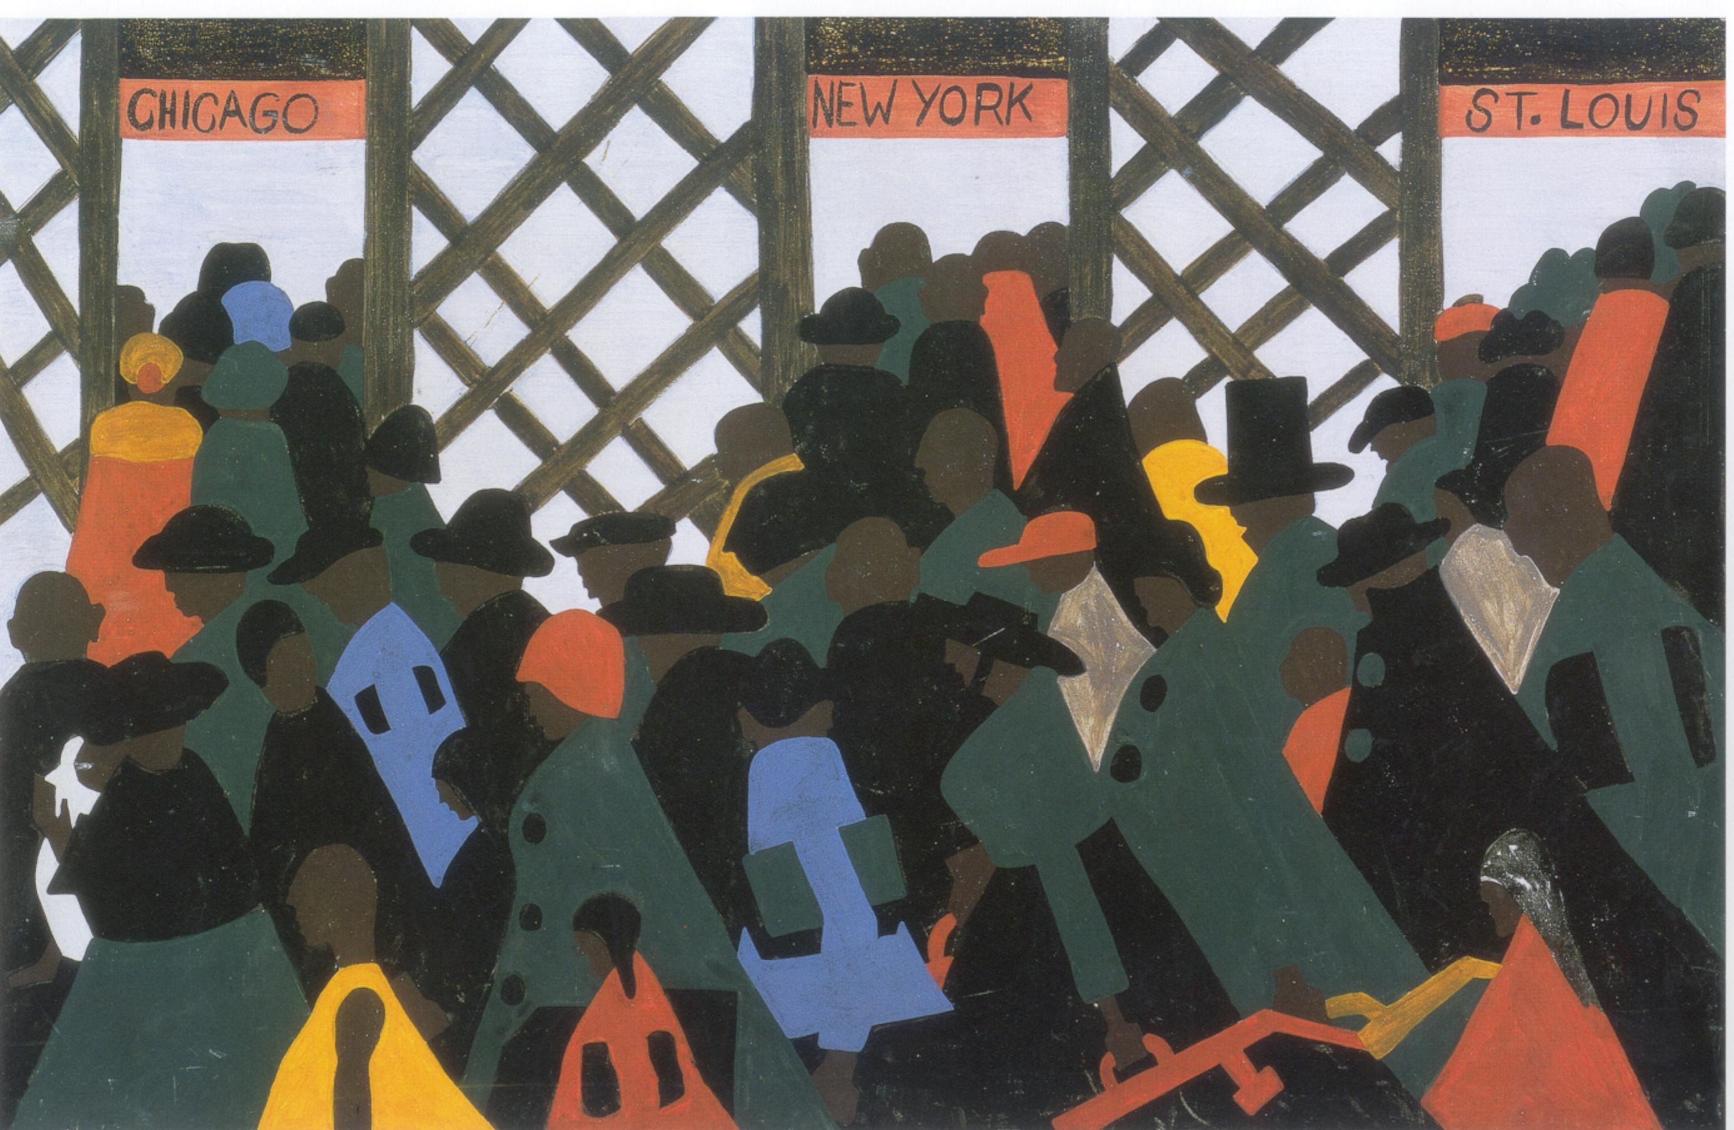

Slide 13
Rhythm in Art
Art can also have rhythm! Jacob Lawrence painted with a lot of repeated patterns, to make figures appear to be moving.
Look closely at the panels from The Migration Series. What does Lawrence repeat in his panels to make a pattern or a rhythm? The same shape? Color? Person?

Slide 14
Activity
Student’s will create a painting using the stylistic features of Jacob Lawrence.

Slide 15
Resources
http://www.avisca.com/African_American_Artists_s/800.htm
http://www.loc.gov/rr/program/bib/ourdocs/15thamendment.html
https://www.nga.gov/kids/scoop-lawrence.pdf
http://www.phillipscollection.org/migration_series/for_educators/worksheets/chronicle_your_own.pdf

