Slide 1
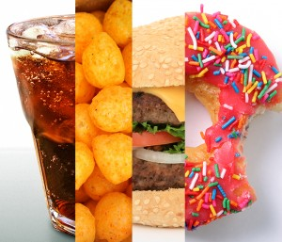
Childhood Obesity
Elizabeth Ferguson
PS 98
EFerguson2015@gmail.com

Slide 2
What is childhood obesity? Turn and Talk
Childhood obesity is a serious medical condition that affects children and adolescents. It occurs when a child is well above the normal weight for his or her age and height (mayoclinic.org)

Slide 3
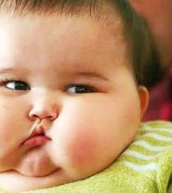
So what’s the big deal with a little baby fat?
Let’s Discuss…

Slide 4
Childhood obesity has both immediate and long-term effects on health and well-being.
Immediate Health Effects
Obese youth are more likely to have risk factors for cardiovascular disease, such as high cholesterol or high blood pressure. In a population-based sample of 5- to 17-year-olds, 70% of obese youth had at least one risk factor for cardiovascular disease.
(Freedman DS, Zuguo M, Srinivasan SR, Berenson GS, Dietz WH)
Obese adolescents are more likely to have prediabetes, a condition in which blood glucose levels indicate a high risk for development of diabetes. (Li C, Ford ES, Zhao G, Mokdad AH.)

Slide 5
Long-term Health Effects
Children and adolescents who are obese are likely to be obese as adults and are therefore more at risk for adult health problems such as heart disease, type 2 diabetes, stroke, several types of cancer, and osteoarthritis. (Office of the Surgeon General)
Overweight and obesity are associated with increased risk for many types of cancer, including cancer of the breast, colon, endometrium, esophagus, kidney, pancreas, gall bladder, thyroid, ovary, cervix, and prostate, as well as multiple myeloma and Hodgkin’s lymphoma. (American Cancer Society)

Slide 6
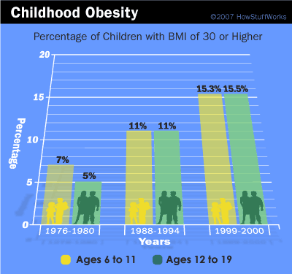
Here is the evidence!
Childhood obesity has more than doubled in children and quadrupled in adolescents in the past 30 years
The percentage of children aged 6–11 years in the United States who were obese increased from 7% in 1980 to nearly 18% in 2012. Similarly, the percentage of adolescents aged 12–19 years who were obese increased from 5% to nearly 21% over the same period.
In 2012, more than one third of children and adolescents were overweight or obese.
http://www.cdc.gov/healthyyouth/obesity/facts.htm

Slide 7
What are some causes?
In your groups, click here to complete the following PPA worksheet to identify some of the causes of childhood obesity.

Slide 8
Reading Wrap-Up
What are some of our findings?
How can we prevent childhood obesity?

