Slide 1
Land of the Misfit Teenagers
Mrs. Fotine Vasiliou
Saint Spyridon Parochial School
fvasiliou@aol.com

Slide 2
Steps of the Public Policy Analyst
Step 1: Define the Problem
Step 2: Gather the Evidence
Step 3: Identify the Causes
Step 4: Examine an Existing Policy
Step 5: Develop New Solutions
Step 6: Select the Best Solution
Feasibility vs. Effectiveness

Slide 3
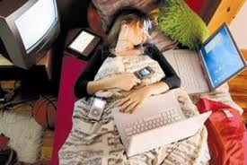
Be honest, is this you?

Slide 4
Introduction
Like previous generations, your generation consists of many individuals from different backgrounds, all with your own special skills and talents. The one characteristic you all share is that you are all technologically obsessed and probably interact more with your IPhones than with real human beings. For this reason, I have dubbed your generation the “Generation of Social Misfits.” This name accurately reflects your generation because we are part of an era in which communication is made mostly in part through text messaging, emailing and instant messaging.

Slide 5
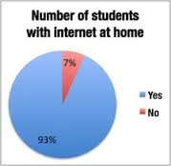
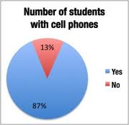
When I was in school this was totally the opposite.

Slide 6
What is the problem ?
Growing up, you were exposed to all off the new inventions in technological communication, and for this reason, you learned to depend on your phones and computers, they stand apart from them because they were raised with the inventions of these technologies while they were forced to adapt and learn how to use them. This makes you unique because these technologies have been all you have ever known. You stand apart from how previous generations used technology.

Slide 7
`
People of older generations who have learned to be dependent on technology use it more for work related things, such as for email and scheduling. Your generation , on the other hand, uses it socially to make friends, upload pictures, and broadcast thoughts. Through these technologies you have learned to interact without actually being face to face. Because of the ease of using a cell phone, or computer, your generation has become socially awkward.

Slide 8
With all of this inexperience in communication, you also lack the ability to read facial expressions and gestures, which are necessary when communicating with other individuals. In this way, your phones and computers have not only hindered your interaction with family and friends, and other members of the community.

Slide 9
Gathered Evidence
http://www.cnn.com/2012/05/21/opinion/clinton-steyer-internet-kids/index.html
http://teenink.com/opinion/social_issues_civics/article/162179/Are-We-Socially-Awkward-because-of-Technology/#.UkoHbqNWGWc.email

Slide 10
Identify the causes.
Smartphones
Tablets
Laptops
Wifi everywhere you go

Slide 11
2+2=4
For every problem,
there are….

Slide 12
Solutions
What can we come up with as a solution to solve the problem?

Slide 13
Okay, boys and girls I would like for you to organize yourselves in groups of fours. After that, decide which of the solutions we came up with works best. Write down your solutions. Make sure you have valid reasons as well as proof for your solutions and why.

