Slide 1
Women’s Rights in Early 20th Century America
Ebony Thompson
City College Academy of the Arts

Slide 2
American History Public Policy Analyst
Today you will analyze the 19th amendment by following these steps:
Define the problem
Gather the evidence
Identify the causes
Evaluate the policy

Slide 3
What do you see? (people, words, actions)
When do you think this cartoon was created? Why?
What is the message of this political cartoon?
Notes:
http://nicholeheady.typepad.com/photos/uncategorized/2008/11/03/cartoon.gif

Slide 4
What are women’s rights?

Slide 5
Definition of women’s rights:
Women’s rights are the legal, political , and social rights that are equal to those of men.
Notes:
http://acelebrationofwomen.org/wp-content/uploads/2012/11/equal-opportunities.jpg

Slide 6
What rights did women have in the early 20th century?

Slide 7
Step 2 of the AHPPA: Evidence of the Problem During the early 20th century, women in America lacked equal rights to men.
Unable to own property
Wages were less than men
Could not take custody of their children after a divorce
Were unrepresented in government
Unable to vote.
Notes:
http://www.education.com/study-help/article/us-history-religion-reform-women-rights/

Slide 8
Why were women not allowed to vote?
In small groups create a list of reasons why women were not allowed to vote in the United States prior to 1920.

Slide 9
Step 3 of the AHPPA: Causes of the Problem Why were women not allowed to vote?
Originally the U.S. Constitution didn’t say much about who had the right to vote. The country’s framers left it up to the states to decide. Most states initially limited voting rights to white male property owners. Over time they extended voting rights to nearly all white men. After the Civil War, three amendments were added to the Constitution. These additions at the federal level freed the slaves, made them citizens and granted them voting rights. The 14th Amendment, ratified in 1868, specifically identified “voters” as male. It was the first time a federal document had done so.
Why were women excluded, both from many individual states’ laws and from the 14th Amendment? The framers of the Constitution—and many who followed them for more than the next 100 years—believed that women were childlike and incapable of independent thought. They believed that women could not be counted on to vote responsibly, so they left women out of states’ voting laws and the Constitutional amendments that granted voting rights to African American men.
As early as the 1840s, some women began speaking out, arguing that women should have the right to vote. It took until 1920 for that right to be added to the United States Constitution.
Notes:
http://www.tolerance.org/sites/default/files/general/women_couldnt_vote[1].pdf

Slide 10
Examine the interactive map of voting rights for women.
Why would the West be more open to letting women vote than the east/south?
How does the U.S. compare with other countries voting rights for women?
Notes:
Link opens to website containing the interactive map of the US and world and dates and info of voting rights.

Slide 11
What is the moral of this story?
Story from the children’s 1880s book Little Miss Consequence.
Notes:
http://www1.assumption.edu/WHW/workshop/untitled1.html

Slide 12
How could the perception of women be used to keep them from voting?
Analyze the following documents and describe the ways that anti-women suffragist restricted male support of women suffrage.

Slide 13
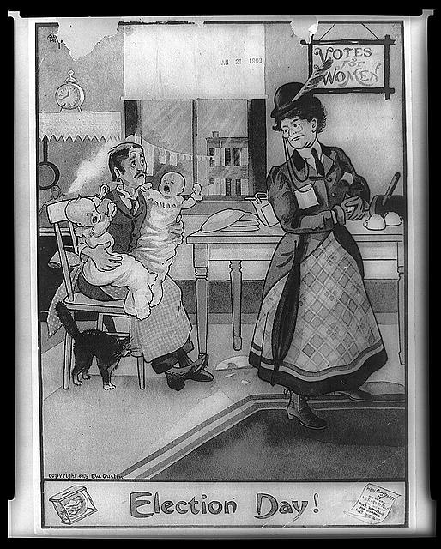
Notes:
http://memory.loc.gov/cgi-bin/ampage?collId=rbcmil&fileName=scrp3004001/rbcmilscrp3004001.db&recNum=0&itemLink=h?ammem/rbcmillerbib:@field(DOCID+@lit(rbcmiller001806))
http://apus-b.wikispaces.com/20s-political+cartoons

Slide 14
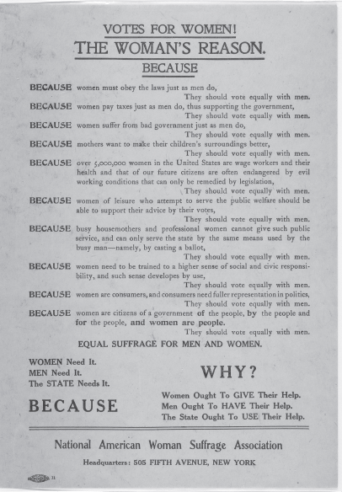
Why women should vote?

Slide 15
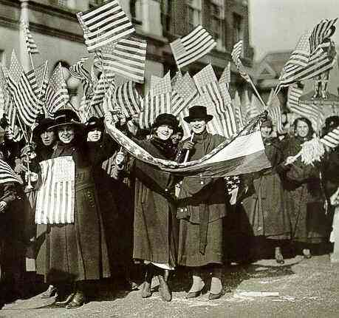
Step 4 of the AHPPA: Evaluate the Policy 19th Amendment, 1920
“The right of citizens of the United States to vote shall not be denied or abridged by the United States or by any State on account of sex.
Congress shall have power to enforce this article by appropriate legislation.”
(Tennessee was the 36th state to ratify and it passed by only 1 vote)
Notes:
http://voiceseducation.org/content/democracy-work-ratification-19th-amendment

Slide 16
Evaluate the 19th Amendment
What were the advantages of this policy?
What were the disadvantages of this policy?
Based on your evaluation of the advantages and disadvantages, should a different policy have been implemented? Explain.

