Slide 1
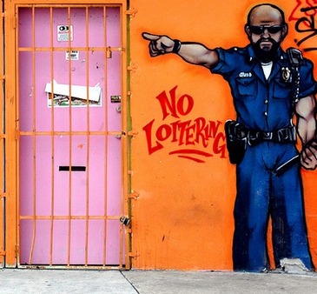
Loitering in Washington Heights
Nowhere For Kids To Go After School
Jeffrey Allen Rodriguez Sr.
I.S. 143M
strive143@gmail.com

Slide 2
6 Steps of the Public Policy Analyst (PPA)
Define the problem
Gather the evidence
Identify the causes
Evaluate and existing policy
Develop solutions
Select the best solution (Feasibility vs. Effectiveness)
http://www2.maxwell.syr.edu/plegal/TIPS/welcome.html

Slide 3
The Problem
Loitering in Washington Heights
Lack of afterschool Arts programs
Lack of afterschool Chess programs

Slide 4
The Evidence
CBO’s predominantly focus on academics and athletics (although these are worthy programs, they are limited)
The nearest Chess In The Schools programs are in lower Manhattan or The Bronx
Some schools offer wonderful afterschool music programs but they are limited to their students only
Funding for the arts continues to diminish community and citywide

Slide 5
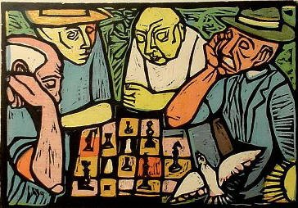
The Causes
Limited variety of afterschool programs
Lack of information
Lack of resources
Cultural indifference

Slide 6
Existing Policy
Supplemental Education Services (SES) offer small group academic assistance
SES programs offer 1 on 1 academic assistance
Dept. of Educ. 37.5 minutes afterschool classes offer small group academic assistance
Community Based Organizations (CBO’s) offer small group academic assistance
CBO’s offer basketball programs

Slide 7
Develop Solutions
Provide workshops for the community
Pilot programs in early grade
ie. Pre K/Kindergarten (Elementary schools)
Grade 6 (Middle School)
Grade 9 (High School)
Research grant options for resources
Partnership/Collaborate with CBO’s to diversify afterschool programs

Slide 8
Select Best Solution
Which solution(s) is most feasible? Which is most effective?
EFFECTIVENESS | FEASIBILITY
 |  | HIGH | MEDIUM | LOW
 | HIGH | Pilot programs in early grades | Partner/collaborate with current community CBO’s | Research grant options
 | MEDIUM | Produce a concert in the park in support of the arts | Hold a competitive chess tournament in the park making it visible | Conduct Chess classes in the parks
 | LOW | Community workshops informing the community | Send informational literature home informing parents | DO NOTHING!

