Slide 1
Dirty NYC Streets
Polluting our neighborhoods
Sylvia Moya
City College Academy of the Arts
Birdeskyflyer@hotmail.com

Slide 2
6 Steps of the Public Policy Analyst (PPA)
Define the problem
Gather the evidence
Identify the causes
Evaluate an existing policy
Develop solutions
Select the best solution (Feasibility Vs. Effectiveness)

Slide 3
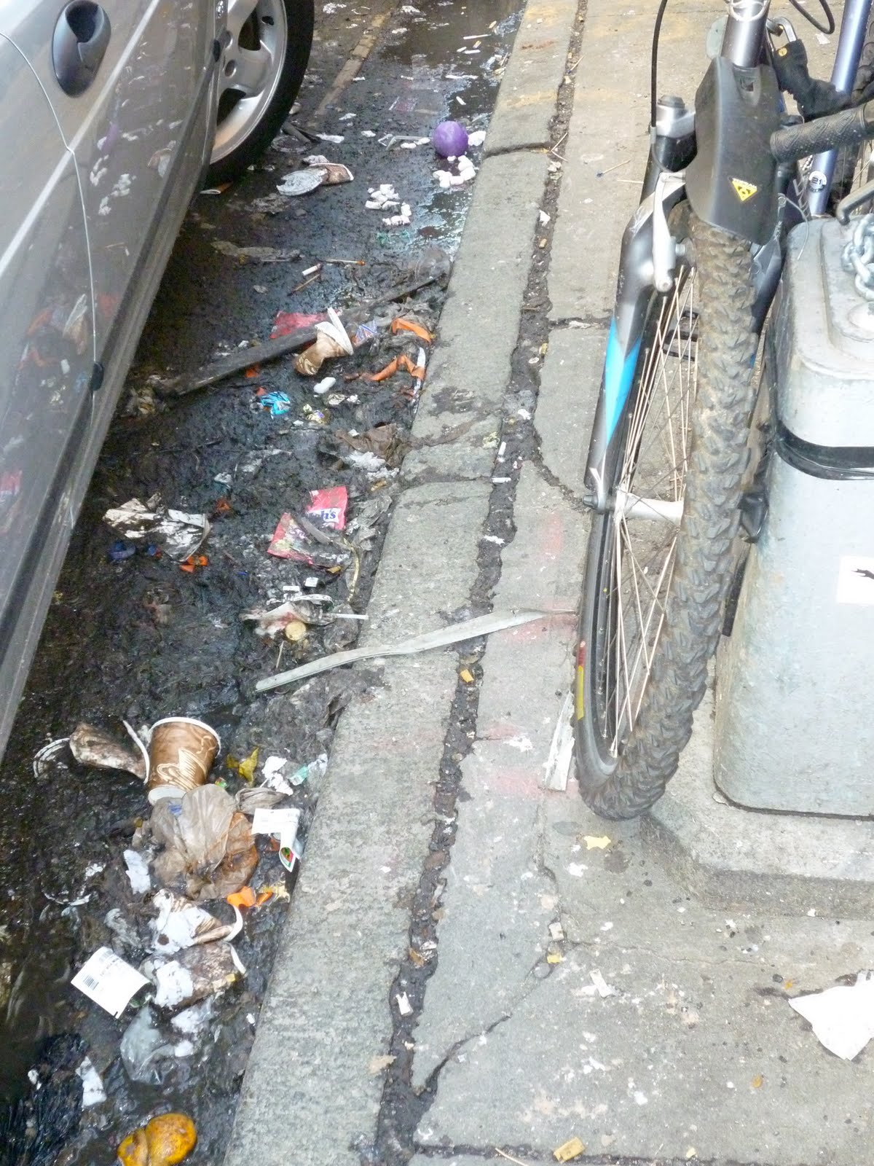
The Problem
Littering in NYC neighborhoods
Dog waste on sidewalks
Attracting disease-carrying pests
Litter gets into NYC water system
Defacing the value of neighborhoods

Slide 4
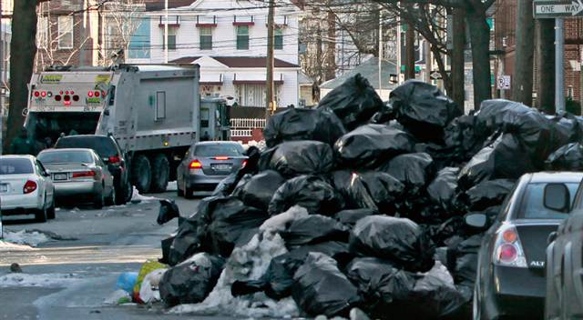
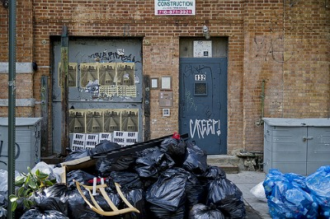
The Evidence
Visual evidence (pictures, videos)
Resident interview

Slide 5
The Cause
Continued cycle
Learned behavior from previous generations, society, or home

Slide 6
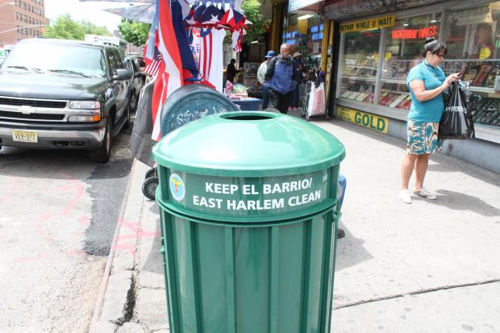
Existing Policy
Street cleaning regulations
Building superintendents are responsible for keeping sidewalks cleaned
No littering signs
Trash cans on street corners

Slide 7
Develop Solutions
What are some solutions to this problem?

Slide 8
Select Best Solution
Which one of your solutions is the most feasible? Which one is the most effective?

