Slide 1
Acting out in the classroom: altering Negative behavior
Ms. Burke
IS 223 – Mott Hall School

Slide 2
Raise hand
and wait
to be
called on
Don’t shout out
How do your teachers expect you to act and behave in class?
One voice
Be respectful
to classmates
Listen to teacher
instructions
Notes:
ASK: How do your teachers expect you to act and behave in class?
Share out student responses, then reveal pop-ups

Slide 3
How should we act in class?
Do not speak while another person is speaking
Be respectful of what others say
Do not shout out
Raise your hand and WAIT to be called on
Be respectful to your teacher and listen to instructions
Notes:
ASK: What student behaviors and actions are appropriate for class?
Allow students time to brainstorm and share ideas aloud via turn and talk, then share.

Slide 4
The Public Policy Analyst Steps
1. Define the Problem
2. Gather the Evidence
3. Identify the Causes
4. Examine an Existing Policy
5. Develop New Solutions
6. Select the Best Solution

Slide 5
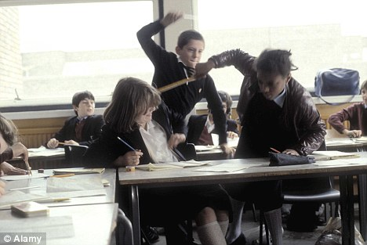
Define the Problem
Notes:
ASK: What is the problem with student behavior in the classroom?
Students behave differently from class to class. They behave properly and act appropriately for some teachers, but not others.

Slide 6
Students have been
disrespectful to their teacher

Slide 7
Gather Evidence
Students call out in class without being called on
Students argue with teacher
Students carry on personal conversations during class instruction
Students talk throughout the class
Notes:
ASK: What evidence would you have that student behavior is not appropriate for the classroom?
Students share out responses. Review evidence from teacher’s POV

Slide 8
Identify Causes
What are some reasons that you practice appropriate classroom behaviors with some teachers but not others?

Slide 9
Identify Causes
No consequences for behavior
Not having respect for the teacher
Feel teacher is disrespectful to student(s)
Teacher may have confusing or unclear expectations for students
Notes:
After students share out their causes, go through a list of common causes.
*Make sure to explain the reasons to students from a teacher’s POV.

Slide 10
Evaluate Existing Policies
1. Verbal warning/conference
2. Phone call home to parents
3. Detention
4. In-school conference with parents

Slide 11
Develop Solutions
What are some solutions to this problem?
Notes:
ASK: What are some solutions to this problem? How can we increase student respect for their teachers and improve student behaviors in the classroom?
On SmartBoard, chart out responses that students come up with.

Slide 12
Select Best Solution
Write a proposal stating and describing the solution you think will best solve the problem.
Support claim (solution) with evidence that you have gathered with your group.
Explain how that evidence helped you arrive at your solution.
What are the advantages and disadvantages of this policy?
Why do you think your solution is the best?
Notes:
Hint: Best solution is highly effective and easy to implement!

