Slide 1
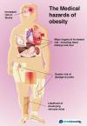
Nutrition
We are what we eat!
Karen Silfa/ IS 143M/ ksilfa@yahoo.com

Slide 2
Steps of the Public Policy Analyst (PPA)
Define the Problem
Gather the Evidence
Identify the Causes
Examine Existing Policy
Develop New Solutions
Select the Best Solution

Slide 3
How can our school develop policies that can help students that are overweight?
Problem: Childhood obesity has increased the past years.
By 2030 Medical cost treating obesity related disease will increase by $ 48 Billion
More than half the population will be obese by 2030.
www.cdc.gov/healthyyouth/obesity/facts.htm
Location of the problem:
United States
Three undesirable social conditions :
Low self esteem
Diseases (diabetes, heart disease, high blood pressure, high cholesterol.
Low productivity
Step 1 of the PPA: Identify the Problem

Slide 4
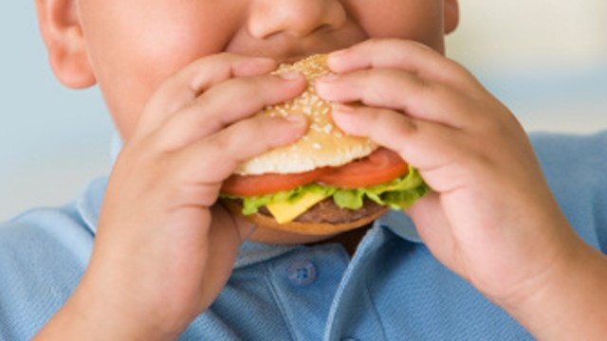
Identifying the cause of obesity
Poor eating habits
Lack of education on healthy food choices
Inactive lifestyle
Emotional problems
Lack of sleep
www.healthychildren.org -Obesity
Step 3 of the PPA: Identify the Causes

Slide 5
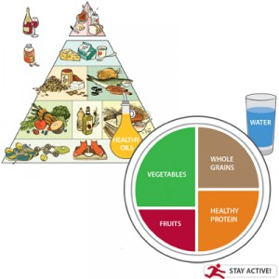
Better eating habits
Balanced diet
Limit refined and processed foods
Breakfast most important meal of the day.

Slide 6
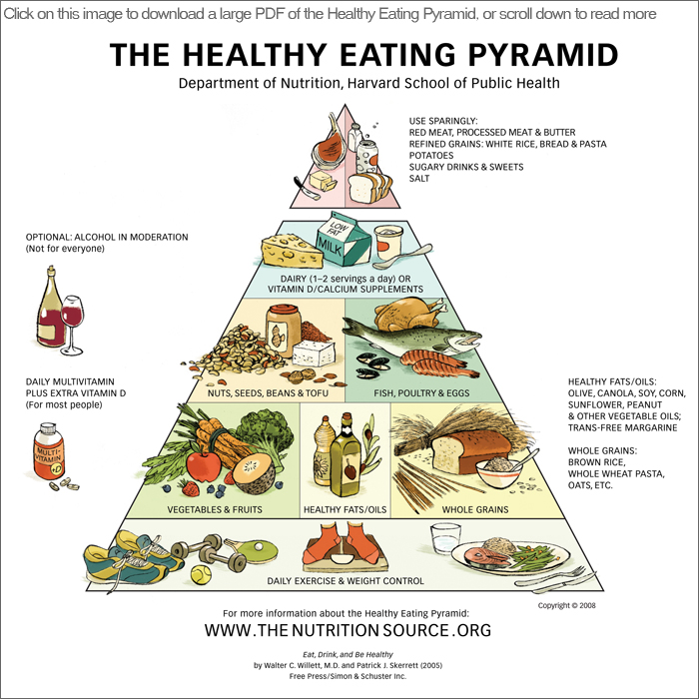
Food Pyramid
Step 4 of the PPA: Examine the Existing Policy

Slide 7
Physical Activity
Controls your weight
Improves your mood
Increases your energy
Improves your health

Slide 8
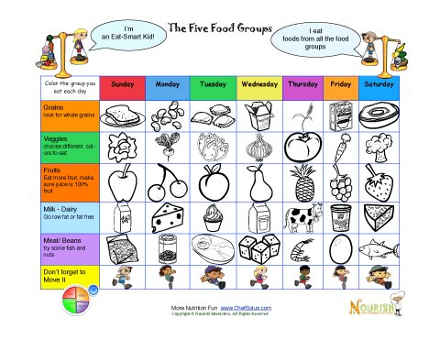
Nutritional Tool
www.nourishinteractive.com

Slide 9
What can be done to resolve this problem?
Brainstorm ideas in your class on what can be done to resolve this issue of obesity.
In your HOME
In your SCHOOL
In your COMMUNITY
In our COUNTRY
EDUCATION ON NUTRITION
Step 5 of the PPA: Develop Solutions

Slide 10
TAKE ACTION!!
Write a policy that can be implemented in our school that can help us solve this problem of unhealthy eating habits. (Example getting rid of soda vending machines)
Work in groups 3-4 students.
Give your plans to your teacher
Work as a class for the next steps.

