Slide 1
Gangs Portrayed in The Outsiders and Gangs Today!
Identify the Problem: As shown in the novel The Outsiders, gangs have been a part of American culture for decades. What can be done to diminish the appeal of joining a gang?

Slide 2
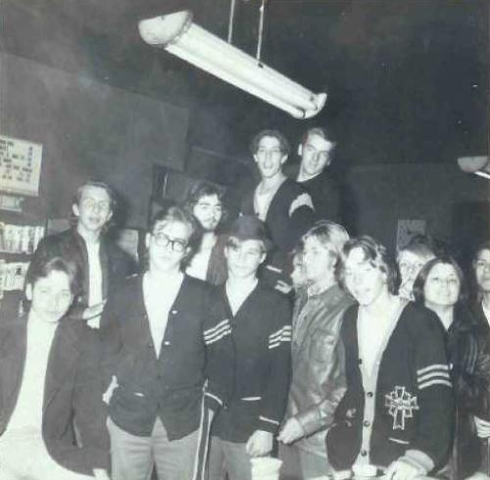
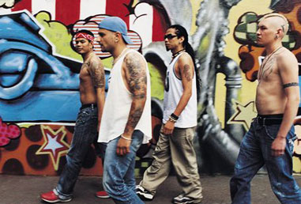
Gangs Are Not a New Phenomenon
Gangs of the Sixties
Gangs of today

Slide 3
“And you can’t win no matter how hard you try against them because they’ve got all the breaks and even whipping them isn’t going to change that fact.” -Pony Boy How does this quote explain some reasons why young people may join gangs? Discuss with your table. Be prepared to share with the class.

Slide 4
Using evidence from the text, explain why each of these characters decided to join the gang.
Write your answer in your journal. Be prepared to share your response with the class.

Slide 5
Gather the Evidence: Gang Statistics
Gang violence statistics While it is true that gang violence has been decreasing, it still exists. The Office of Juvenile Justice and Delinquency Prevention in the Department of Justice offers a National Youth Gang Survey. Some of the results from this survey include the following gang statistics:
100% of cities with a population of more than 250,000 report gang activity.
11% of rural counties report gang activity.
35% of suburban counties report gang activity.
More than half of the homicides reported in Los Angeles, and more than half of the homicides reported in Chicago, are elated to gang violence.
More than 24,500 gangs are active in the U.S.
772,500 people are members of gangs in the U.S.
94% of gang members are male.
Only 2% of gangs are predominantly female.
Only 37% of gang members are under the age of 18 right now.
Gang member ethnicity breaks down this way: 47% Hispanic, 31% African American, 13% white, 7% Asian.
Gang violence costs more than $100 billion a year.
In the end, it is a sobering look at the picture of gang violence. Even though the crime rate has decreased, and a great deal of progress has been made in terms of education, and providing opportunities for would-be gang members, there are still problems to be improved upon.

Slide 6
What fact did you find most shocking and why?

Slide 7
Susan Eloise Hinton was a shy teenager who attended Will Rogers High School in Tulsa. At the time, "Greasers" and "Socs" were separated by thick social and economic lines. Hinton herself was not a Greaser or a Soc. She had friends and acquaintances from both groups. Part of the reason Hinton wrote The Outsiders was because she was bothered by the status wars. Hinton has been quoted as saying, "It was the cold-blooded beating of a friend of mine that made me want to write a book." She wanted to do something to change people's opinions of Greasers. Hinton has also said that the character of Dally was based on a real-life Tulsa boy who was shot and killed by police after he stole a car.

Slide 8
Identify the Causes: Use the handout to list the key causes that lead young people to join gangs today.

