Slide 1
Household and Street Basket Waste Creation and Disposal
St. Spyridon Parochial School
Mr. S. O’Brien

Slide 2
Steps of the Public Policy Analyst (PPA)
Step 1: Define the Problem
Step 2: Gather the Evidence
Step 3: Identify the Causes
Step 4: Examine Existing Policy
Step 5: Develop Solutions
Step 6: Select the Best Solution
Notes:
Pay attention to the sections of this presentation that refer to the different steps of the PPA.

Slide 3
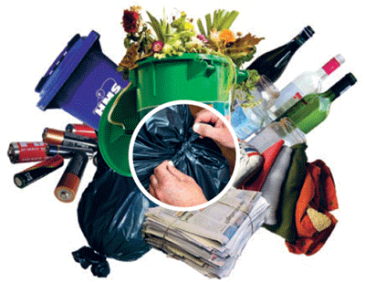
What are the typical items that end up in our garbage cans at home?
List as many
as you can
A) ______
B) ______
C) ______
D) ______

Slide 4
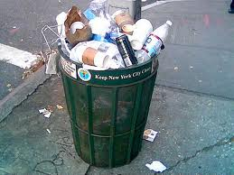
What are the typical items that end up in street baskets?
List as many
as you can
A) ______
B) ______
C) ______
D) ______

Slide 5
Household and Street Basket Waste
Examine this WCS (Waste Characterization Study) document
In your assigned groups, complete the following:
With regard to household waste, how would you list the types of waste in order of most to least abundant.
What do you believe constitutes street basket waste?

Slide 6
Is all of this waste necessary?
In your groups, list as many ways as you can to identify how we all contribute unnecessarily to the waste produced and deposited in household and street basket receptacles.
Where do you think this waste ends up?
What can we do to make a difference?
Step 3 of the PPA: Identify the Causes

Slide 7
What is the current policy regarding trash collection and recycling for NYC?
Research Project:
What are NYC residents mandated to do with regard to recycling household waste? Is there any existing policy outlining our responsibilities, or the responsibilities of landlords in the city?
Outline these policies in a summary paper, citing references and sources of information.
Step 4 of the PPA: Examine an Existing Policy
Notes:
Recyclable Vs non-recyclable materials.

Slide 8
Documents and Resources

Slide 9
What’s in NYC’s Waste? http://www.nyc.gov/html/nycwasteless/html/resources/wcs.shtml
The New York City 2004-05 Residential and Street Basket Waste Characterization Study (WCS) is a "census of NYC waste" — a comprehensive look at the amount and composition of what New Yorkers discard at home, and in street baskets. Its goal was to provide detailed, accurate, and reliable statistics on the different materials that New Yorkers discard at home and in street baskets, including trash and recycling.
CONTINUE
BACK
Step 2 of the PPA: Gather the Evidence

Slide 10
CURRENTLY DESIGNATED FOR RECYCLING THROUGH DSNY COLLECTION
paper: newsprint, cardboard, and mixed paper
plastic bottles and jugs
glass containers
metal cans, foil, and other household metal items
beverage cartons
NOT CURRENTLY DESIGNATED FOR RECYCLING THROUGH DSNY COLLECTION
other types of plastics besides bottles and jugs
other paper: napkins, tissues, paper plates and cups, laminated paper
organics: including food scraps, yard trimmings, and other organic materials
electronic waste: including TV's, monitors, computers, cell phones, and other electronics
textiles and carpets
construction and demolition debris (C&D)
household hazardous waste
miscellaneous inorganic materials
BACK
Step 4 of the PPA: Examine an Existing Policy

