Slide 1
OVERPOPULATION IN CHINA
DEVELOPING AN EDITORIAL ON WHAT SHOULD BE DONE?

Slide 2
The Public Policy Analyst (PPA)
Step 1: Define the Problem
Step 2: Gather the Evidence
Step 3: Identify the Causes
Step 4: Examine an Existing Policy
Step 5: Develop Solutions
Step 6: Select the Best Solution

Slide 3
THE FACTS
According to a recent study conducted by the World Health Organization(WHO), China is the world’s most populous country in the world.
With more than 1.3 billion people China represents 20% of the world’s population.
( 1 in 5 people on the planet is a resident of China)
. Overpopulation can lead to degration of land, pollution and poor living conditions
Step 1: Define the Problem

Slide 4
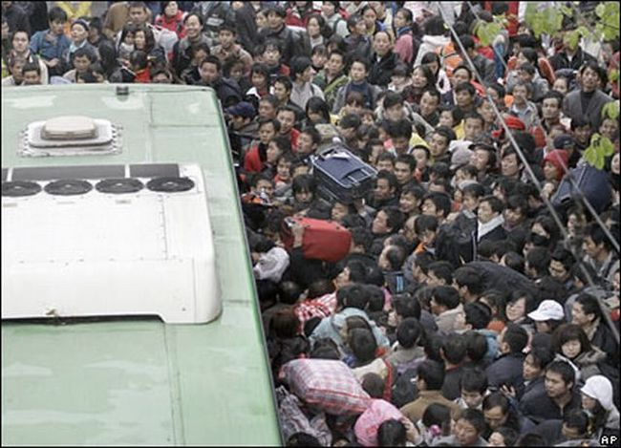
The Problem

Slide 5
The Problem Cont.

Slide 6
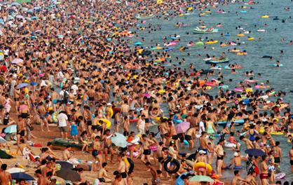
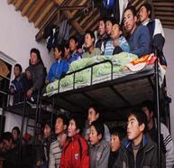
The Problem Cont.
jkk

Slide 7
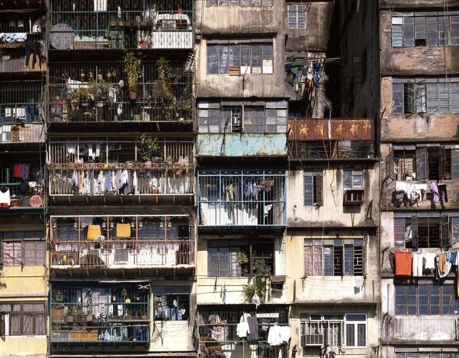
The Problem Cont.

Slide 8
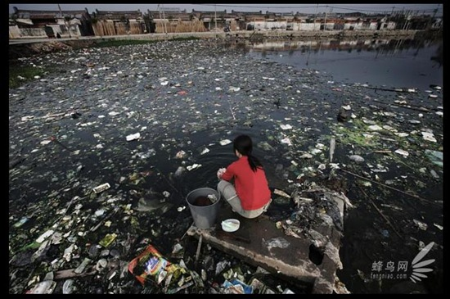
The Problem Cont.

Slide 9
The Consequences
Group Activity: Reflect on the photos from the previous slides and identify three consequences of overpopulation.

Slide 10
GATHER THE EVIDENCE
Overpopulation can have a definite impact on a country's economy, environment and its government.
When countries are overpopulated the people suffer from a lack of natural resources, such as: food, water, energy and clean air
A fast growing population will mean that there are more people than there are jobs.
High unemployment will lead to an increase in the crime rate of a country; this will lead to an increasing cost for police, the courts and the prison system
The government of an overpopulated country falls into constant increasing debt as it tries to provide for its ever growing population.
Step 2: Gather the Evidence

Slide 11
CAUSES OF OVERPOPULATION
Overpopulation is the situation of having large numbers of people with too few resources and too little space.
There are four major factors that contributes to overpopulation:
Social issues
Economical issues
Environmental issues
Security problems
Step 3: Identify the Causes

Slide 12
CONTROLLING OVERPOPULATION
Chinese authorities have put into place the following policies to control or decrease overpopulation:
China's Family Policy
Birth-Control Policy
One -Child Policy
One Apartment Purchase per Family
New Car Lottery Policy
Step 4: Examine an Existing Policy

Slide 13
The Solutions
Group Activity: Based on the consequences formulated by your group members, determine the solutions that can be taken to address the issue of overpopulation in China.
Step 5: Develop Solutions

Slide 14
Best Solution
Individual Activity: There can be many solutions in solving a problem. From the list of solutions generated from your group, select the best solution that can address the issue of overpopulation in China. Your solution should be both effective and feasible( see hand-out).This solution will allow you to state your claim on the issue of overpopulation in China when you begin to develop your editorial.
Step 6: Select the Best Solution

Slide 15
The Task
In Social Studies you have learned about the social problem of overpopulation in China. You read several articles written on various methods that are being used by the government of China to address this issue. To conclude our unit, you will be required to compose an editorial on this issue.
TASK: Consider your position on this topic and decide whether you agree or disagree with the methods being used by the Chinese government addressing the issue of overpopulation. You must develop a claim and support your calim with reasons that are supported by evidence found through research. You must also consider an opposing point of view and counter that claim. Lastly, you must convince the reader of the importance of this topic by issuing a call to action by identifying the best solution that can address this problem.

Slide 16
THE TASK CONT.
Steps for developing your editorial:
Step #1: Consider your position and state your claim
Step #2: Gather your evidence related to your claim or position on this issue
Step #3: Plan your editorial
Step #4: Write your first draft
Step #5: Revise
Step #6: Edit and Publish

