Slide 1
Social Problem: Sexism and Gender Inequality
Lidia Lopez
Gregorio Luperon High School
llopez21@schools.nyc.gov

Slide 2
Do Now:
Have you ever felt inferior to the opposite sex?
Have you ever felt superior to the opposite sex?
In both cases, what were the circumstances in which you felt this way?

Slide 3
Steps of the Public Policy Analysis (PPA)
Define the Problem
Gather the Evidence
Identify the Causes
Examine Existing Policy
Develop Solutions
Select the Best Solution

Slide 4
What does Sexism mean?
It refers to the range of attitudes, beliefs, policies, laws, and behaviors that discriminate based on gender.
Results in a system of
gender inequality.
Step 1 of the PPA: Define the Problem

Slide 5
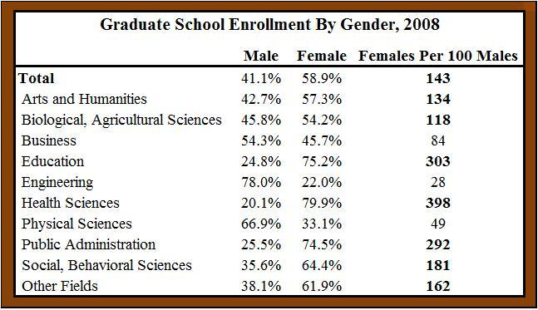
EVIDENCE
The table above displays graduate school enrollment by gender in 2008 using data recently released by the Council of Graduate Schools (CGS).
http://freemarketmojo.wordpress.com/2009/10/28/gender-inequality-in-higher-education/
Step 2 of the PPA: Gather the Evidence

Slide 6
What are the causes?
Step 3 of the PPA: Identify the Causes

Slide 7
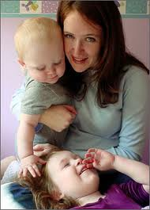
IN THE FAMILY:
The role or wife or mother has been a subordinate role in society.
Example: Mothers have to nurture their infants, therefore, they have to spend more time with them at home. Some of them eventually become stay-home mothers.

Slide 8
IN THE MEDIA:
Media portrays men and women in traditional roles.
Example: Men always are portrayed to have more physical strength.

Slide 9
IN EDUCATION:
Women choose female occupations.
For example: Many women choose to become secretaries or nurses.

Slide 10
Evaluating the Existing Policy
Women and men are both entitled to receive the same free public education.
Guys and girls have equal access to different types of work.

Slide 11
Solutions in our school:
Participation in sports activities involving both sexes.
Encourage club organizations to have an equal ratio of males and females.
Identify who is becoming disengaged from education and is likely to do less well than hoped.
Challenge stereotypical, either/or understandings of what it means to be male and female.
Step 5 of the PPA: Develop Solutions

Slide 12
Best Solution
Encourage club organizations to have an equal ratio of males and females.
Step 6 of the PPA: Select the Best Solution

