Slide 1
Obesity Epidemic in the United States: M. Donoghue I.S. 143 Eleanor Roosevelt
What Should Be Done?

Slide 2
Steps of the Public Policy Analyst (PPA)
Define the Problem
Gather the Evidence
Identify the Causes
Examine an Existing Policy
Develop Solutions
Select the Best Solution

Slide 3
Evidence of Obesity
About 68 percent of adults in the United States aged 20 years or older are overweight or obese. Among children, the rate is nearly 32 percent. The obesity epidemic poses major challenges for policy makers, public health professionals, and other decision makers who need to act decisively to respond to this complex, population-based health problem. To inform their decisions, they need relevant and useful evidence on promising obesity prevention actions for the populations they serve.
Step 2 of the PPA: Gather the Evidence

Slide 4
Causes of Obesity
In America, a changing environment has broadened food options and eating habits. Grocery stores stock their shelves with a greater selection of products. Pre-packaged foods, fast food restaurants, and soft drinks are also more accessible. While such foods are fast and convenient they also tend to be high in fat, sugar, and calories. Choosing many foods from these areas may contribute to an excessive calorie intake. Some foods are marketed as healthy, low fat, or fat-free, but may contain more calories than the fat containing food they are designed to replace. It is important to read food labels for nutritional information and to eat in moderation.
Portion size has also increased. People may be eating more during a meal or snack because of larger portion sizes. This results in increased calorie consumption. If the body does not burn off the extra calories consumed from larger portions, fast food, or soft drinks, weight gain can occur.
Step 3 of the PPA: Identify the Causes

Slide 5
Causes of Obesity
Overweight and obesity result from an energy imbalance. This involves eating too many calories and not getting enough physical activity.
Body weight is the result of genes, metabolism, behavior, environment, culture, and socioeconomic status.
Behavior and environment play a large role causing people to be overweight and obese. These are the greatest areas for prevention and treatment actions.

Slide 6
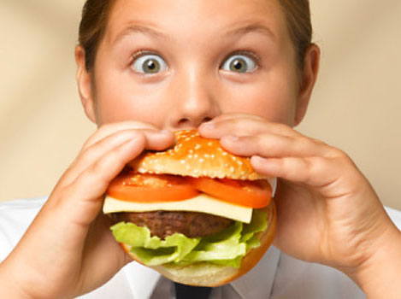
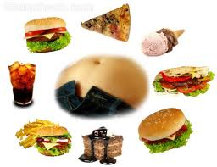
Images of Causes:

Slide 7
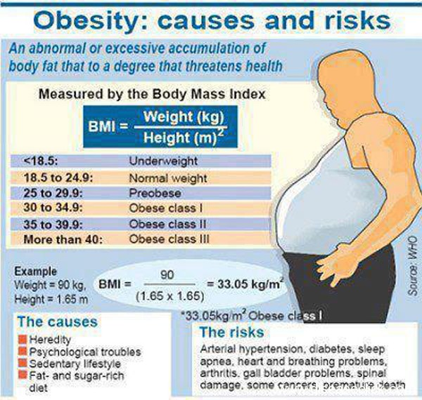
Causes and Risks Involved:

Slide 8
Existing Policies in the United States Regarding Obesity:
http://www.cnn.com/2012/05/10/health/fda-diet-drug/index.html
Step 4 of the PPA: Examine the Existing Policy

Slide 9
What Can Be Done?
Step 5 of the PPA: Develop Solutions

