Slide 1
Climate Change
J. Morgan
T.R. Proctor High School
jmorgan@uticaschools.org

Slide 2
Public Policy Analyst (PPA)
Define the Problem
Gather the Evidence
Identify the Causes
Evaluate an Existing Policy
Develop Solutions
Select the Best Solution (Feasibility vs. Effectiveness)

Slide 3
Define the Problem
Climate change is impacting the environment of the polar ice caps.
Source: Google images

Slide 4
Gather the Evidence
How do we know that climate change is happening?
Complete Worksheet 2 with your group, collecting at least 3 valid pieces of data.
http://flippedtips.com/plegal/tips/worksheet2.doc
Remember to cite your sources!

Slide 5
Gather the Evidence
Decreased snow cover
Glacial retreat
Artic sea ice declining
Decreasing ice sheets
Rise in sea level
Global temperature increase
Ocean temperature increase
Source: nasa.gov

Slide 6
Identify the Causes
Why is climate change happening?
BRAINSTORM and complete Worksheet #3 with your group.
http://flippedtips.com/plegal/tips/worksheet3.html
WHY?

Slide 7
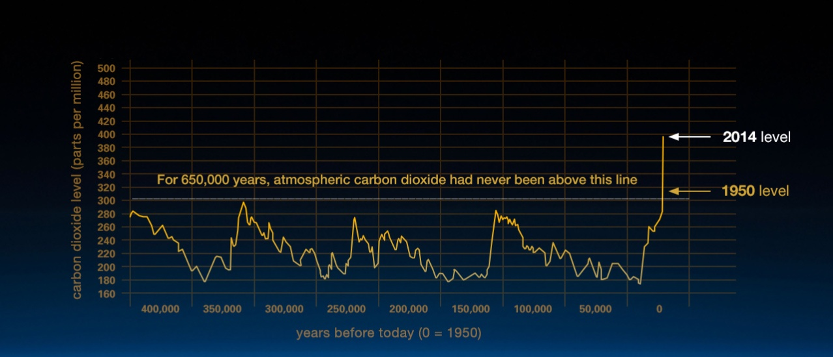
Identify the Causes
HOPEFULLY you came up with TWO definite reasons!
HUMANS
Source: nasa.gov
CARBON DIOXIDE

Slide 8
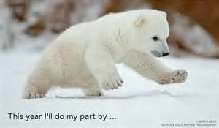
Develop Solutions
What can we do to stop or reduce climate change?
BRAINSTORM and complete Worksheet 5 with your group.
http://flippedtips.com/plegal/tips/worksheet5.html
Source: Google images

Slide 9
Develop Solutions
Reduce Reuse Recycle
Everyone must have Hybrid/Electric cars
Finding/developing alternative forms of fossil fuels
Outlaw fossil fuel usage
Outlaw factories that emit pollution
Everyone plant a tree (get rid of the excess CO2)
Pollution regulation laws for big businesses

Slide 10
Select the Best Solution
Feasibility VS Effectiveness
What is FEASIBILITY?
What is EFFECTIVENESS?

Slide 11
Alt. fuel.
Outlaw fuel
Outlaw factories
Recycle
Pollution regulations
Hybrid cars
Plant a tree

Slide 12
Select the Best Solution
Which solution is the best?
Discuss this question with your group and come up with the solution that your group thinks is the BEST!
We will collaborate as a class and vote on the BEST solution.
Source: Google images

Slide 13
What’s Next?
Let’s do our part!
WE ONLY HAVE ONE EARTH!
Source: Google images

