Slide 1
Teenage Drinking- What’s the Big Deal?
Girls (and Guys) Just Wanna Have Fun…
Tamara Hughes
TR Proctor High School
tahughes@uticaschools.org

Slide 2
We will be using the Steps 1-3 of the Public Policy Analyst (PPA) to help us understand the problem of teenage drinking:
1) Define the Problem
2) Gather the Evidence
3) Identify the Causes
4) Evaluate an Existing Policy
5) Develop Solutions
6) Select the Best Solution (Feasibility vs. Effectiveness)

Slide 3
1) Define the Problem

Slide 4
Many teenagers under age 21 admit to drinking alcoholic beverages:
By age 15, half of teens have had at least one drink.
By age 18, more than 70% of teens have had at least one drink.
http://www.niaaa.nih.gov/alcohol-health/special-populations-co-occurring-disorders/underage-drinking

Slide 5
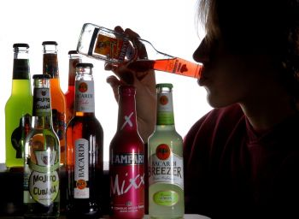
Teenagers don’t drink alcohol as often as adults but when they do, they drink more. This is called binge drinking.
In a 2013 survey, 21% of high school students admitted to binge drinking.
http://www.cdc.gov/alcohol/fact-sheets/underage-drinking.htm

Slide 6
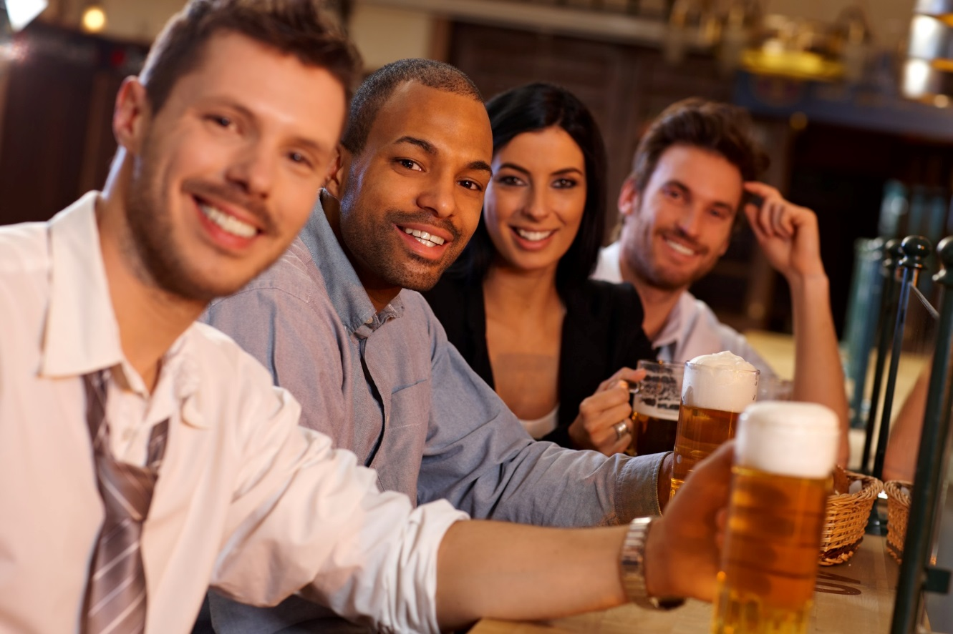
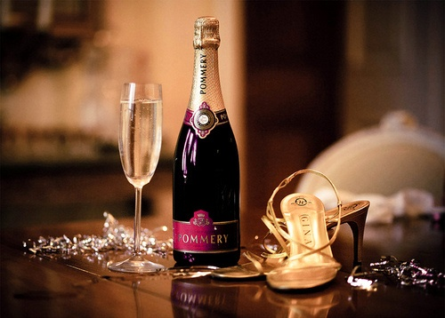
So why is this such a problem? After all, adults especially make drinking alcohol look really fun and classy…
http://www.google.com/url?sa=i&rct=j&q=&esrc=s&source=images&cd=&cad=rja&uact=8&ved=0CAcQjRw&url=http%3A%2F%2Fwww.energesse.com%2Fcan-spiritual-still-go-pub%2F&ei=Z-e1VJnaDpDlgwT03oKYCw&bvm=bv.83640239,d.eXY&psig=AFQjCNFsr2ntmESNJh4rIvZ_5IY1UOoo4g&ust=1421293774855672
https://www.google.com/search?q=alcohol+glamour&rls=com.microsoft:en-US:IE-Address&source=lnms&

Slide 7
2) Gather the Evidence
Teenagers who drink alcohol are more likely to….

Slide 8
have problems in school:
poor or failing grades
higher number of absences

Slide 9
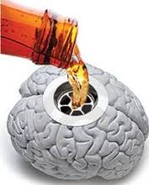
Teenagers who drink alcohol are more likely to have brain development problems:
http://www.psychologytoday.com/blog/teen-angst/201301/teen-binge-drinking-all-too-common

Slide 10
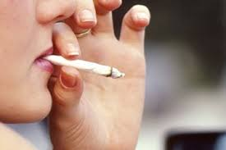
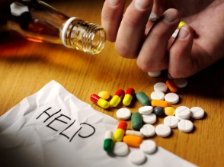
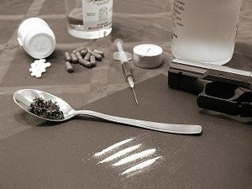
abuse other drugs:

Slide 11
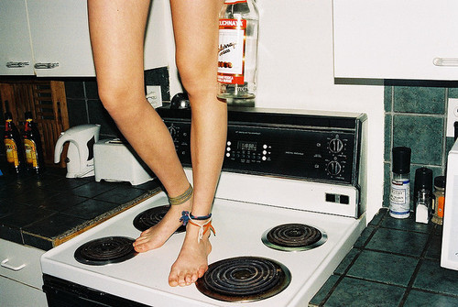
Teenagers who drink alcohol are more likely to make bad choices:
Drinking while driving
Fighting
Unprotected sex and other risky behaviors
http://www.theguardian.com/society/2012/apr/22/bad-parent-state-policing-minister
http://www.autostraddle.com/your-state-may-or-may-not-be-binge-drinking-by-your-side-done-129036/

Slide 12
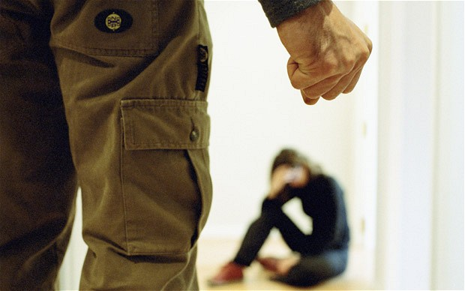
be a victim of physical and/or sexual assault:
http://www.telegraph.co.uk/women/womens-life/11013739/UK-domestic-violence-refuge-closures-the-most-dangerous-thing-of-all-for-women.html

Slide 13
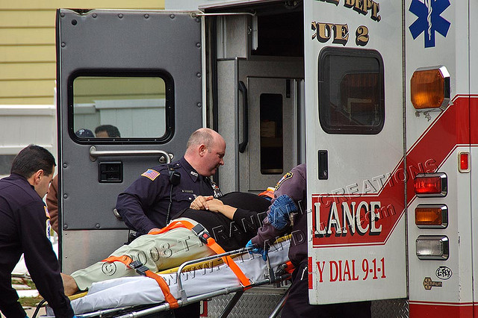
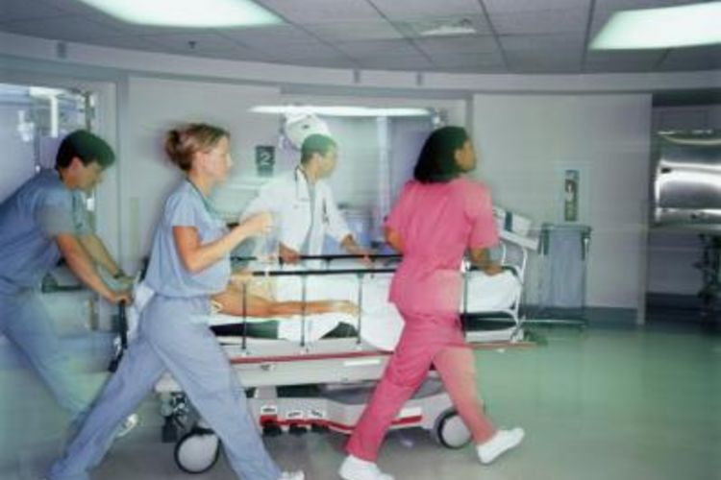
be seriously injured:
More than 190,000 people under age 21 visited an emergency room for alcohol-related injuries in 2008 alone.
http://www.cdc.gov/alcohol/fact-sheets/underage-drinking.htm

Slide 14
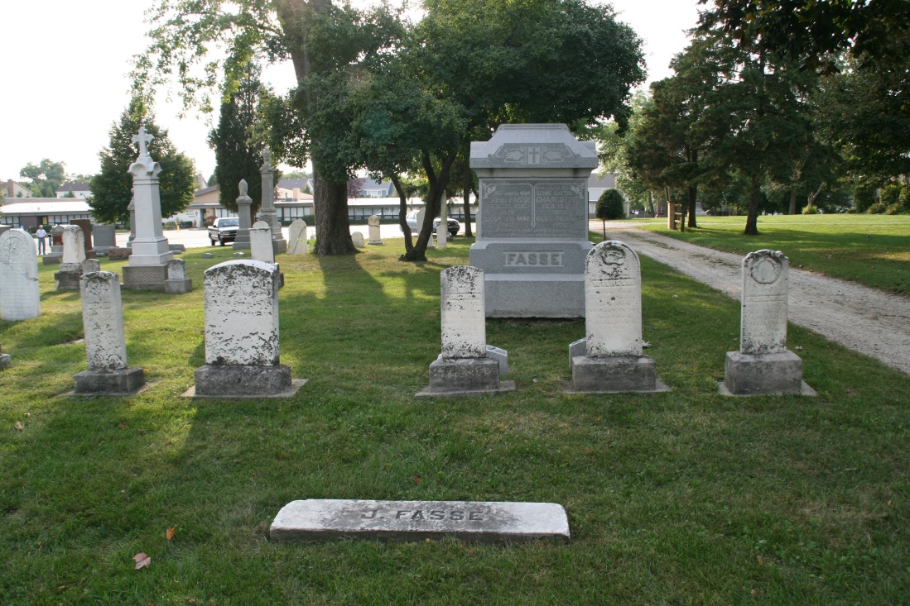
Teenagers who drink alcohol are more likely to die:
Each year 5000 teenagers die from alcohol-related
car accidents
murders
suicides
injuries (such as drowning, burns, falls)
alcohol poisoning
http://www.niaaa.nih.gov/alcohol-health/special-populations-co-occurring-disorders/underage-drinking

Slide 15
So why do so many teenagers drink alcohol?

Slide 16
3) Identify the causes

Slide 17
Discussion:
Google Docs version:
Question: Why do teenagers (under age 21) drink alcohol?
Microsoft Word version
Question: Why do teenagers (under age 21) drink alcohol?

Slide 18
Sources:
http://www.niaaa.nih.gov/alcohol-health/special-populations-co-occurring-disorders/underage-drinking
http://www.cdc.gov/alcohol/fact-sheets/underage-drinking.htm

