Slide 1
Cyber Bullying Among American Teenagers
How do we stop
bullying online?
Ashley Hinckley
Proctor High School
English 9
ahinckley@uticaschools.org

Slide 2
The 6 Steps of the Public Policy Analyst
Define the Problem
Gather the Evidence
Identify the Causes
Evaluate the Existing Policy
Develop Solutions
Select the Best Solution
http://flippedtips.com/plegal/ppa/ppasteps.htm

Slide 3
Define the Problem – What is Cyberbullying?
Cyberbullying is bullying that takes place using electronic technology. Electronic technology includes devices and equipment such as cell phones, computers, and tablets as well as communication tools including social media sites, text messages, chat, and websites.
www.stopbullying.gov

Slide 4
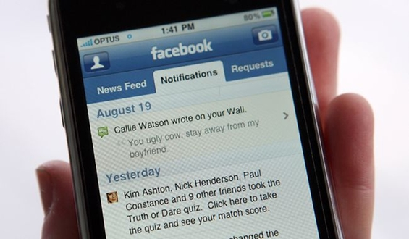
How do I know if I am cyberbullying?
Examples of cyberbullying include mean text messages or emails, rumors sent by email or posted on social networking sites, and embarrassing pictures, videos, websites, or fake profiles.

Slide 5
Think Pair Share Activity
Now with a partner, brainstorm some reasons why you think teenagers cyberbully?
Now, Click the link below and complete the following worksheet based on the brainstorming between you and your partner.
Define the Problem - Cyberbullying Causes

Slide 6
Gather Evidence
Cyberbullying is a problem because according to cyber bullying statistics from the i-SAFE foundation:
1. Over half of adolescents and teens have been bullied online, and about the same number have engaged in cyber bullying.
http://www.bullyingstatistics.org/content/cyber-bullying-statistics.html

Slide 7
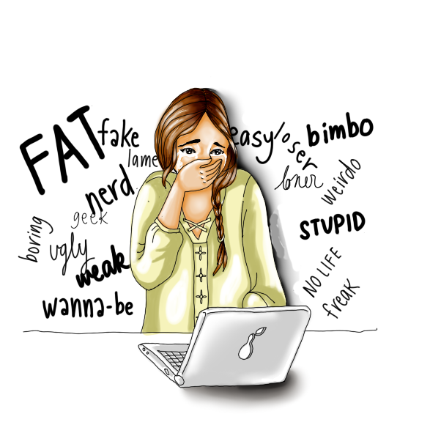
Gather Evidence
Cyberbullying is a problem because according to cyber bullying statistics from the i-SAFE foundation:
2. More than 1 in 3 young people have experienced cyber threats online.
http://www.bullyingstatistics.org/content/cyber-bullying-statistics.html

Slide 8
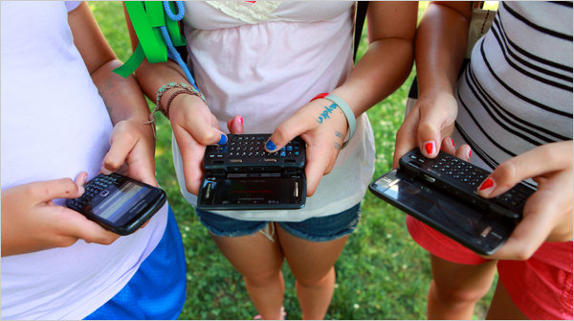
Gather Evidence
Cyberbullying is a problem because according to cyber bullying statistics from the i-SAFE foundation:
3. Over 25 percent of adolescents and teens have been bullied repeatedly through their cell phones or the Internet.
http://www.bullyingstatistics.org/content/cyber-bullying-statistics.html

Slide 9
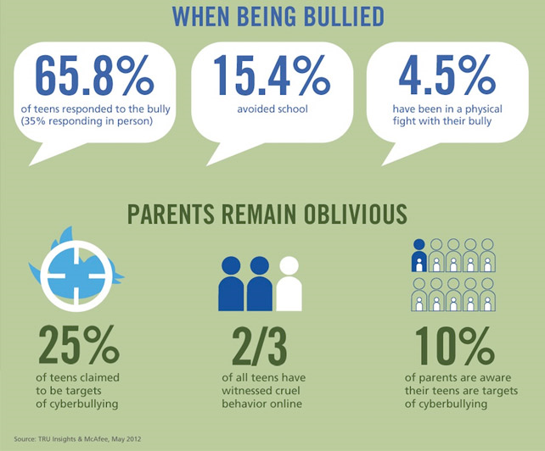

Slide 10
Why is Cyberbullying different?
Kids who are being cyberbullied are often bullied in person as well. Additionally, kids who are cyberbullied have a harder time getting away from the behavior.
Cyberbullying can happen 24 hours a day, 7 days a week, and reach a kid even when he or she is alone. It can happen any time of the day or night.
Cyberbullying messages and images can be posted anonymously and distributed quickly to a very wide audience. It can be difficult and sometimes impossible to trace the source.
Deleting inappropriate or harassing messages, texts, and pictures is extremely difficult after they have been posted or sent.

Slide 11
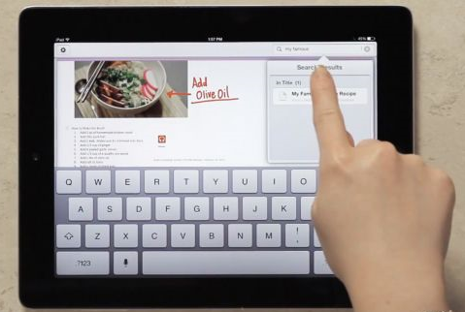
Causes: So let’s take a survey, by a show of hands:
How many of you sleep with your phone next to your bed?
How many of you have access to the internet 24 hours a day?

Slide 12
Having access to the internet and a cell phone or other electronic device at all times, means that bullying can happen at anytime. Although many people use technology for the good, it can also be used to be harmful to others.
Now, click the link below to the worksheet where you and your partner will identify some other causes of cyberbullying.
Causes of cyberbullying

Slide 13
Policies and Laws
State and local lawmakers have taken action to prevent bullying and protect children. Through laws (in their state education codes and elsewhere) and model policies (that provide guidance to districts and schools), each state addresses bullying differently.
Bullying, cyberbullying, and related behaviors may be addressed in a single law or may be addressed in multiple laws. In some cases, bullying appears in the criminal code of a state that may apply to juveniles.

Slide 14
Policies and Laws Cont.
In December 2010, the U.S. Department of Education reviewed state laws and identified 11 key components common among many of those laws.
These key components include:
Purpose Statement, Statement of Scope, Specification of Prohibited Conduct, Enumeration of Specific Characteristics, Development and Implementation of LEA Policies, Components of LEA Policies, Review of Local Policies, communication plan, Training and Preventive Education Transparency and Monitoring Statement of Rights to Other Legal Recourse.
11 key components

Slide 15
Develop solutions
Now with your group, fill out the following worksheet to come up with some ideas as to how we can solve the cyber bullying problems that are taking place among teens.
Solutions Worksheet

Slide 16
Best Solution
Now based on the solutions you came up with on that worksheet you are now going to select the best one based on feasibility, and effectiveness.
Feasibility refers to the likelihood that your policy would be enacted by the government or government agency.
Effectiveness refers to the likelihood that your policy will produce results that lessen the social problem.
Best Solution Worksheet

