Slide 1
Gun Violence in American Schools
Mrs. Greene
JFK Middle School
ngreene@uticaschools.org

Slide 2
Public Policy Analyst
Define the problem
Gather the evidence
Identify the causes
Evaluate an existing policy
Develop solutions
Select the best solution (Feasibility vs. Effectiveness)
http://flippedtips.com/plegal/tips/welcome.html

Slide 3
Problem?
Think, Pair, Share
Do you believe that gun violence is a problem?
Have you ever heard about gun violence in schools?
What are some tragedies that have occurred that deal with gun violence in schools.
Using the prompts above define the social problem by completing the worksheet below.
http://flippedtips.com/plegal/tips/worksheet1.html

Slide 4
GATHER THE EVIDENCE
Over the past decade there has been an alarming increase in the number of shootings taking place in American schools.
Use the following website to research and review recent shootings in American schools.
http://abcnews.go.com/US/mass-school-shootings-history/story?id=17975571

Slide 5
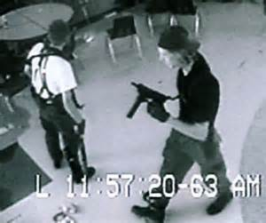
Evidence of Gun Violence in American Schools
Columbine High School Massacre
April 20, 1999
Columbine High School Columbine, CO
Two students shot and killed 12 students and 1 teacher during school hours.
21 other students were injured.

Slide 6
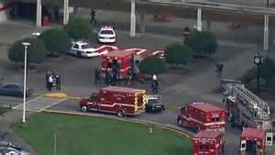
Evidence of Gun Violence in American Schools
Marysville Pilchuck High School Shooting
October 24, 2014
Marysville Washington
15-year-old freshman student shot 5 students killing 4.

Slide 7
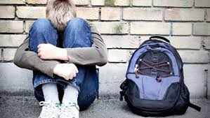
Causes
Easily accessible weapons
Cyber abuse/ Bullying
Environmental Impact
School Environment- 50% of teenagers believe schools are becoming more violent.
Increase in the number of students in gangs by 24%.
Neglect and abusive family life.
http://www.crf-usa.org/school-violence/causes-of-school-violence.html

Slide 8
Existing Policy
SAFE ACT
"The SAFE Act stops criminals and the dangerously mentally ill from buying a gun by requiring universal background checks on gun purchases, increases penalties for people who use illegal guns, mandates life in prison without parole for anyone who murders a first responder, and imposes the toughest assault weapons ban in the country. For hunters, sportsmen, and law abiding gun owners, this new law preserves and protects your right to buy, sell, keep or use your guns."
- Governor Andrew Cuomo
http://programs.governor.ny.gov/nysafeact/gun-reform

Slide 9
Evaluate the Safe Act
Bans possession of any "high-capacity magazines" regardless of when they were made or sold.
Ammunition dealers are required to do background checks, similar to those for gun buyers. Dealers are required to report all sales, including amounts, to the state.
Requires creation of a registry of assault weapons.
Requires designated mental health professionals who believe a mental health patient made a credible threat of harming others to report the threat to a mental health director, who would then have to report serious threats to the state Department of Criminal Justice Services.
Stolen guns are required to be reported within 24 hours. Failure to report can result in a misdemeanor.
Requires background checks for all gun sales, including by private sellers.
Guns must be "safely stored" from any household member who has been convicted of a felony or domestic violence crime.
Mandates that all purchases of firearms go through a licensed firearm dealer(FFL).
Increases sentences for gun crimes, including upgrading the offense for taking a gun on school property from a misdemeanor to a felony.
Limits the state records law to protect handgun owners from being identified publicly.
Requires pistol permit holders or owners of registered assault weapons to have them renewed at least every five years.
Allows law enforcement officials to pre-emptively seize one's firearms without a warrant or court order when there is probable cause the individual is mentally unstable or intends to use the weapons to commit a crime.

Slide 10
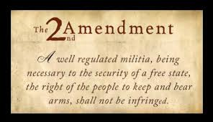
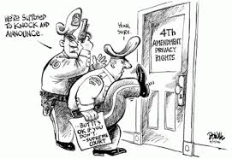
SAFE ACT vs. Bill of Rights
2nd Amendment: Individuals have the right
“to bear arms”
Own firearms
4th Amendment: Protects individuals from
illegal search and seizure.
Warrant is necessary along with
probable cause

Slide 11
YOU CHOOSE!!!
Answer the following:
Does the SAFE ACT infringe on individuals rights granted by the U.S. Constitution?
Should individuals give up their rights to lessen gun violence?
Is there a way to limit gun violence in American schools without taking away Americans rights as granted to them in the U.S. Constitution?

Slide 12
Solutions?
Think about the last question: Is there a way to limit gun violence in American schools without taking away Americans rights as granted to them in the U.S. Constitution?
Now in groups of three brainstorm and propose three new public policies to lessen and or eliminate gun violence in schools using the worksheet below.
http://flippedtips.com/plegal/tips/worksheet5.html

