Slide 1
Mr. Justin Eberley
John F. Kennedy Middle School
Utica, NY
jeberley@uticaschools.org

Slide 2
Steps of Public Policy Analyst (PPA )
1) Define the problem
2) Gather information
3) Identify causes
4) Evaluate an existing policy
5) Develop solutions
6) Select best solution(feasibility vs. effectiveness)

Slide 3
Worksheet #1
1) Define Problem
Ebola in the US

Slide 4
What is Ebola? What do you know about Ebola? Where does Ebola come from? How is it transformed?
Turn and talk

Slide 5
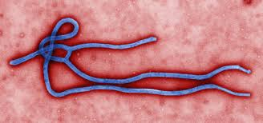
Ebola can reproduce with a host. Ebola is transmitted through body contact (Body fluids include saliva, mucus, vomit, feces, sweat, tears, breast milk, urine, and semen.) not coughing or sneezing Ebola on dry surfaces, such as doorknobs and countertops, can survive for several hours. Travels along with host where ever in the world they go while infected.
2) Gather Evidence
Ebola in the US is dangerous because….

Slide 6
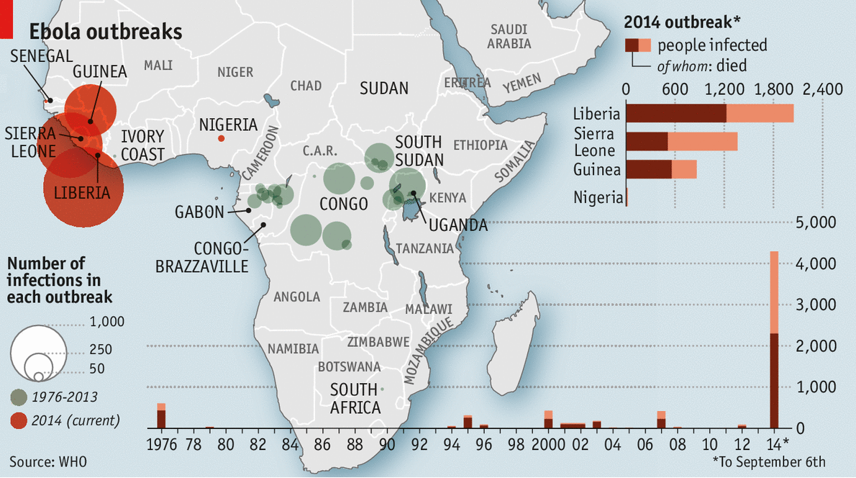
Worksheet #2
Research

Slide 7
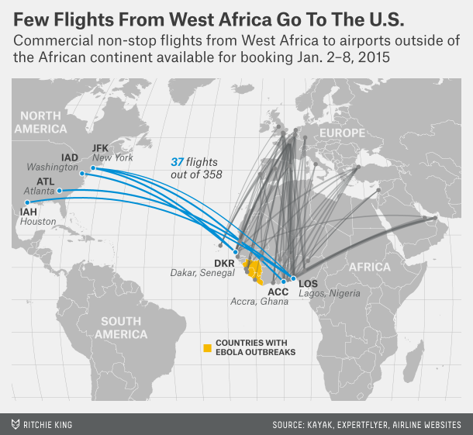
Highly contagious and infectious Symptoms do not show up immediately How many people travel to and from Africa daily?
3) Identify the Causes

Slide 8
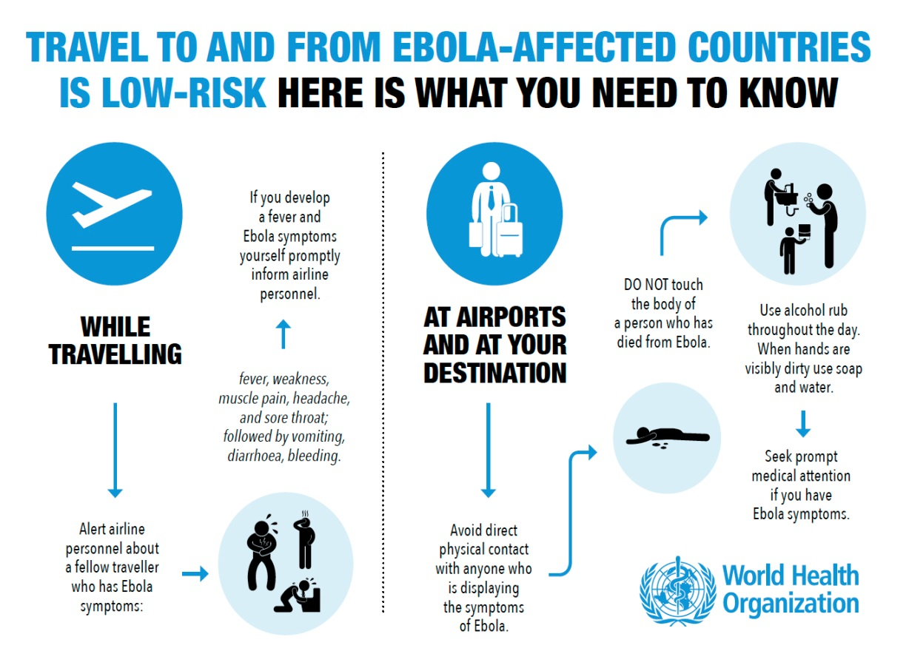
Worksheet #3

Slide 9
Worksheet #4
Complete Worksheet #4 to evaluate one of the major U.S. policies which deals with ebola

Slide 10
Works Cited
www.news10.net
http://www.cdc.gov/vhf/ebola/transmission/qas.html
http://www.economist.com/news/science-and-technology/21616888-hunt-ebola-medicines-being-accelerated-fast-tracking-treatments

