Slide 1
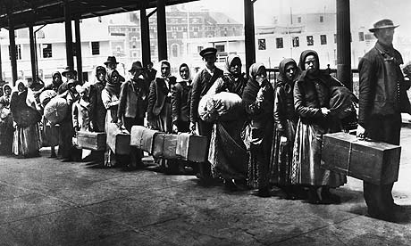
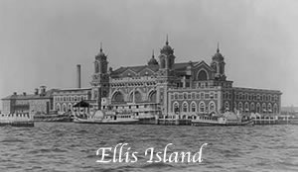
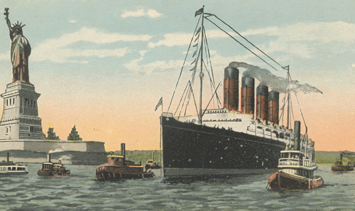
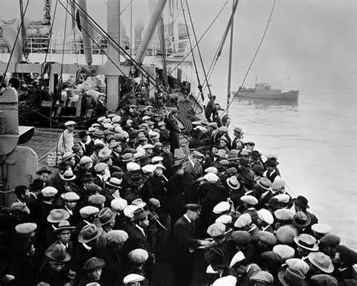
Immigration
J.DeLong, Proctor H.S.
late 1800s-early 1900s

Slide 2
The 4 Steps of the American History Public Policy Analyst (AHPPA)
1. Define the Problem
2. Gather the Evidence
3. Identify the Causes
4. Evaluate the Policy

Slide 3
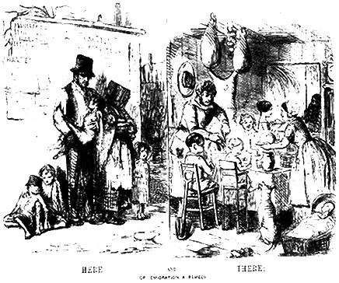
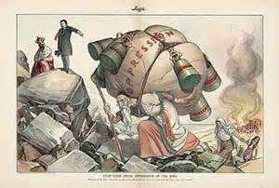
Motivation for Emigration:
1. Economic hardship.
2. Limited political rights.
3. Persecution/racism/war/genocide.
4. The potential for economic opportunities and political freedoms.

Slide 4
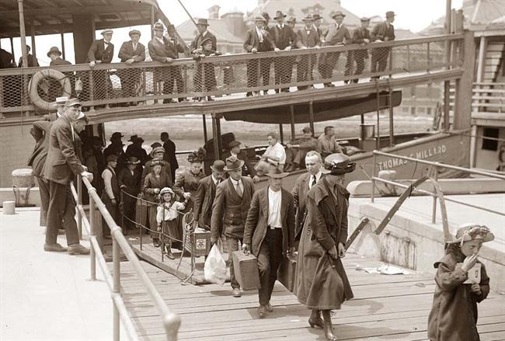
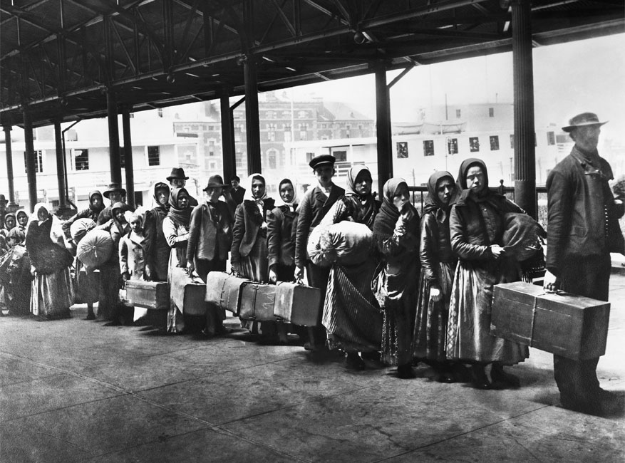
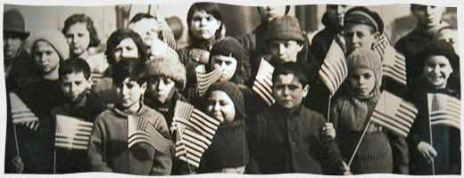
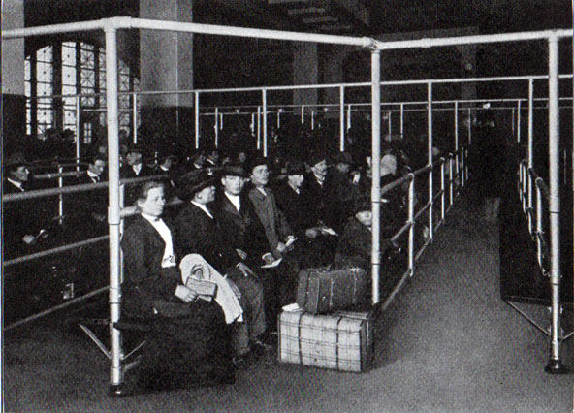
Coming to America

Slide 5
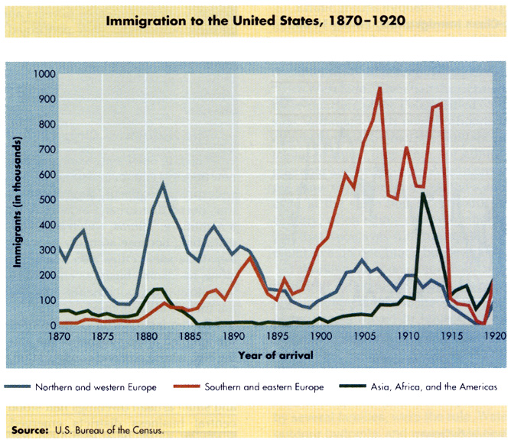
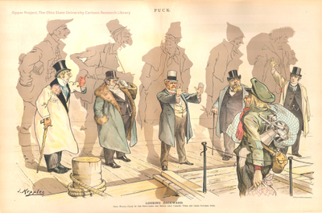
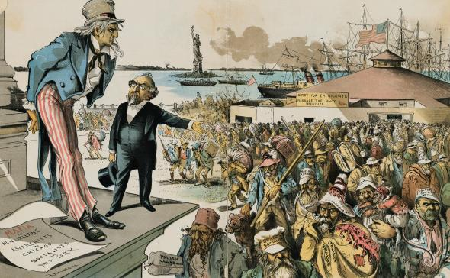
‘Old’ immigration vs. ‘New’ immigration

Slide 6
Perceived problems created by ‘Open Immigration’
1. At first the businessmen favored this policy, because it created surplus/cheap labor.
2. Nativists (racist/anti-immigrant Americans), began to see the surge of immigrants as competition for jobs and a drain on wages.
3. Immigrants tended to isolate and self-segregate themselves into ethnic neighborhoods.
4. Some worried that the influx of cultural diversity would somehow saturate American Culture.

Slide 7
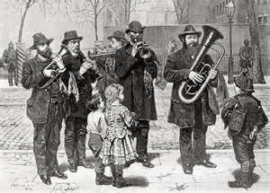
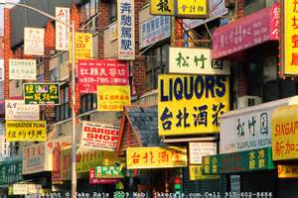
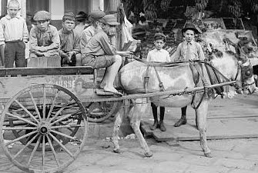
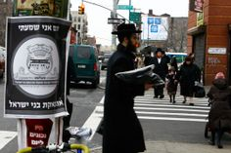
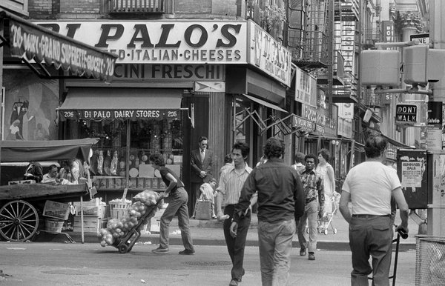
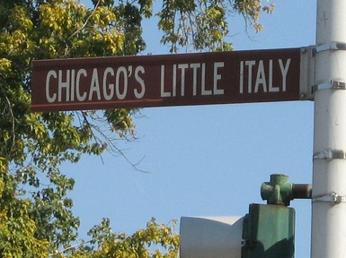
Ethnic Neighborhoods

Slide 8
Restrictions on Immigration
1. Chinese Exclusion Act (1882) restricted Chinese immigration until 1945.
2. The Gentlemen’s Agreement (1907) restricted Japanese immigration until 1945.
3. The National Origins Act/Quota Act (1924) limited immigration mostly from the parts of the World that were judged to be less desirable.

Slide 9
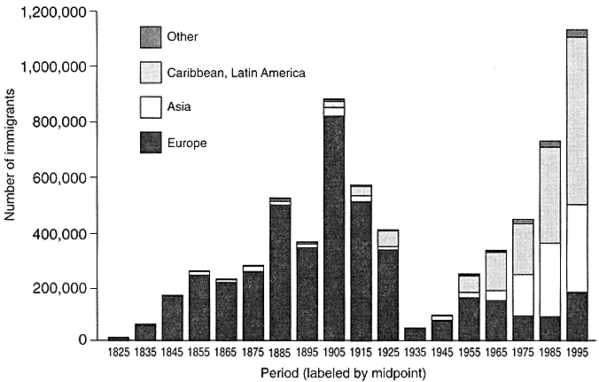
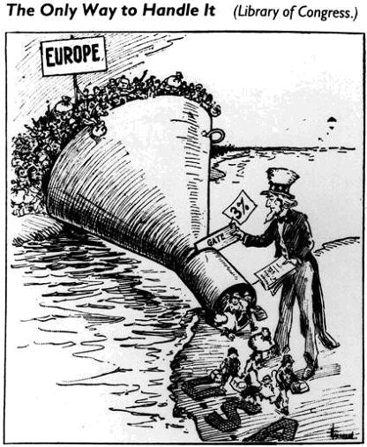
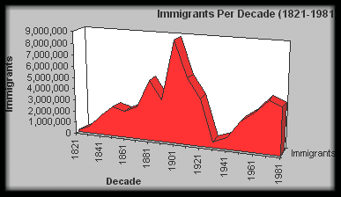
Immigration post-National Origins Act/Quota Act (1924)

Slide 10
The 4 Steps of the American History Public Policy Analyst (AHPPA)
1. Define the Problem
2. Gather the Evidence
3. Identify the Causes
4. Evaluate the Policy
J.DeLong, Proctor H.S.

