Slide 1
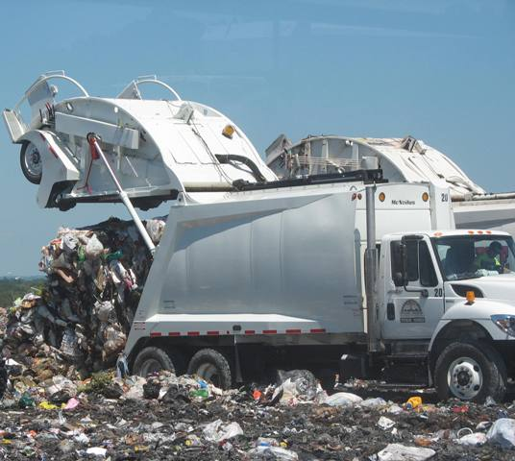
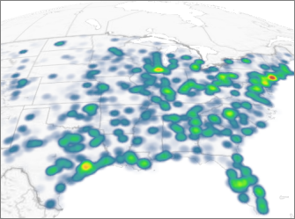
What to do with waste in Oneida County? By Pamela Allen, UCSD
big problem, many solutions.

Slide 2
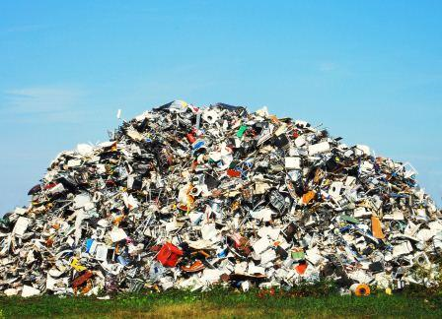
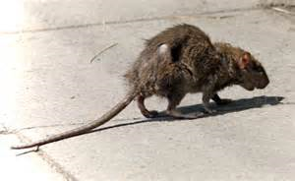
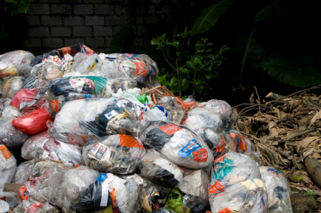
1. Define the Problem
List some problems associated with waste:
Why can’t we live with it?
Where can we put it?
How much does it cost to put it there?
What are the trade-offs? (A trade-off is something you want in exchange for something you don’t want.)
Worksheet 1

Slide 3
2. Gather Evidence
What kinds of wastes do humans produce?
How much waste do humans produce?
What do we do with the waste we produce?
What about sewage?
Are there ever accidents??
Worksheet 2

Slide 4
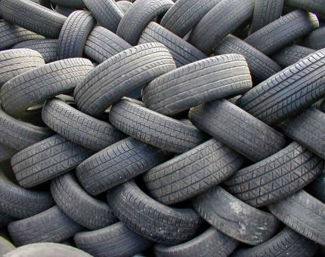
3. Identify the causes. Use the worksheet link on the left to help you organize your findings as you research the causes of our waste problem.
WORKSHEET: Identify the Causes

Slide 5
4. The current policy
What do we currently do with the garbage produced in Oneida county?
Landfill
Recycle
Composting
Evaluate the positives and negatives of the current policy

Slide 6
5. Developing solutions
Some places are finding ways to use the waste that they produce.
using the Landfill
the Brewery
Elsewhere
Evaluate each of the above using the attached form

Slide 7
Selecting the Best Public Policy
Use the form and matrix provided to select and justify the best public policy for waste in Oneida County.

Slide 8
