Slide 1
Poor Academic Performance
Maureen K. Spatuzzi
Proctor High School

Slide 2
Steps of the Public Policy Analyst
Define the Problem
Gather the Evidence
Identify the Causes
Examine an Existing Policy
Develop New Solutions
Select the Best Solution
Feasibility vs. Effectiveness
http://www2.maxwell.syr.edu/plegal/TIPS/welcome.html

Slide 3
Problem
Poor Academic Performance at Proctor High School
Step 1: Define the Problem

Slide 4
Evidence
Low Test grades/Low State Tests Results
Lack of homework completion
Attendance
Other factors
Step 2: Gather the Evidence

Slide 5
Article on Student Achievement
Achievement Gap - Education Week Research Center

Slide 6
QUESTION
What causes students to have poor academic performance?
Discuss in groups of 4.
Step 3: Identify the Causes

Slide 7
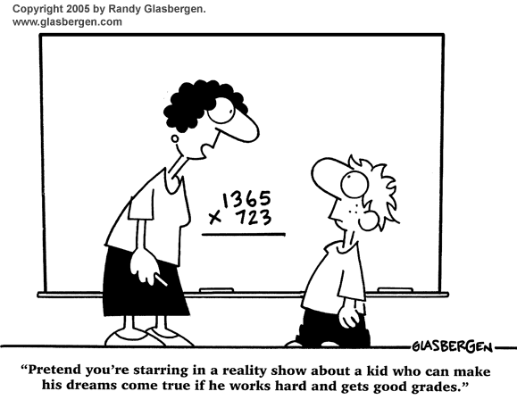

Slide 8
Students Response

Slide 9
Teacher Response
Similarities
Didn’t study
Don’t understand it
Other things to do
Unable to stay after
Can’t do it

Slide 10
Individually ask yourself the following question
What has caused me to do perform poorly academically?(write answers down )

Slide 11
Question Response
Reasons for poor academic performance

Slide 12
School Policy
Retake tests below 65
After school help
Attendance
Study Halls
Learning Center
Computer Lab
Step 4: Examine an Existing Policy

Slide 13
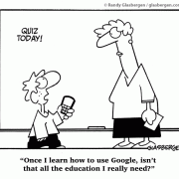
Question
How can I do Better? ( List your responses)

Slide 14
What solutions will work for you?
Discuss and list solutions
Step 5: Develop New Solutions

