Slide 1
Don’t Frack With Our Water…
Jennifer Roberts
Utica City School District
Jroberts@uticaschools.org

Slide 2
Steps of the Public Policy Analyst (PPA)
Defining the social problem
Gathering evidence of the problem
Identify the cause of the problem
Evaluating existing public policies
Developing public policy solutions
Selecting the best public policy solution

Slide 3
Why is there a need for hydrofracking?
Way to obtain natural gas from under layers of shale rock.
Natural gas is a fossil fuel, but is said to be a cleaner burning fossil fuel.
Natural gas can serve as an alternative to coal and oil in fueling our lives.
Since it is a cleaner burning fuel, people think we should make a switch to it as soon as possible.
In addition to it being a cleaner burning fuel, we can obtain natural gas domestically, rather than internationally, which would reduce dependence on foreign oil.
Obtaining fuel locally will likely boost our economy. It will add another big industry to the United States Economy, much like the coal and oil industries.
People are needed to operate the drills and deliver the millions of gallons of chemicals, water, sand and other materials needed to frack, and do other jobs relating to the process of hydraulic fracturing.

Slide 4
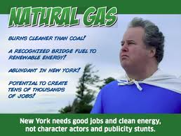
What many government officials think of Hydrofracking..

Slide 5
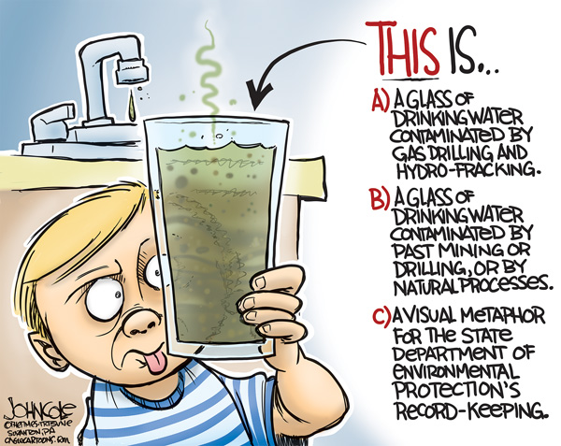
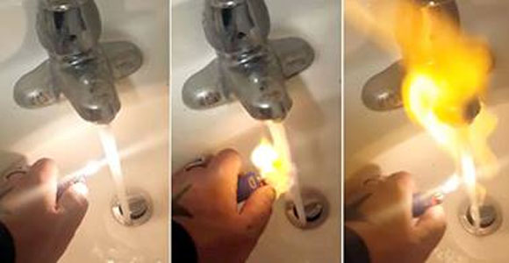
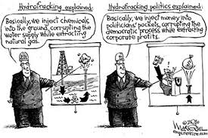
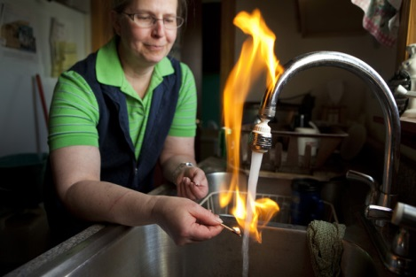
What many people in America think of hydrofracking…

Slide 6
Your Thoughts?
How do you feel about the use of hydrofracking?
What information led you to feel this way about hydrofracking?
Gather some information about how the “public” views hydrofracking.
Gas Land Movie Trailer

Slide 7
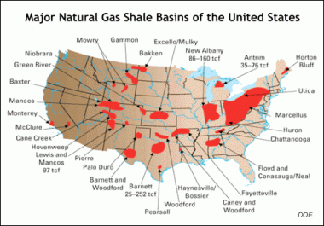
Gather information
Gathering evidence of the problem
We Live on one of the major shale basins of the US

Slide 8
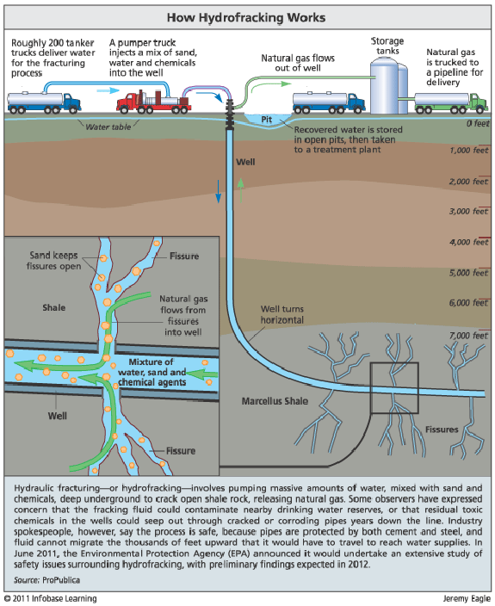
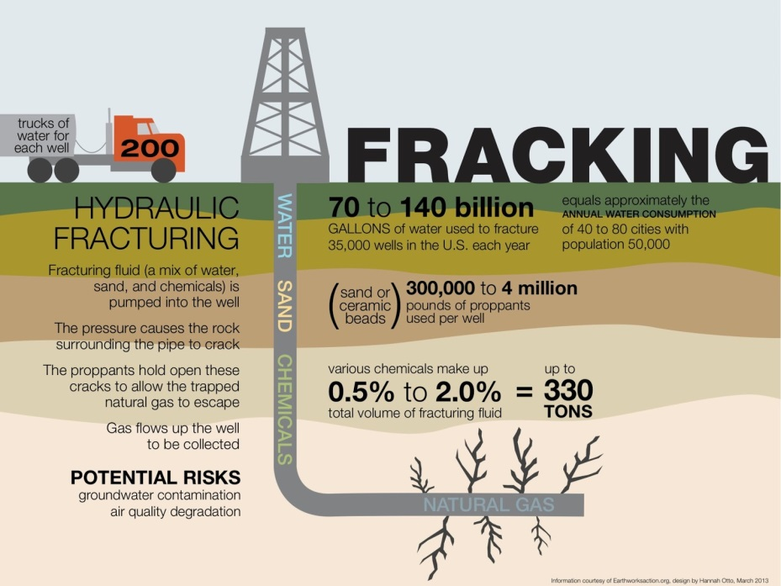
Gathering Information
Think Before You Frack
Pipe Dream

Slide 9
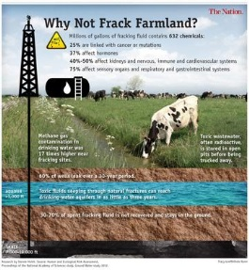
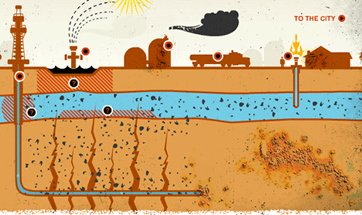
Gathering Information

Slide 10
Identifying the cause of the problem …
Hydrofracking!
Can cause water to become contaminated
Can cause cancer
Can kill wildlife animals
Uses millions of gallons of freshwater
Air can become polluted and can travel many miles away from drilling sites

Slide 11
Existing Public Policy
Public Policy

Slide 12
Developing public policy solutions
Companies that hydrofrack do not need to follow the guidelines set out in the EPA in the Clean water Act- this needs to change immediately.
The government needs to enforce strict laws and not leave laws to individual states

Slide 13
Select the best policy
Companies that hydrofrack need to follow the guidelines set out in the EPA in the Clean water Act- they should not be exempt from this.

