Slide 1
PUBLIC POLICY ANALYST
Designing policy to deal with social problems
Carol Ravina Proctor High School Science
cravina@uticaschools.org

Slide 2
Steps involved:
•Define the problem
•Gather evidence
•Identify causes
•Evaluate a policy
•Develop solutions
•Select best solution

Slide 3
Together we will do step one using chemical cycles

Slide 4
Chemical cycles have become disrupted on earth
Your task: Gather evidence and identify causes to a cycle of your choice

Slide 5
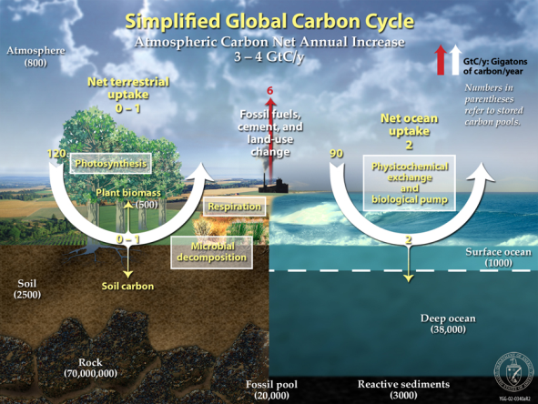
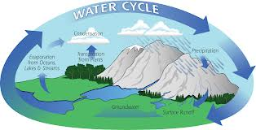
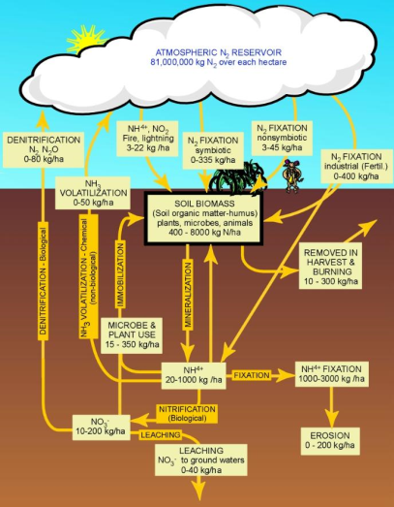
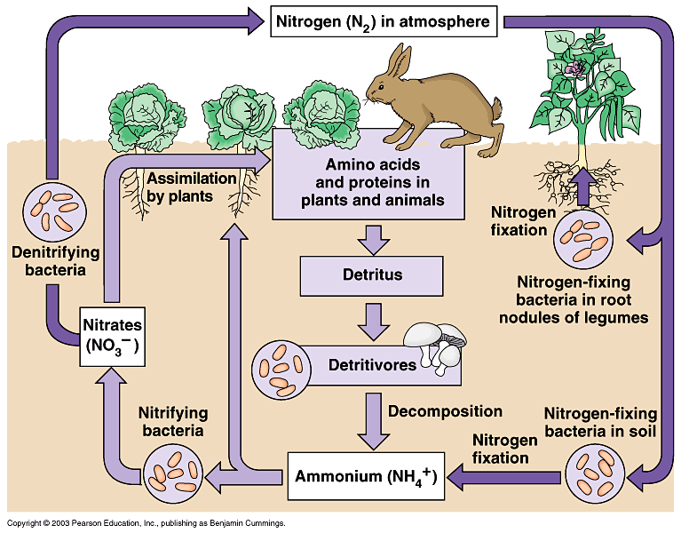
Chemical cycles have become disrupted on earth
http://pmm.nasa.gov/education/water-cycle
http://climatechange.procon.org/view.resource.php?resourceID=003799
Hydrologic cycle
Carbon cycle
http://nutrients.ifas.ufl.edu/Cycle.asp
http://bioh.wikispaces.com/More+Elemental+Cycles
Phosphorus cycle
Nitrogen cycle

Slide 6
INTERRELATIONSHIPS EXAMPLE
http://www.leadernetworks.com/tag/the-social-mind

Slide 7
STEP 2: Gather evidence
Use the worksheet to help you focus
http://nateduffy.blogspot.com/2012/10/evidentialist-atheism.html

Slide 8
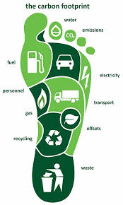
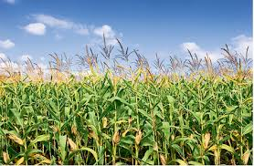
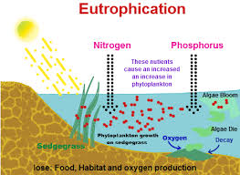
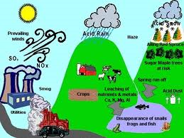
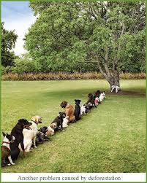
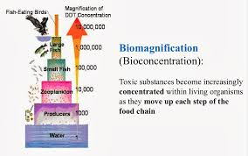
Possible causes that affect cycles:
http://bigmyrtle.blogspot.com/2011/08/beef-its-why-there-is-no-dinner.html
Monocropping
http://mbhsbiochem1.blogspot.com/2013/10/biomagnification_28.html
https://www.complydirect.com/news/carbon-footprint-the-facts-about-the-footprint/#.UydM4cvD_cs
Cultural eutrophication
Carbon footprint
http://www.watershedmanagement.vt.gov/bass/htm/bs_acidrain.htm
http://chemistry.tutorvista.com/biochemistry/eutrophication.html
Acid rain
http://www.zmescience.com/other/yet-another-problem-caused-by-deforestation-15042010/
Biomagnification
Deforestation

Slide 9
Step 3: Identify causes
Use the worksheet to help you focus
Be prepared to present your topic next class
http://unmgrc.unm.edu/conference/2014-conference/registration/oral-presentation.html

