Slide 1
A Shot at PPA
Kathryn Ranieri-Lawless
Living Environments/Biology
Proctor High School
Klawless@uticaschools.org

Slide 2
Public Policy Analyst
Let’s take a look at what it takes to develop a public policy in the field of Science.
Today we will begin a journey into understanding and formulating a policy of our own.
Begin by reviewing and familiarizing yourselves with this link below.
Step 1 has been done for you.
Public Policy Analyst

Slide 3
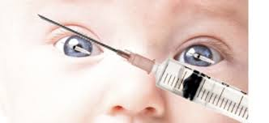
Step 1: The Social Problem
The refusal of parents to vaccinate their children in the United States is on the rise.
Photo: www.healthimpactnews.com
Audio: www.youtube.com/watch?v.

Slide 4
What is a vaccine?
A vaccine is basically taking a weakened or dead microbe and inserting it into an organism, in this case an infant or baby.
The vaccine will help prepare and improve the immunity of the infant or baby to a particular disease.
Photo: www.museumvictoria.com.au/collections

Slide 5
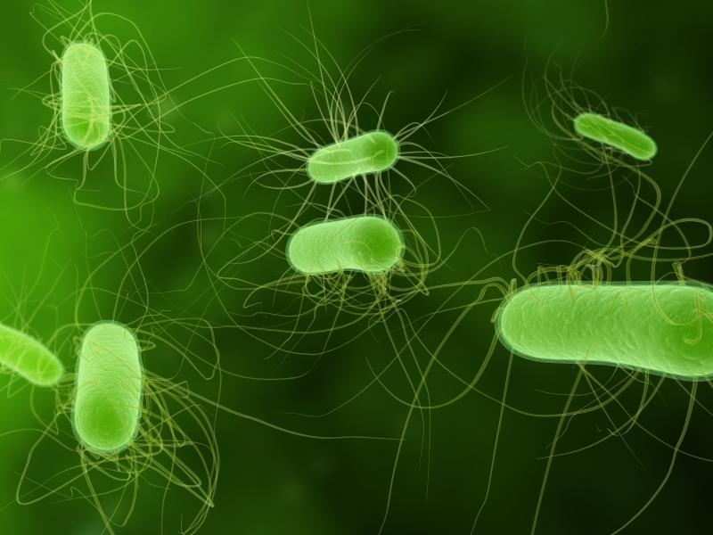
HOW?
What happens in your immune system?
CLICK HERE TO FIND OUT
Photo: www.Sciencedaily.com

Slide 6
Step 2: Gathering Evidence
Our next step is to find out, if in fact, the vaccination rate of infants has decreased in the United States.
Where do I look for that information?
National Center for Disease Control & Prevention
National Center for Health Statistics
National Immunization Survey
National Health Interview Survey

Slide 7
Step 3: Identify Causes
Now that we have our evidence, lets take a moment of science and think about why the rate of parents refusing to vaccinate their children is on the rise.
FEAR
Misinformed
Trendy
Socio-economic
Beliefs

Slide 8
Homework
Please begin by investigating some of the identified causes.
Remember to get them approved before you start.
Interviews
Surveys/calls
Articles (Peer reviewed)

