Slide 1
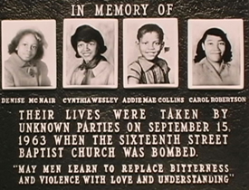
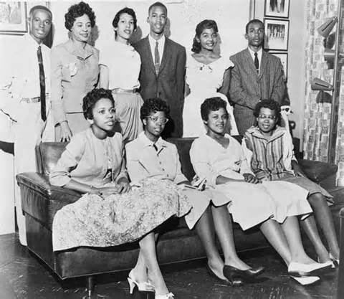
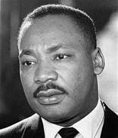
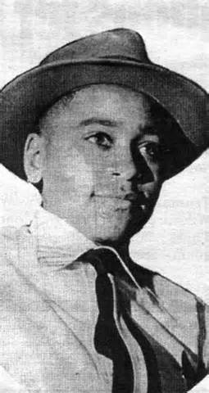
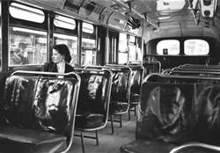
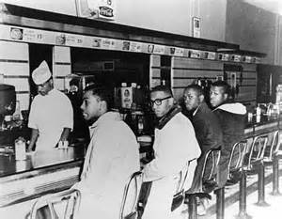
How did the US solve:
SEGREGATION
IN AMERICA

Slide 2
Steps of the American History Public Policy Analyst
Define the Problem
Segregation in the U.S.
Gather the Evidence
Identify the Causes
Evaluate the Policy

Slide 3
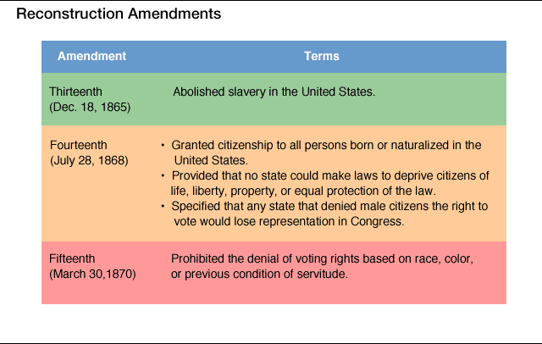

Slide 4
How did the South Respond?
In what ways did Southern Whites react to the 13th, 14th and 15th Amendments?
1.
2.
3.
4.
5.

Slide 5
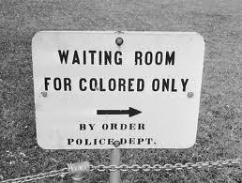
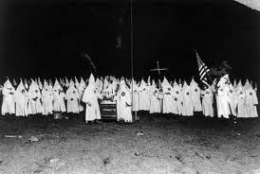
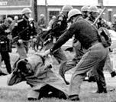
Looking at the photos, what fostered segregation?

Slide 6
Dr. Martin Luther King Jr.’s Letter from a Birmingham City Jail
“(W)e so diligently urge people to obey the Supreme Court’s decision in 1954 outlawing segregation in public schools. … One has not only a legal but a moral responsibility to obey just laws. Conversely, one has a moral responsibility to disobey unjust laws. I would agree with St. Augustine that “an unjust law is no law at all.” … Now, what is the difference between the two? How does one determine whether a law is just or unjust? A just law is a man-made code that squares with the moral law or the law of God. An unjust law is a code that is out of harmony with the moral law. To put it in the terms of St. Thomas Aquinas: An unjust law is a human law that is not rooted in eternal law and natural law. Any law that uplifts human personality is just. Any law that degrades human personality is unjust. All segregation statutes are unjust because segregation distorts the soul and damages the personality. It gives the segregator a false sense of superiority and the segregated a false sense of inferiority. … Thus it is that I can urge men to obey the 1954 decision of the Supreme Court, for it is morally right; and I can urge them to disobey segregation ordinances, for they are morally wrong.
Sometimes a law is just on its face and unjust in its application. For instance, I have been arrested on a charge of parading without a permit. Now, there is nothing wrong in having an ordinance which requires a permit for a parade. But such an ordinance becomes unjust when it is used to maintain segregation and to deny the citizens the First Amendment privilege of peaceful assembly and protest. … One who breaks an unjust law must do so openly, lovingly, and with a willingness to accept the penalty. I submit that an individual who breaks a law that conscience tells him is unjust, and who willingly accepts the penalty of imprisonment in order to arouse the conscience of the community over its injustice, is in reality expressing the highest respect for law….”

Slide 7
How Did Segregation End?
Brown v. the Board of Education of Topeka, KS (1954)
The Montgomery Bus Boycott (1955)
Integration of Little Rock’s Central High School (1957)
The Freedom Rides of 1960-1961
Martin Luther King, Jr.’s I Have a Dream Speech (1963)
The Civil Rights Act of 1964
The Voting Rights Act of 1965

Slide 8
Evaluation of the Policies
Click on the link for the worksheet that accompanies this lesson:
Evaluation Form

