Slide 1
Crisis in The Ukraine
What do we know?

Slide 2
What will you do:
Become a Public Policy Analyst, through a series of steps to help you think like one
“As a public policy analyst, your group or your class will first need to select a problem topic and then specifically define a social problem. Since you will be spending a great deal of time learning about this problem and developing solutions for it, be sure to pick a social problem topic that is of interest to everyone in the group”

Slide 3
Steps of the IPPA
Define the Problem
Gather the Evidence
Identify the Causes
Examine an Existing Policy
Develop Solutions
Select the Best Solution

Slide 4
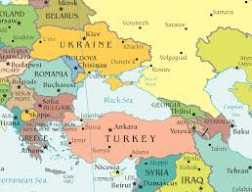
What is The Ukrainian Crisis?
The Ukraine is experiencing social and political changes. Let’s use the following organizer to identify some of the problems in The Ukraine, based on current news media and historical evidence from your assigned reading
The Ukrainian Crisis
Organizer

Slide 5
Define the Problem
A social problem is a condition that at least some people in a community view as being undesirable. What are some social problems in The Ukraine today as the crisis is unfolding

Slide 6
Focus on the Evidence
Based on our discussion and search on the crisis in The Ukraine, you and your group will decide on a social problem you would like to investigate. Please click on the link to access the guide on how to gather evidence

Slide 7
What works?
Let’s evaluate what works to address the problem you identified

Slide 8
What is the Solution to the problem(s) in The Ukraine?
Remember that:
“One way to solve a problem is to eliminate or lessen the causes or contributory factors”

