Slide 1
Women’s rights & Their eyes were watching god
Utilizing APP to identify women’s social problems using Their Eyes Were Watching God Sara Meays ~ Notre Dame High School, Utica, NY
smeays@syrdiocese.org

Slide 2
American history Public policy analyst
Identify the problem.
Gather the evidence.
Determine causes.
Evaluate the policy.
http://www2.maxwell.syr.edu/plegal/ppa/usppai1.html
Notes:
Today we are going to explore the social context of Their Eyes Were Watching God. We will use steps 1 and 2 of the AHPPA to explore how women’s social issues of the early 1900s are reflected in Their Eyes Were Watching God, and more specifically through the character of Janie.

Slide 3
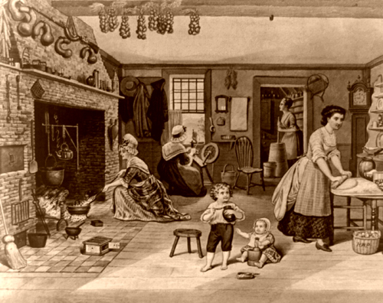
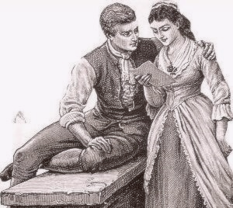
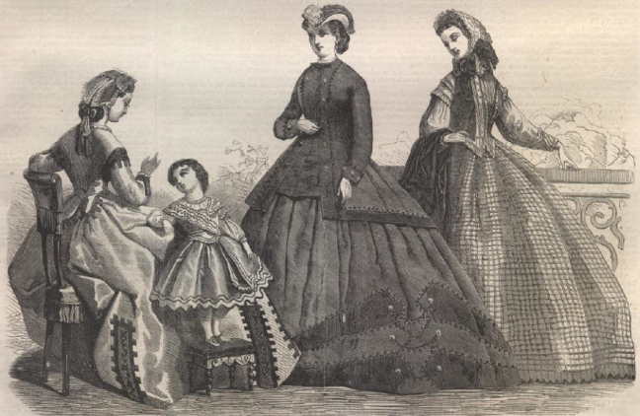
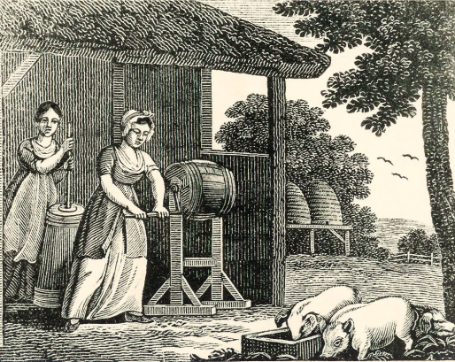
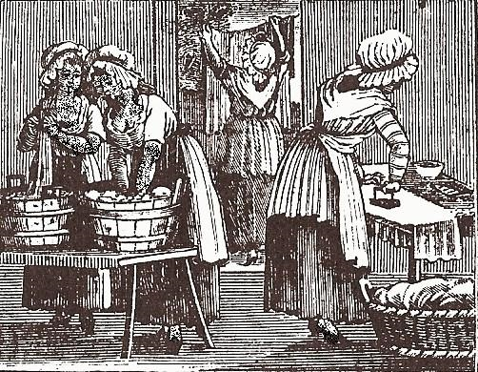
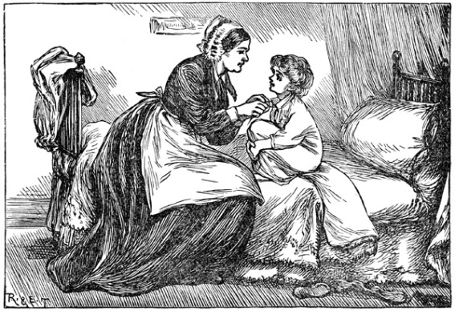
What was women’s role in 1800’s America?

Slide 4
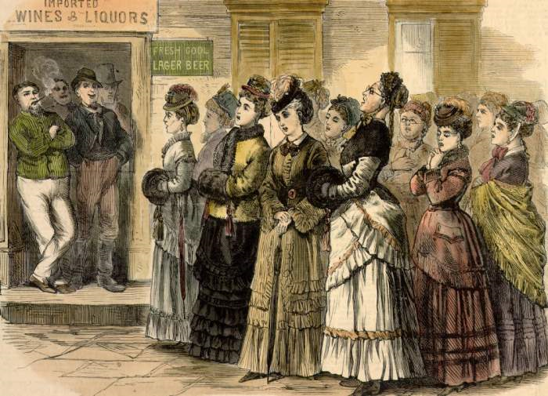
Watch this clip on the women’s movement

Slide 5
What changed in the early 1900s?

Slide 6
Did suffrage immediately solve women’s social Problems?
However,
Notes:
So, even as women were gaining the right to vote, they still faced with day-to-day struggles; this was compounded for African American women.

Slide 7
How does Janie reflect women’s social issues of the early 1900s?

Slide 8
Relating the women’s movement to Janie
In small groups, identify one women’s social issue that Janie confronts.
Find evidence from the book to support your claim.
Complete this worksheet based on your discussion.
Define the women’s social problem here. WS
Provide evidence to support your claim here. WS

Slide 9
Debrief
How is Janie’s fictional struggle similar to the real struggle of women in early 20th century America?
What were problems Janie faced?
What evidence do you have to support your claim?
Notes:
After groups complete Steps 1 and 2 of PPA, bring the class back together to discuss Janie’s problems and evidence in relation to the women’s movement of the early 20th century.

