Slide 1
Proctor
High School
ELA 11
The Evolving American Dream
Karrie Kehoe
kkehoe@uticaschools.org

Slide 2
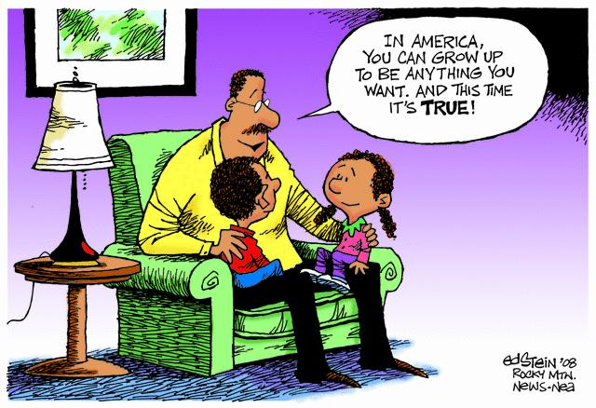
Public Policy Analyst Step #1: Identify the Problem
What is the American Dream?
Draw a line dividing your white boards in half.
2. On one half of the white board create an illustration portraying how you feel residents in the City of Utica are fulfilling the American Dream.
On the other half of the white
board create an illustration
portraying how you feel residents
of the City of Utica are not
fulfilling the American Dream

Slide 3
Public Policy Analyst Step #1: Identify the Problem
What the American Dream is in Utica
What the American Dream is not in Utica
As a class we will combine our visions to create one illustration of how residents of Utica are achieving the American Dream and how they are not.

Slide 4
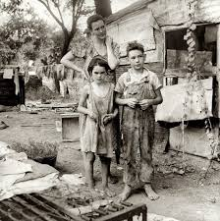
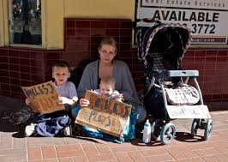
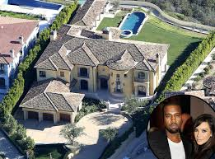
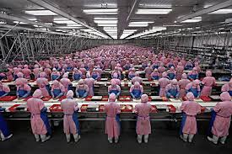
Which of the following images is most representative of the American dream to the residents of Utica? Why? What do you notice?

Slide 5
Public Policy Analyst Step #1: Identify the Problem
What do you find to be strange, interesting and revealing in relation to the City of Utica?
Based on the images and your idea of the American Dream; in small groups discuss the modern American Dream as it pertains to the residents of Utica and complete the attached worksheet – Defining the Social Problem

Slide 6
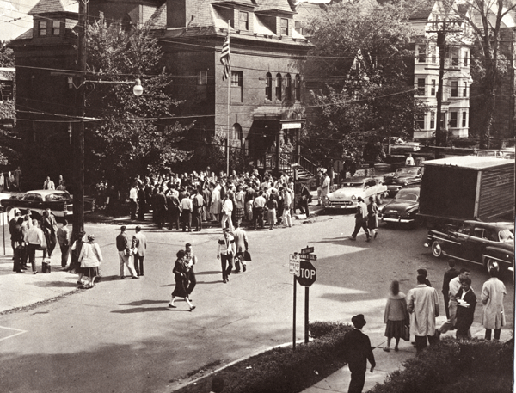
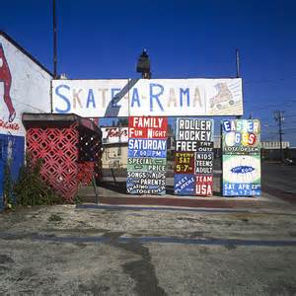
Public Policy Analyst Step #1: Identify the Problem
As a class we have decided that the social problem we have identified pertaining the American Dream in the city of Utica is:
The American Dream of ________________________________ has become unattainable in the city of Utica.

Slide 7
Public Policy Analyst Step #2: Gathering Evidence
Let’s gather some classroom evidence!!
What aspects of this portion of the American Dream have you noticed displayed in Utica.
What aspects of this portion of the American Dream have you not noticed displayed in Utica.

Slide 8
Public Policy Analyst Step #2: Gathering Evidence
In your groups, search the internet to find two pieces of evidence to support the problem the class identified.
One piece of evidence must be a visual and the other piece of evidence must be in written format.
Email the links for your evidence to
me
Complete the following worksheet:
Gathering Evidence

Slide 9
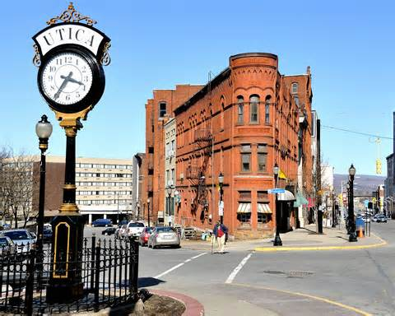
Public Policy Analyst Step #2: Gathering Evidence
Report Out!!
Share your evidence with the class
What did you find?
Where can you look for more evidence?
Homework – Find evidence of this problem within the City of Utica and bring it with you next class. For example you can either take a photo, interview a person, survey multiple people, etc… to gather more evidence. This will be compiled next class.
How can we approach the next step – Identifying Causes?

Slide 10
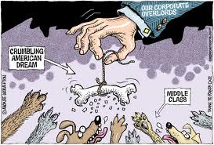
Coming up next!!
You will be working with your group members to complete a web quest that will take you on an adventure to analyze public policies already in place and develop your own public policy solution.
Stay Tuned!!
You are on your way to being a public policy analyst!!

