Slide 1
What is Accountability Among Teens?
A Public Policy Analysis/Literature Review
Ms. Davidson/English 11
wdavidson@uticaschools.org
T.R. Proctor High School
Teens just don’t seem to care…about ANYTHING.
Worse yet, teens don’t take responsibility for ANYTHING.
Why is this happening?
Is this a new problem?
What can be done to fix it?
Questions.jpgwww.avoiceformen.com

Slide 2
Questions to consider regarding the lack of teen accountability:
What is accountability?
Why do we need accountability?
What happens in society without it?
What is the basis for the problem?
Who should be held accountable?
When was this issue presented in literature?
Questions to ask A Prospective Salinas-based Private Security ...tbdavissecurity.com

Slide 3
Defining the Problem Among Teens:
What is accountability?
Accountability definition for kids, or in business
www.my-account-online.com
Discuss amongst yourselves.
Work out a definition with your group…
http://www2.maxwell.syr.edu/plegal/tips/select.html

Slide 4
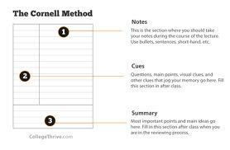
2. Gather Evidence:
Why do we need accountability?
Look, watch, listen, take notes:
Video on Accountability
Note Taking | Lake Washington Institute of Technology
www.lwtech.edu
Develop a theory with your group based on all your notes.
http://www2.maxwell.syr.edu/plegal/TIPS/gather.html

Slide 5
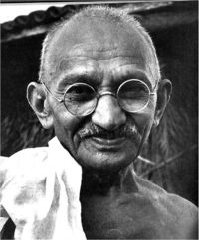
2. Gather Evidence:
What happens in society without it?
“It is wrong and immoral to seek to escape the consequences of one's acts.”
~ Mahatma Gandhi
http://www.goodreads.com/author/show/5810891.Mahatma_Gandhi
Regents Prax:
On your own…Write a critical lens essay in which you analyze and interpret this quote based on the literature we have read together.

Slide 6
3. Identify Causes:
Read and annotate the following article:
“Teflon Kids: Why Children Avoid Responsibility—and How to Hold Them Accountable”
by James Lehman, MSW
Read more:
http://www.empoweringparents.com/Teflon-Kids-Why-They-Avoid-Responsibility-and-How-to-Hold-Them-Accountable.php#
wwwatanabe: Close Read Complex Text, and Annotate with Tech--Part 1
wwwatanabe.blogspot.com

Slide 7
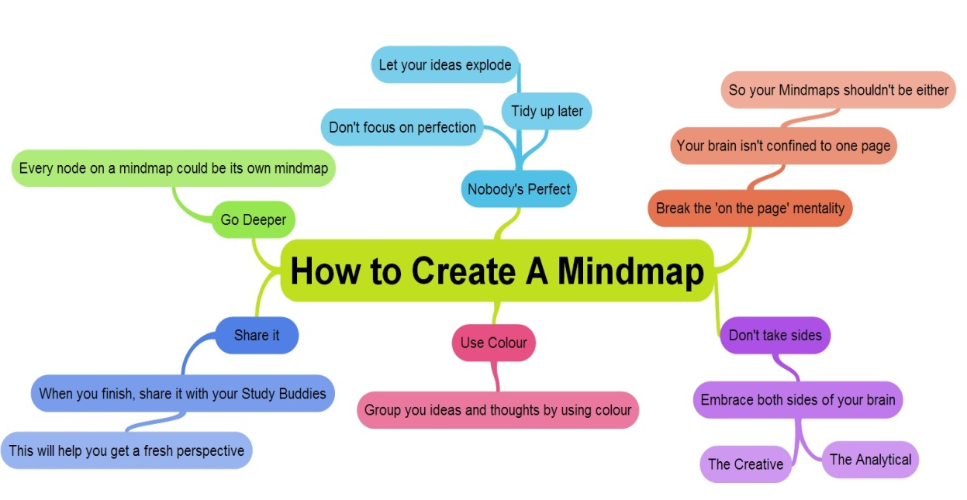
3. Identify causes
What is the basis for the problem?
Make a Mind Map
https://info.examtime.com/files/2012/11/How-to-create-a-mind-map-mindmap.jpg
http://www2.maxwell.syr.edu/plegal/TIPS/identify.html

Slide 8
4. Evaluate a policy
Who should be held accountable?
How can this be achieved?
Read the report on page 32 entitled,
“Invest in Promising Non-Residential Alternatives”
from the Annie E. Casey Foundation study
http://www.aecf.org/OurWork/JuvenileJustice/~/media/Pubs/Topics/Juvenile%20Justice/Detention%20Reform/NoPlaceForKids/JJ_NoPlaceForKids_Full.pdf#page=3
http://www.aecf.org/OurWork/JuvenileJustice/~/media/Pubs/Topics/Juvenile%20Justice/Detention%20Reform/NoPlaceForKids/NoPlaceForKids_cover_200x223.jpg
Consider the validity of the ideas presented
http://www2.maxwell.syr.edu/plegal/TIPS/existing.html

Slide 9
5. Develop solutions of your own
IT Solutions Computer Support | Secure Networks ITC
www.securenetworksitc.com
Who should be held accountable?
What do you think can be done to enforce accountability?
As a group,
Draft a plan of action…
http://www2.maxwell.syr.edu/plegal/TIPS/solutions.html
Design a group poster, to present to the class, showcasing your solutions to the lack of teen accountability.

Slide 10
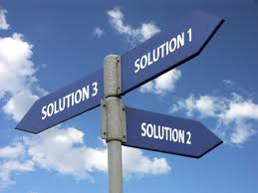
6. Select the best solution:
After each group shares out with the class, we
will collectively decide which solutions seem the most
viable.
http://www2.maxwell.syr.edu/plegal/TIPS/bestsol.html
Cloud Solutionswww.authorinet.com

Slide 11
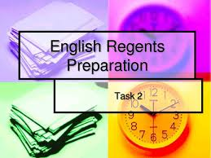
Demonstrate your understanding:
Read the following poems about accountability:
Write a literary analysis paragraph based on one of the poems
Write a controlling idea paragraph about accountability in both works.
English Regents Preparation
www.docstoc.com

Slide 12
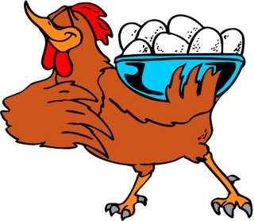
Accountability
FOLKS ain't got no right to censuah othah folks about dey habits; Him dat giv' de squir'ls de bushtails made de bobtails fu' de rabbits. Him dat built de gread big mountains hollered out de little valleys, Him dat made de streets an' driveways wasn't shamed to make de alleys. We is all constructed diff'ent, d'ain't no two of us de same; We cain't he'p ouah likes an' dislikes, ef we'se bad we ain't to blame. Ef we'se good, we need n't show off, case you bet it ain't ouah doin' We gits into su'ttain channels dat we jes' cain't he'p pu'suin'. But we all fits into places dat no othah ones could fill, An' we does the things we has to, big er little, good er ill. John cain't tek de place o' Henry, Su an' Sally ain't alike; Bass ain't nuthin' like a suckah, chub ain't nuthin' like a pike. When you come to think about it, how it's all planned out it's splendid. Nuthin's done er evah happens, 'dout hit's somefin' dat's intended; Don't keer whut you does, you has to, an' hit sholy beats de dickens,-- Viney, go put on de kittle, I got one o' mastah's chickens.
Paul Laurence Dunbar
http://www.poemhunter.com/poem/accountability/
St. Elmo Feed & Seed - Nani's Country Ramble
stelmofeed.com
What does this poem say about accountability?
What literary devices does the author use to develop the passage?

Slide 13
Accountability
By William E. Stafford Cold nights outside the taverns in Wyoming
pickups and big semis lounge idling, letting their
haunches twitch now and then in gusts of powder snow,
their owners inside for hours, forgetting as well
as they can the miles, the circling plains, the still town
that connects to nothing but cold and space and a few
stray ribbons of pavement, icy guides to nothing
but bigger towns and other taverns that glitter and wait:
Denver, Cheyenne.
Hibernating in the library of the school on the hill
a few pieces by Thomas Aquinas or Saint Teresa
and the fragmentary explorations of people like Alfred
North Whitehead crouch and wait amid research folders
on energy and military recruitment posters glimpsed
by the hard stars. The school bus by the door, a yellow
mound, clangs open and shut as the wind finds a loose
door and worries it all night, letting the hollow
students count off and break up and blow away
over the frozen ground.
Bus Clipart Image - Cartoon School Bus
www.pamsclipart.com
http://www.poetryfoundation.org/poem/171509
What does this poem say about accountability?
What literary devices does the author use to develop the passage?

Slide 14
Apply what you’re learned:
Using the insights developed from this public policy analysis and the literature we have read write an informative paper explaining the issue of accountability answering the following questions:
What is accountability?
Why do we need accountability?
What happens in society without it?
What is the basis for the problem?
Who should be held accountable?
When was this issue presented in literature?
Real Growth | Facebook
www.facebook.com
Your paper is due next class. Please follow the rubric on the next slide
for the writing requirements.

Slide 15
