Slide 1
Problem of South Sudan
Gina Buono
Donovan Middle School
Utica, NY
GBuono@uticaschools.org

Slide 2
What are the basic needs you need to survive?

Slide 3
Defining the problem:
Lack of clean water in Southern Sudan has led to illness, despair, famine, & conflict which caused many Sudanese to flee the country.

Slide 4
Gather the Evidence:
Look at the following pictures of Sudan.
Complete your “I Notice, I Wonder” organizer by writing down specific things you “notice” in the picture and things you “wonder” about the picture.
I Notice, I Wonder chart

Slide 5
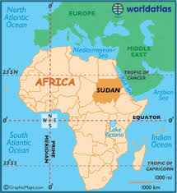
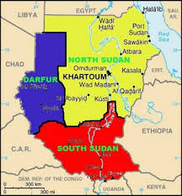
Picture #1:

Slide 6
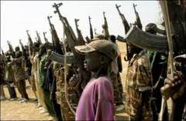
Picture #2:

Slide 7
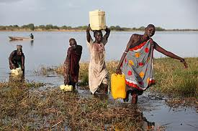
Picture #3:

Slide 8
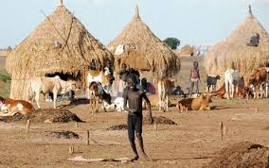
Picture #4:

Slide 9
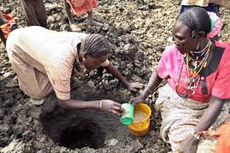
Picture #5:

Slide 10
Discuss “I Notice, I Wonder”
charts

Slide 11
IDENTIFY the causes:
After looking through the pictures and completing the “I Notice, I Wonder” chart, complete the PPA worksheet (Worksheet 3: Identifying the Causes MSWORD) identifying the causes of why many Sudanese were forced to flee their country.

Slide 12
Identify causes:
Assignment:
What caused many Sudanese people to flee Sudan?
Click on the link to view
Short Response Assignment:

Slide 13
Source Page:
www.world atlas.com
Map of Africa
maps-africa.blogspot.com
Map of Sudan
www.dismalworld.com
Picture #2
crs.org
Picture #3
www.telegraph.co.uk
Picture #4
en.starafrica.com
Picture #5
www.hasdpa.net
Homework clipart

