Slide 1
The Negative Effects of Students Using Cell Phones
Pamela Winn
Proctor High School

Slide 2
Steps of the Public Policy Analyst (PPA)
Define the Problem
Gather the Evidence
Identify the Causes
Examine an Existing Policy
Develop New Solutions
Select the Best Solution
Effectiveness vs. Feasibility

Slide 3
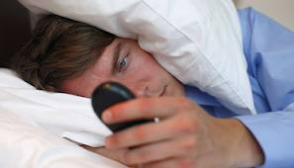
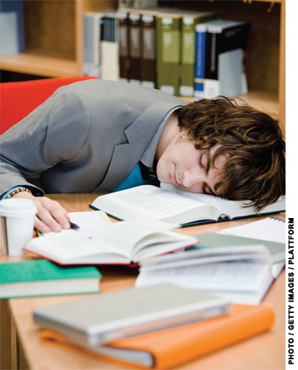
Cell phone usage hinders student performance
*Sleep Deprivation
Students texting all hours of the night have difficulty learning
Step 1 of the PPA: Define the Problem

Slide 4
Texting Lingo in School Writing
Lack of grammar skills
No punctuation
Inventive spelling
in the play romeo and juliet
i will tell u abt the events
b4 juliet died

Slide 6
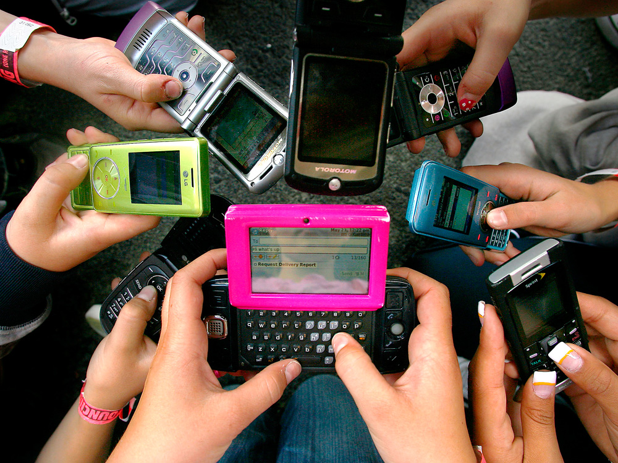
No Verbal communication
Unable to express thoughts on a job interview
Difficulty conveying feelings

Slide 7
TEST CHEATING ON THE RISE
**Searching the web for
answers
**Looking up stored
information
**Texting answers to a friend
**Taking a picture of the test
and sending it to a friend

Slide 8
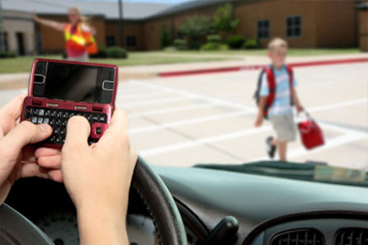
On a much more serious note… Could you live with yourself if this happened to you while you were texting?

Slide 9
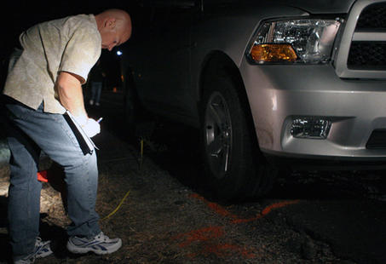
Vernal Police Sgt. Vance Norton diagrams the scene of a crash Sunday, Sept. 2, 2012. Investigators say a man was texting and driving when he struck a Vernal teen who was walking alongside 500 West with a friend. The teen suffered critical injuries. He died Monday, Sept. 3, 2012, at Primary Children's Medical Center.
http://www.deseretnews.com/article/865561699/Texting-driver-struck-Vernal-teen-police-say.html?pg=all
Step 2 of the PPA: Gather the Evidence

Slide 10
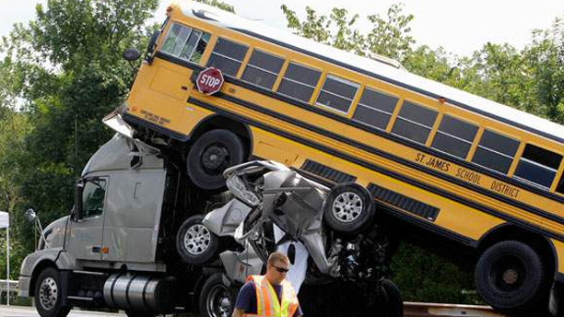
The accident above was caused by a texting teenager, who had sent 11 texts in the 11 minutes that preceded the accident, according to investigators. It occurred in Gray Summit, Mo. and killed two people (AP).

Slide 11
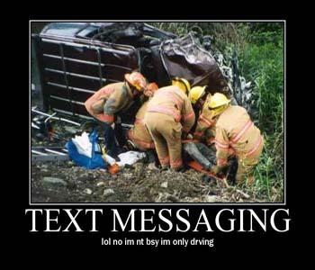
Fatal Distraction: Texting & driving like Russian roulette
In this two-part report, Rock Center Kate Snow investigates the dangers of texting and driving. One leading researcher says texting and driving is eight times as bad as driving drunk. When the behavior leads to serious and sometimes deadly crashes, some texting drivers walk away with surprisingly light punishment.
http://video.msnbc.msn.com/rock-center/50428850

Slide 12
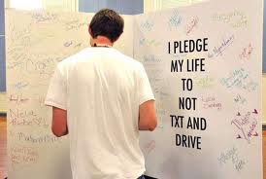
In a small group, discuss how you as students can get the word out in Proctor High School that:
“texting while driving is dangerous”
Step 5 of the PPA: Develop New Solution
TAKE THE PLEDGE
The fight to end distracted driving starts with you. Make the commitment to drive phone-free today.
Distracted driving kills and injures thousands of people each year.
I pledge to:
***Protect lives by never texting or talking on the phone while driving.
***Be a good passenger and speak out if the driver in my car is distracted.
***Encourage my friends and family to drive phone-free.

Slide 13
