Slide 1
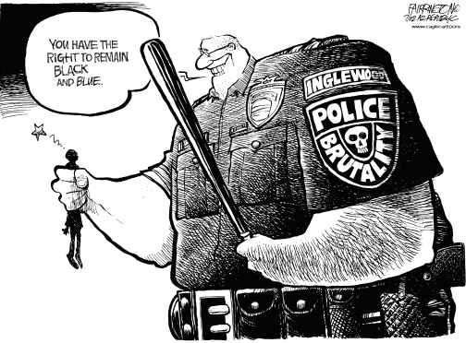
Police Crime A PPA Powerpoint
JILL SCHAAL
DONOVAN MIDDLE SCHOOL
jschaal@uticaschools.org

Slide 2
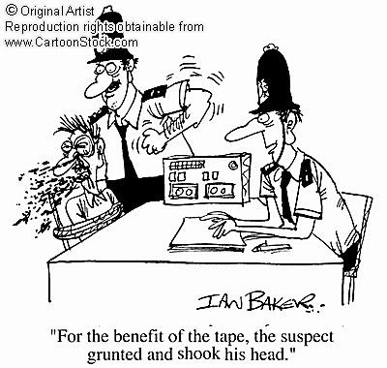
What is police brutality?
“Police brutality is the use of any force exceeding that reasonably necessary to accomplish a lawful police purpose.” (Dictionary of American History”
Read the rest of the article for background information.

Slide 3
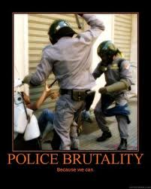
Why do some police commit crimes?
Whether it is the stress of the job or the love of the power, police do commit crimes.
During this class, we are going to find out why that is and come up with solutions to that problem.
We will use the Public Policy Analysis (PPA) to complete this task.

Slide 4
Public Policy Analysis
Define the problem.
Gather the evidence.
Identify the causes.
Examine the existing policy.
Develop solutions.
Choose the best solution.

Slide 5
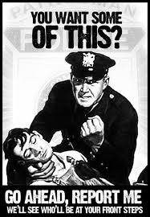
1. DEFINE THE PROBLEM
Working with a partner, come up with 3 reasons that police brutality is a problem. Share them with the class here:

Slide 6
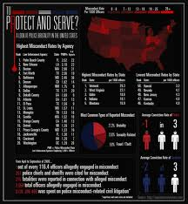
2. GATHER THE EVIDENCE
Use the following resources to gather evidence. Use worksheet provided for your notes.
Brutality Infographic
Types of police crimes
Police brutality

Slide 7
3. IDENTIFY THE CAUSES
Read the following articles before continuing to complete the worksheet
Causes of Police brutality
Use of excessive force
Race and riots

Slide 8
4. EXAMINE EXISTING POLICY
Laws intended to protect against police abuse of authority include the Fourth Amendment to the United States Constitution - protects against unreasonable searches and seizures; the Fourteenth Amendment to the United States Constitution, which includes the Due Process and Equal Protection Clauses; the Civil Rights Act of 1871; and the Federal Tort Claims Act. The Civil Rights Act has evolved into a key U.S. law in brutality cases. However, 42 U.S.C. § 1983 has been assessed as ultimately ineffective in deterring police brutality.^{[37]} Judges often give police convicted of brutality light sentences on the grounds that they have already been punished by damage to their careers.^{[38]} Much of this difficulty in combating police brutality has been attributed to the overwhelming power of the stories mainstream American culture tells about the encounters leading to police violence.^{[39] (Wikipedia)}
Cliff Notes version
NYC Police Policies and Practices

Slide 9
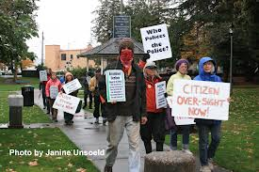
5. DEVELOP SOLUTIONS
Together with your partner, come up with three different solutions that may stop police brutality. Be prepared to share them with the class here:

Slide 10
6.CHOOSE THE BEST SOLUTION
Now that we have some ideas on how to solve this problem, how do we go about choosing the best one?
Click here to go to the PPA web site for more help.

Slide 11
Picture Citations
http://s3.amazonaws.com/rapgenius/police-brutality-because-we-can.jpg
janineslittlehollywood.blogspot.com
thepardu.wordpress.com
venitism.blogspot.com
www.policecrimes.com
thenothingist.wordpress.com
www.freedomsphoenix.com
www.occupyforaccountability.org

