Slide 1
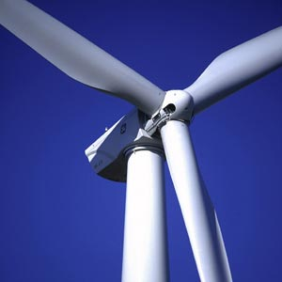
The Problem With Wind Turbines
Mr. Richard Calenzo
Proctor High School
rcalenzo@uticaschools.org

Slide 2
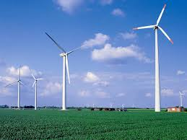
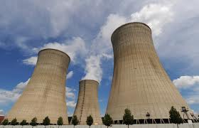
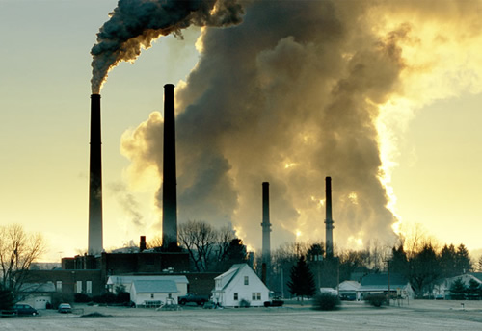
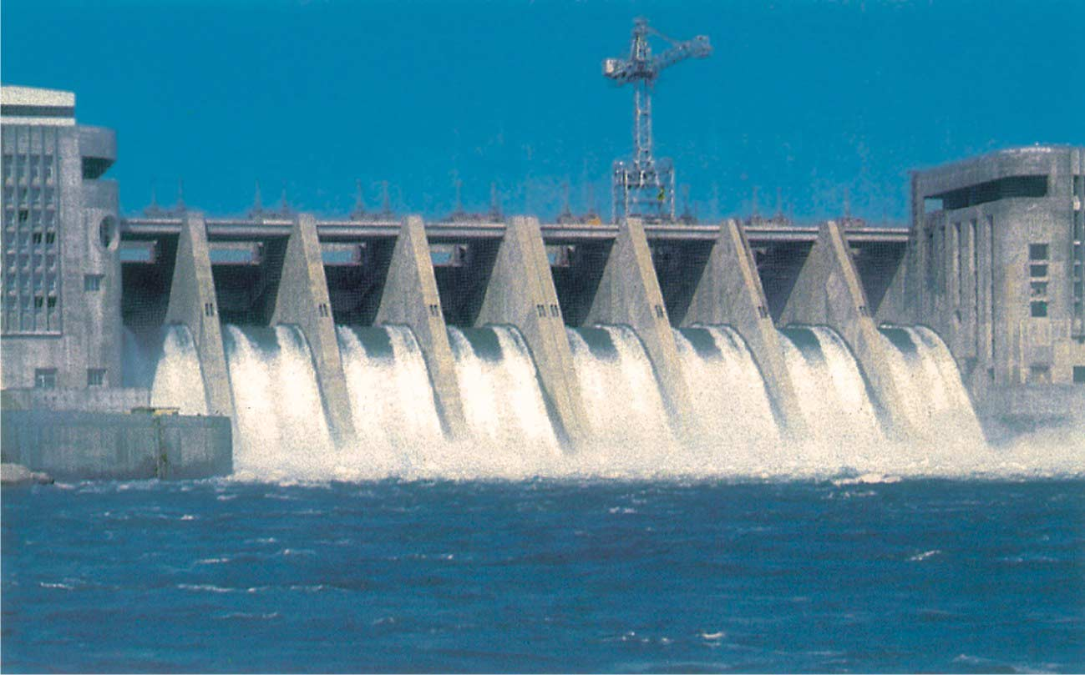
Sources of Energy Production
Name the various ways that the United States produces energy
Hydroelectric
Coal
Oil
Nuclear
Natural Gas
Wind

Slide 3
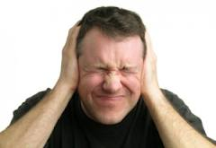
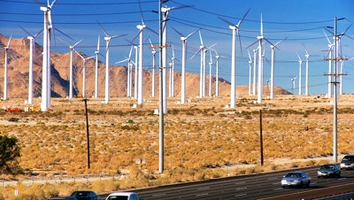
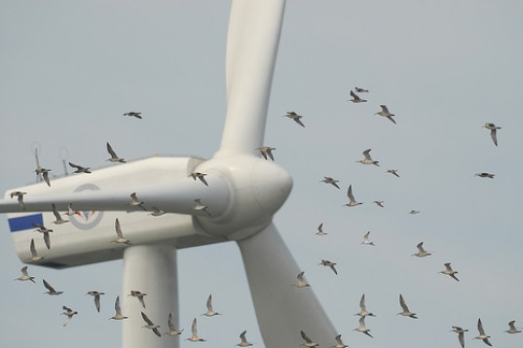
The Problem With Wind Turbines
The construction of wind turbines disturbs local landowners. They complain of
unwanted noise
unsightliness
negative effects to wildlife.

Slide 4
The Steps of Public Policy Analysis
Define the Problem
Gather the Evidence
Identify the Causes
Examine an Existing Policy
Develop Solutions
Select the Best Solution
Effectiveness vs. Feasibility
http://www.wind-power-problems.org/

Slide 5
Economic Effects
Wind Power Causes Economic Problems:
Homes located near wind turbines lose significant value
Some homes become impossible to sell and are abandoned by their owners
Wilderness areas lose economic value as recreational and vacation locations
Tourism supported businesses suffer

Slide 6
Environmental Effects
Wind Turbines Cause Environmental Damages:
Destruction of fragile ecosystems and animal habitats
Deforestation
Excavation
Erosion
Turbines kill birds and other flying animals
Eagles
Raptors
Hawks
Migrating Birds
Bats

Slide 7
Human Health Effects
Turbine "blade thump" noise causes a health problem known as Wind Turbine Syndrome
Symptoms include:
Sleep disturbance
Headache
Ringing or buzzing in the ears
Dizziness
Vertigo
Nausea
Visual blurring
Rapid heart rate
Irritability
Problems with concentration and memory
Panic episodes associated with sensations of internal pulsation or quivering, which arise while awake or asleep

Slide 8
Proponents of Wind Power say:
Wind power promises clean source of electricity
Doesn’t contribute to carbon emissions
Wind power is inexpensive
Wind is free to collect
Wind farms create jobs
Denmark is cited as a model for the use of wind as an energy source

Slide 9
Solutions to the Problem
Use bird-friendly blades that protect birds from harm
Require a noise ordinance that limits the sound from wind turbines
Build wind farms away from population centers
Compensate landowners for nearby wind farms

Slide 10
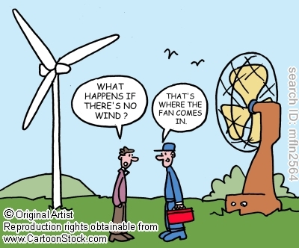
Wind Energy Quiz
Click on the Cartoon Below

