Slide 1
Prohibition
Richard Allen
T. R. Proctor High School – Utica N.Y.
rallen@uticaschools.org

Slide 2
What is a social problem?
•“A social problem is a condition that some people in a community view as being undesirable.”

Slide 3
The Steps in Public Policy Analysis
Define the Problem
Gather Evidence
Identify Causes
Evaluate the Policies

Slide 4
American History Public Policy Analyst
As public policy analysts you will use the AHPPA to identify the social problem and complete the question.

Slide 6
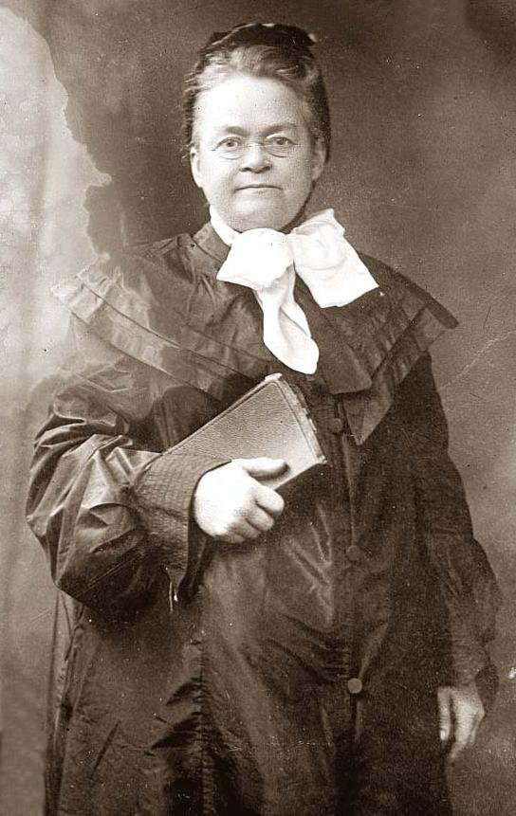
List on your own paper a lists of reasons to ban drinking
Carry Nation: campaigned for prohibition

Slide 7
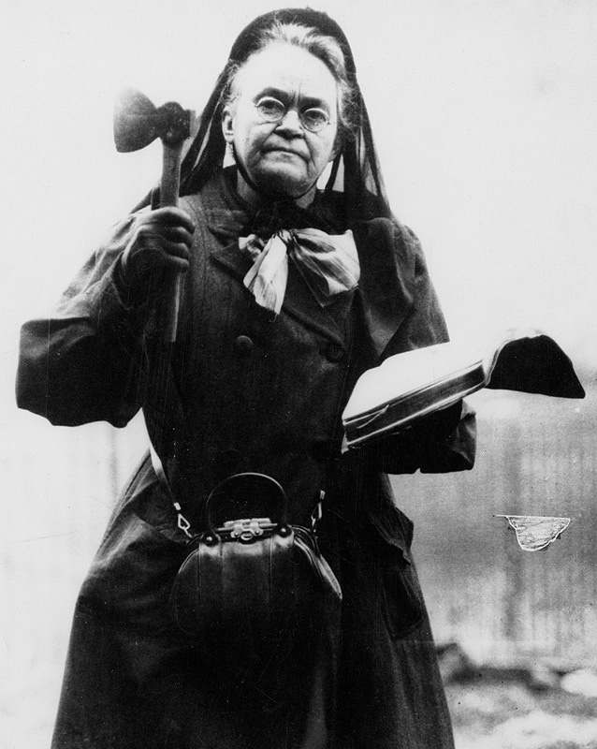

Slide 8
What social problem do you think led to the Prohibition?
•In one or two sentences, state the nature of the social problem.
Defining the Social Problem

Slide 9
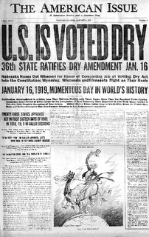

Slide 10
1919 – 18th Amendment passed in Jan 1919
“illegal to manufacture, sell and transport alcoholic beverages”
Volstead Act Oct 1919

Slide 11
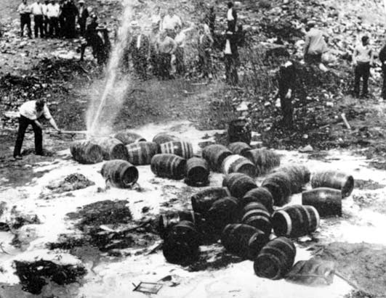
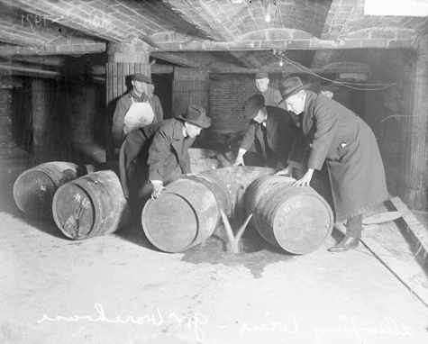
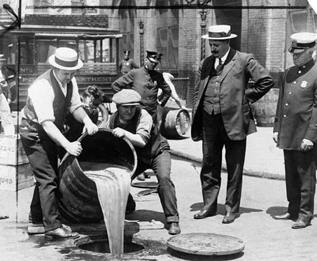
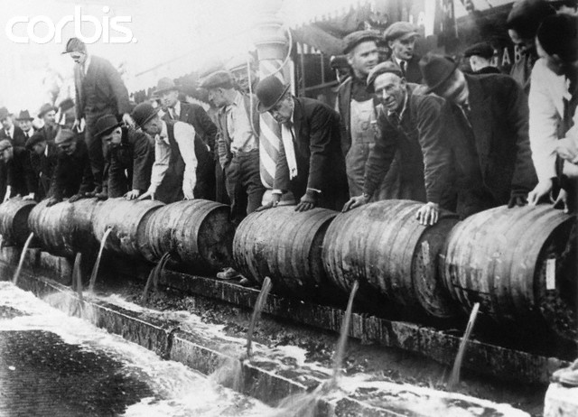

Slide 12
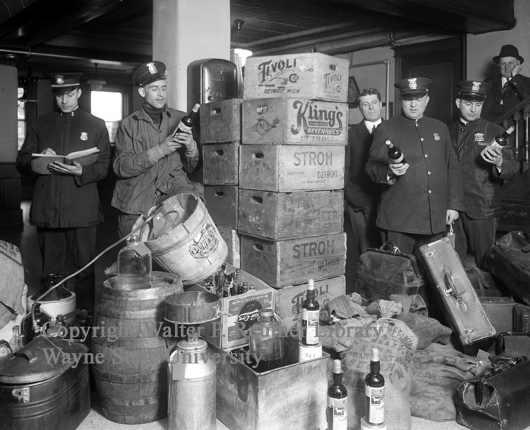
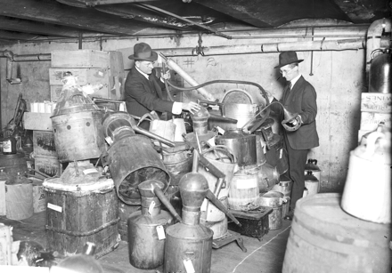

Slide 13
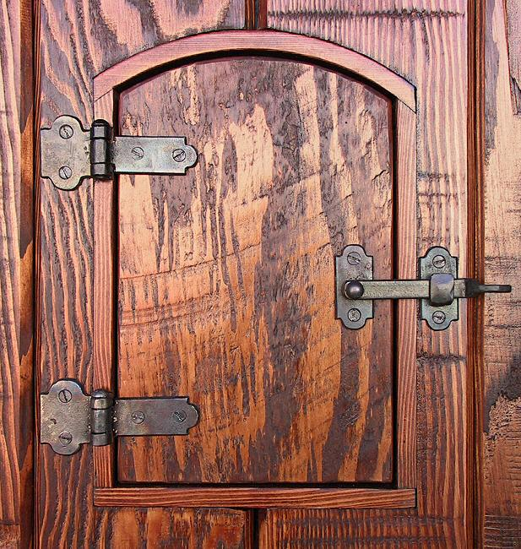
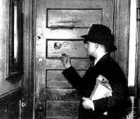
Bootlegging
Speakeasy

Slide 16
On your won paper list several reasons for the Growth in Organized Crime

Slide 19
Reasons to end prohibition:
economic – return workers to liquor industry
tax revenues
laws that most don’t want don’t work
Passed the 21st amendment Repealed the 18th
ratified 1933

Slide 20
Did the solution to the social problem create unintended problems?
•In one or two sentences, state the nature of the social problem.

