Slide 1
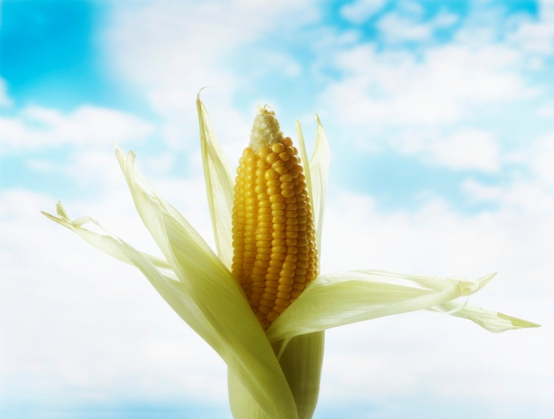
The Need to Feed 7 Billion.
By Pamela Allen
Donovan Middle School, Utica ,NY
pallen@uticaschools.org

Slide 2
Today’s population situation
In 2011, the world’s population of humans hit the 7 billion mark. Click on the heading above to get a more exact number for today.
To see get more information and a visual of what that might look like click here.

Slide 3
What is hunger and why?
Take the quiz to help you define hunger.
How many hungry people are in the world?
According to worldhunger.org, the world produces enough food, but there is not an even distribution of calories, largely due to poverty and conflict.
Environmental concerns are affecting food supplies.

Slide 4
Our Dwindling Food Variety
As we've come to depend on a handful of commercial varieties of fruits and vegetables, thousands of heirloom varieties have disappeared. It's hard to know exactly how many have been lost over the past century, but a study conducted in 1983 by the Rural Advancement Foundation International gave a clue to the scope of the problem.
It compared USDA listings of seed varieties sold by commercial U.S. seed houses in 1903 with those in the U.S. National Seed Storage Laboratory in 1983.
The survey, which included 66 crops, found that about 93 percent of the varieties had gone extinct. More up-to-date studies are needed.

Slide 5
A crisis is looming
To feed our growing population, we’ll need to double food production. Yet crop yields aren’t increasing fast enough, and climate change and new diseases threaten the limited varieties we’ve come to depend on for food. Luckily we still have the seeds and breeds to ensure our future food supply—but we must take steps to save them.

Slide 6
Defining the problem
Please define the problem using the attached worksheet.

Slide 7

Food Ark
Link to and read the article: http://tinyurl.com/foodark
What is the authors main point?
Pick out three sentences that support his position.
What is your opinion of this article?
What can be done to remedy the situation?
What problems can you predict?

Slide 8
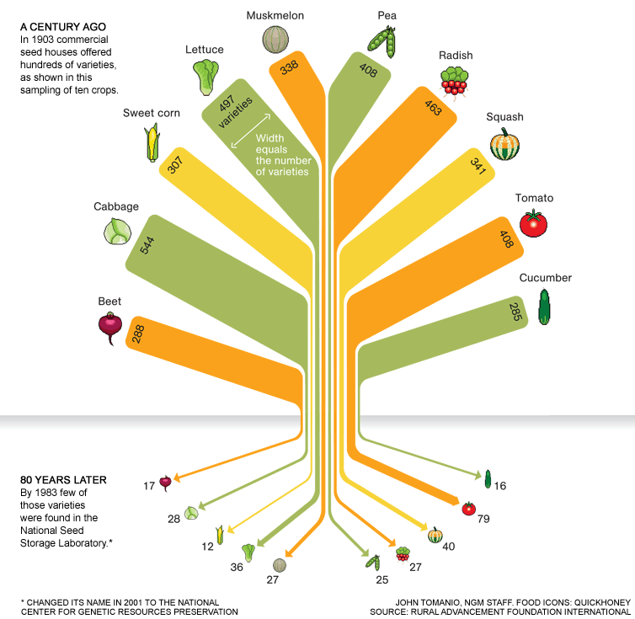

Slide 9


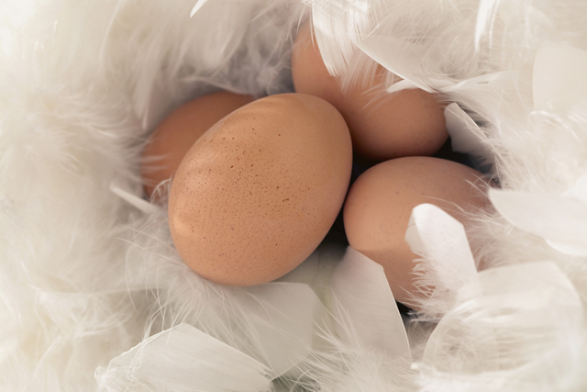
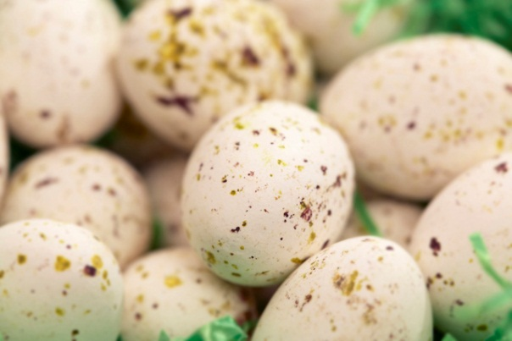
Counting on Uncommon Chickens
People eat more eggs and poultry than ever, but the world’s reliance on a few high-yielding breeds is edging out hundreds of others: Nearly a third of chicken breeds are at risk of extinction. That’s alarming because many varieties have traits, like heat or pathogen resistance, that could be invaluable in the future.

Slide 10
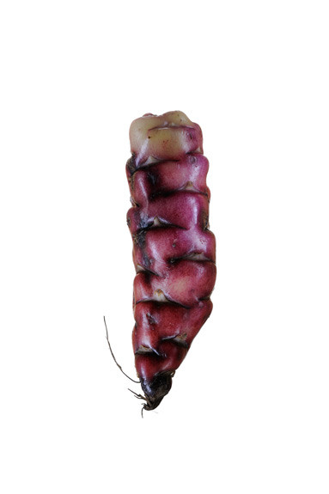
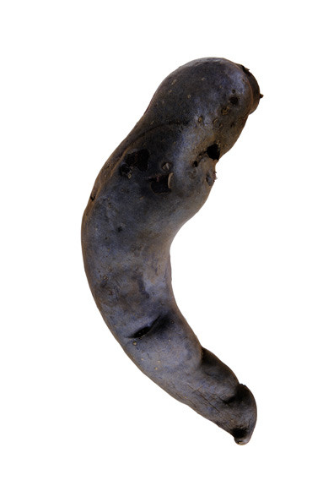
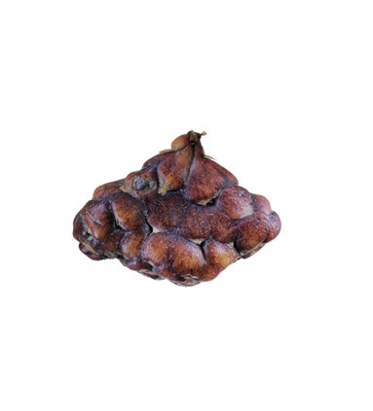
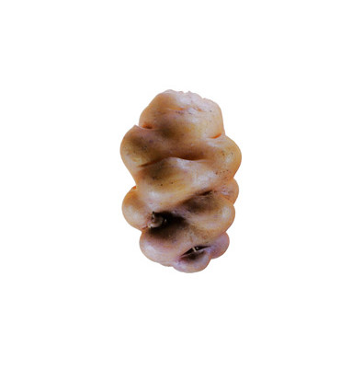
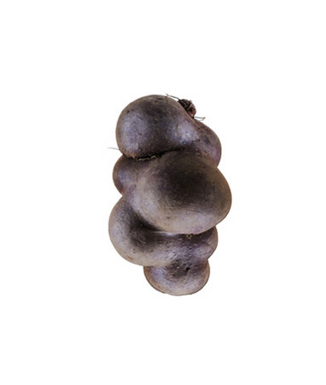
That's a Potato?
Unlike the handful of varieties in U.S. markets, potatoes in Peru and Bolivia—the species' geographic center of origin—come in thousands of colors and shapes. They are so varied in flavor and nutrition that a whole diet can be built around them.

Slide 11
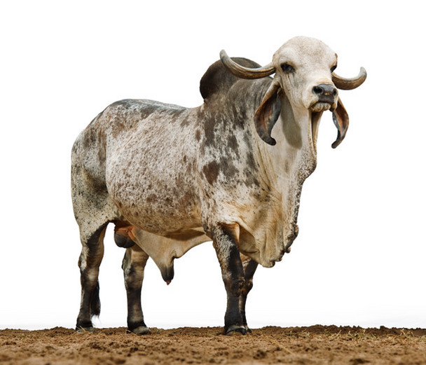
ZEBU
Also known as Humped or Brahman, this breed is relied on by farmers in the tropics because it can withstand severe heat.
Zebu

Slide 12
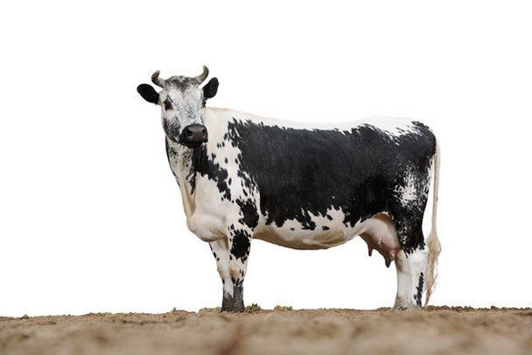
RANDALL LINEBACK
Sturdy, distinctly marked survivors of a herd indigenous to Vermont, the breed nearly went extinct in the 1980s but is rebounding.
Q: Could this breed live in New York?

Slide 13

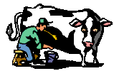
Sustainable Beef
Rare-breed advocates say the best way to preserve vulnerable cattle is to *keep them in the food chain, producing milk or meat.
Their motto:
"To save them we've got to eat them.“
*Draw a hypothetical food chain involving cattle .

Slide 14
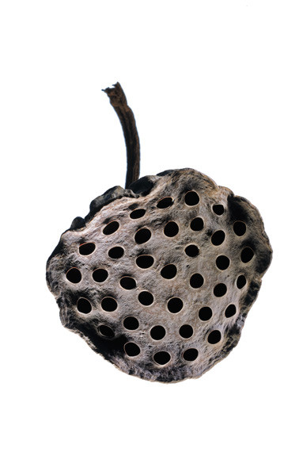
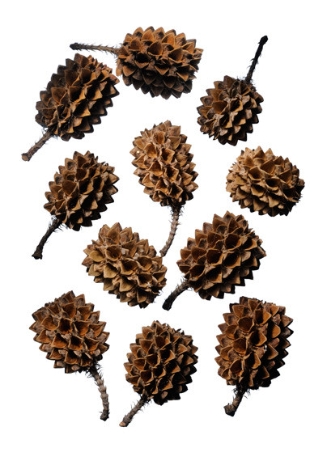
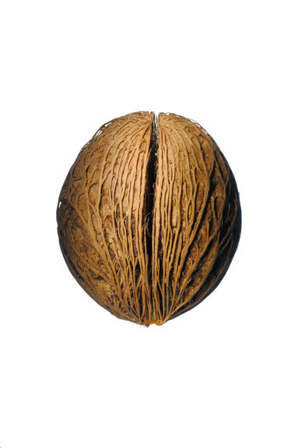
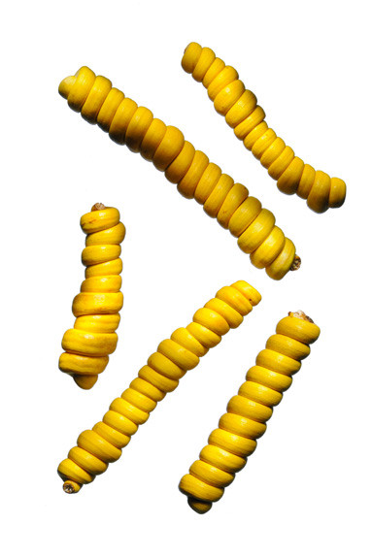
Seeds Worth Saving
Otherworldly seeds (and their pods) are as varied as the plants they become.
Agriculture isn’t just about growing food; it includes trees and other plants that produce fiber, control wind erosion, and shade livestock.

Slide 15
credits
National Geographic Magazine
“Food Ark” by Charles Siebert, July 2011
Photography by Jim Richardson
http://ngm.nationalgeographic.com/2011/07/food-ark/food-variety-graphic
National Geographic Magazine
“The Face of 7 Billion”
http://ngm.nationalgeographic.com/2011/03/age-of-man/face-interactive
http://www.worldhunger.org/articles/Learn/world%20hunger%20facts%202002.htm
Today’s world population
http://www.worldometers.info/world-population/
Slideshow: P. Allen, Utica Schools

