Slide 1
Education and Democracy
EQ: Is education important in a democracy?

Slide 2
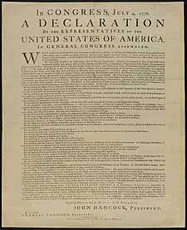
Where does government get their power to govern?
“… Governments are
instituted among Men,
deriving their just powers
from the consent of the
of the governed…..”
from the
Declaration of Independence

Slide 3
Think About It
How would someone learn about……
…government?
…how government works?
…be able to read about and understand their rights?
…be able to read about government activities?
Should every person in a country be entitled to the same education?
Notes:
Students will respond to these questions on poster size paper hung up around the room. They will be given 5 minutes for this task and 5 minutes will be given to read ideas written down.

Slide 4
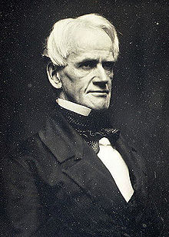
Horace Mann
“ If we do not prepare children to
become good citizens,
if we do not enrich their minds
with knowledge…
…then our republic must go down
to destruction as others have
gone before it.”

Slide 5
Listen for Information
You will now listen to a short biography about Horace Mann. While you listen, please use the graphic organizer to take notes about Horace Mann, his concerns and suggested solutions. Listen for any information that might help you understand why he felt the way he did.

Slide 6
Why did he personally feel that everyone deserved an education?
What were the
changes that he
thought were
necessary?
What was wrong
with the public
school system?
Notes:
By listening and taking notes students will begin to define the problem, gather evidence, identify causes, and examine the policy.

Slide 7
Public Policy Analyst (PPA)
*Define the Problem
*Gather the Evidence
*Identify the Causes
*Examine the Policy

Slide 8
Define the Problem
Using Worksheet 1: This worksheet will help you define the problem.

Slide 9
Gather Evidence
Read pages 417 – 418 to gather evidence to help you complete Worksheet 2.
Worksheet 2

Slide 10
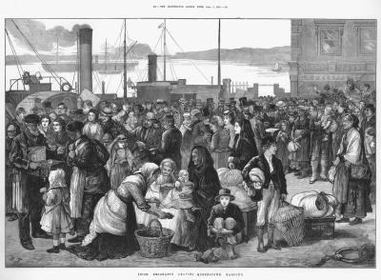
Many immigrants came to American cities in the early 1800’s.

Slide 11
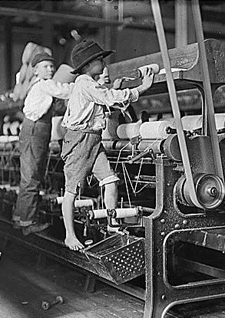
Children were working in factories to help support their families.

Slide 12
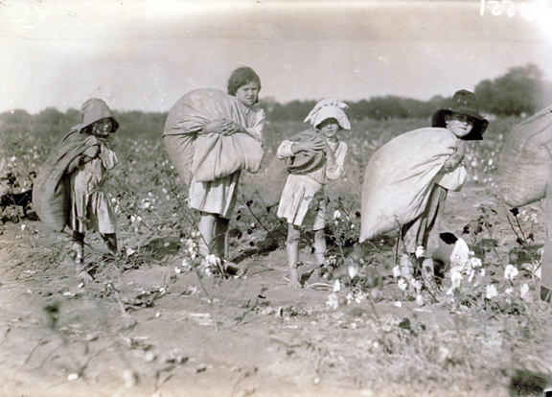
Not everyone had slaves. Some families had to work together to make a living.

Slide 13
Determine Causes
Worksheet 3

Slide 14
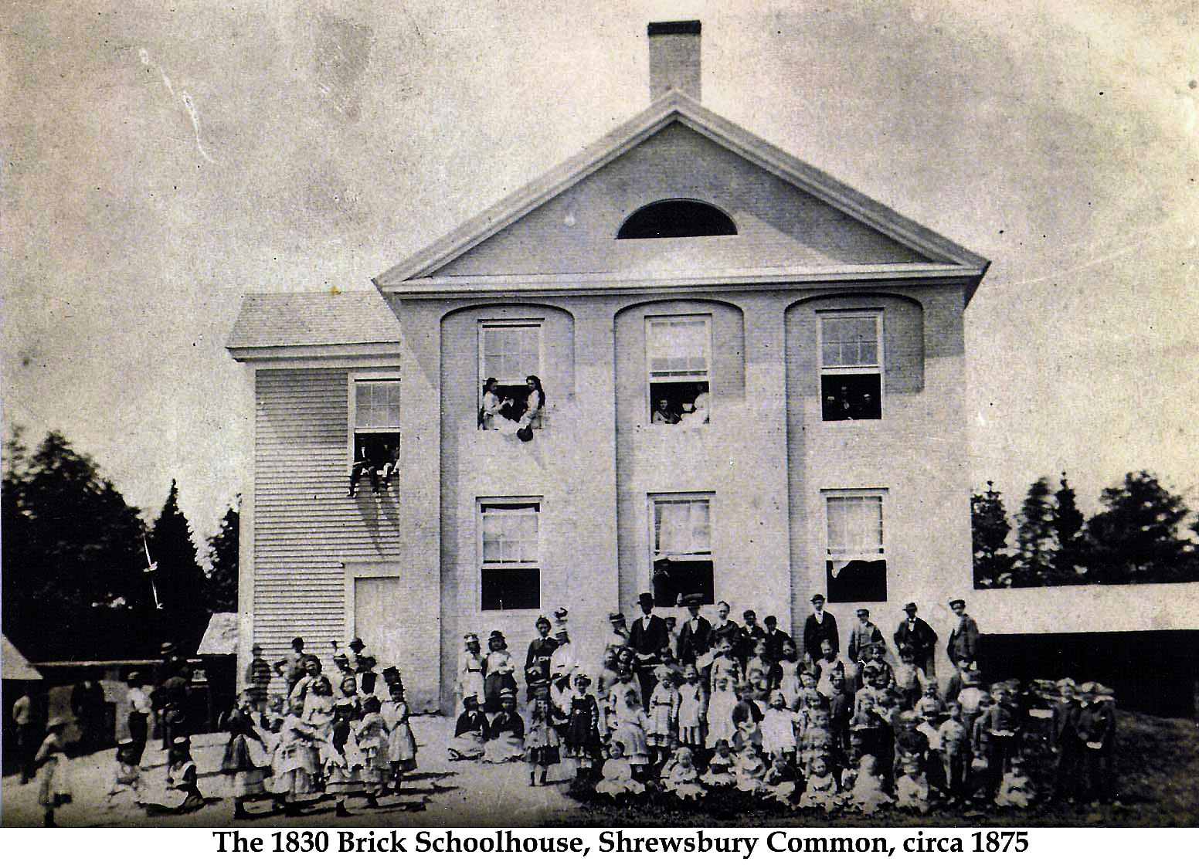
Examine the Policy
Worksheet 4

