Slide 1
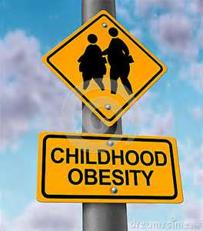
Obesity in the united states Monja mitchell- Donovan middle school

Slide 2
Steps of the PPA- Public policy analyst
Define the Problem
Gather Evidence
Identify Causes
Evaluate a Policy
Develop Solutions
Select Best Solution

Slide 3
What is your definition of obesity?
Let’s do a Splash using one word you think of when you
hear the word:
Obesity.

Slide 4
Obesity- splash
Notes:
Students come up to the board and write one word they think of when they hear the word- Obesity

Slide 5
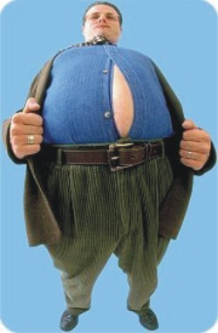
Definition of obesity
A condition characterized by the excessive accumulation and storage of fat in the body
http://www.merriam-webster.com/dictionary/obesity

Slide 6
Let’s define the problem of obesity in the united states
With your group you are going to define the problem.
Use the worksheet titled: Defining the Social Problem.
Pick one person to be the recorder.
You will have 20 minutes to talk and discuss and fill in the worksheet Online Stopwatch

Slide 7
Define the Problem
What is the social problem?
Where is the social problem located (school, city, state, country)?
What are some of the bad consequences of your social problem?
Write a short phrase summarizing your problem and its location?
Notes:
Each group will come up and fill in the questions and then we will compare the results

Slide 8
Define the Problem
What is the social problem?
Where is the social problem located (school, city, state, country)?
What are some of the bad consequences of your social problem?
Write a short phrase summarizing your problem and its location?
Notes:
Each group will come up and fill in the questions and then we will compare the results

Slide 9
Define the Problem
What is the social problem?
Where is the social problem located (school, city, state, country)?
What are some of the bad consequences of your social problem?
Write a short phrase summarizing your problem and its location?
Notes:
Each group will come up and fill in the questions and then we will compare the results

Slide 10
Compare and contrast
Compare | Contrast

