Slide 1
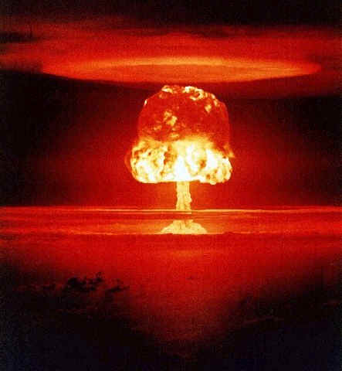
Fear of Nuclear Power
Charlene Mazur
Utica City School District
cmazur@uticaschools.org

Slide 2
What the public thinks about nuclear power

Slide 3
What scientists think about nuclear power

Slide 4
Define the Problem
http://www2.maxwell.syr.edu/plegal/ppas/select.html

Slide 5
Your Thoughts?
How do you feel about the use of nuclear power?
What information led you to feel this way about nuclear power?
Gather some information about how the “public” views nuclear power.

Slide 6
Gather Evidence
http://www2.maxwell.syr.edu/plegal/ppas/gather.html

Slide 7
Evidence from Public Polls
http://politicalticker.blogs.cnn.com/2011/03/22/cnn-poll-public-says-yes-to-nuclear-energy-but-no-to-new-plants/
http://www.guardian.co.uk/environment/damian-carrington-blog/2011/jun/23/nuclearpower-nuclear-waste

Slide 8
Causes for Fear
http://www2.maxwell.syr.edu/plegal/ppas/identify.html
Can you list some sources of fear of nuclear power?
List some specific incidents that may have occurred in the past.

Slide 9
Cause for Fear? Three Mile Island
The Three Mile Island accident was a partial core meltdown in Unit 2 (a pressurized water reactor manufactured by Babcock & Wilcox) of the Three Mile Island Nuclear Generating Station in Pennsylvania near Harrisburg.
The accident was attributed to mainly human error.

Slide 10
Three Mile Island

Slide 11
Cause for Fear? Chernobyl
The Chernobyl disaster was a nuclear accident that occurred on 26 April 1986 at the Chernobyl Nuclear Power Plant in the Ukrainian SSR (now Ukraine).
An explosion and fire released large quantities of radioactive contamination into the atmosphere, which spread over much of Western Russia and Europe.
It is considered the worst nuclear power plant accident in history

Slide 12
Chernobyl

Slide 13
Cause for Fear? Fukushima
The Fukushima nuclear accidents are a series of ongoing equipment failures and releases of radioactive materials at the Fukushima I Nuclear Power Plant, following the 2011 Tōhoku earthquake and tsunami on March 11, 2011.

Slide 14
Cause for Fear? Fukushima
The plant comprises six separate boiling water reactors maintained by the Tokyo Electric Power Company (TEPCO).
Reactors 4, 5 and 6 had been shut down prior to the earthquake for planned maintenance.
The remaining reactors were shut down automatically after the earthquake, and emergency generators were started to run the water pumps needed to cool them.

Slide 15
Cause for Fear? Fukushima
The plant was protected by a seawall designed to withstand a tsunami of 5.7 meter (19 ft), but a few minutes after the earthquake it was struck by a 14-meter (46 ft) tsunami wave that easily topped the seawall.
The entire plant, including the low-lying generator building, was flooded. As a consequence, the emergency generators were disabled and the reactors started to overheat due to natural decay of the radioactive waste contained in them.
The flooding and earthquake damage prevented assistance being brought from elsewhere

Slide 16
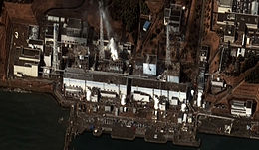
Fukushima

Slide 17
How common are nuclear reactor meltdowns?
According data collected by PSI on accident and fatalities that occur in energy producing workplaces, nuclear power plants have very low numbers of accidents.
http://www.oecd-nea.org/ndd/reports/2010/nea6862-comparing-risks.pdf
How many accidents and resulting fatalities occurred at coal producing facilities? How many at nuclear power producing facilities between 1969-2000?

Slide 18
Cause for Fear? Waste Disposal
The major problem of nuclear waste is what to do with it. In fact, one of the biggest (and perhaps the single biggest) expenses of the nuclear power industry could eventually be the storage of nuclear waste.
Currently there are several ways in which nuclear waste is stored. Most of these methods are temporary. In most cases a viable long-term solution for waste storage has yet to be found. This is because the time period for storage is so incredibly long, on the order of thousands of years.

Slide 19
Calming Public Fears
What are some technologies or policies that are being implemented now or in the future that could make nuclear power even safer?

Slide 20
Evaluate a Policy
http://www2.maxwell.syr.edu/plegal/ppas/existing.html

Slide 21
How is the nuclear waste managed now??
http://www.nei.org/resourcesandstats/documentlibrary/nuclearwastedisposal/factsheet/safelymanagingusednuclearfuel/
May 2010 Key Facts All the used nuclear fuel produced by the U.S. nuclear energy industry in 50 years of operation—approximately 62,500 metric tons—would, if stacked end to end, only cover an area the size of a football field to a depth of about 7 yards.
Used fuel is a solid material that is stored safely and securely at nuclear power plant sites, either in enclosed, steel-lined concrete pools filled with water, or in steel or reinforced concrete containers with steel inner canisters. The U.S. Nuclear Regulatory Commission determined that used fuel could be stored safely at power plant sites or central storage facilities for at least 120 years. However, this storage was never intended to be permanent.

Slide 22
In 1982, Congress directed the U.S. Department of Energy to build a geologic repository by 1998 for used nuclear fuel and defense program waste. The Nuclear Waste Fund, paid by a fee on electricity consumers, was established to support the civilian part of the program.
Congress and President Bush approved Yucca Mountain, Nev., as the repository site in 2002, and DOE submitted a license application to the NRC in 2008. However, the Obama administration has decided to terminate the project.
In January, DOE announced the formation of a blue ribbon commission to make recommendations for managing the nation’s high-level radioactive waste. The commission’s interim report is expected in 18 months.
Advanced technologies are being developed to recycle used nuclear fuel. These technologies would reduce the amount of radioactive byproducts in the material, while recovering valuable energy, but would not completely eliminate the byproducts. Under any used fuel management scenario, disposal of radioactive byproducts in a permanent geologic repository is necessary.

Slide 23
Benefits and Cost
http://www2.maxwell.syr.edu/plegal/ppas/bencost1.html

Slide 24
Pebble Bed Reactors- Future?
The Pebble Bed Modular Reactor (PBMR) is a new type of high temperature helium gas-cooled nuclear reactor
The peak temperature that can be reached in the reactor core (1600 degrees Celsius under the most severe conditions) is far below any sustained temperature (2000 degrees Celsius) that will damage the fuel. The reason for this is that the ceramic materials in the fuel such as graphite and silicone carbide - are tougher than diamonds.

Slide 25
Pebble Bed Reactors- Future?
The helium itself, which is used to cool the reaction, is chemically and radiologically inert: it cannot combine with other chemicals, it is non-combustible, and non-radioactive.
The design is smaller and should be more cost effective to build due to less safety protocols that need to be in place.

Slide 26
Conclusion
How do you feel about nuclear power now?
Would you endorse the use of nuclear power?
Would you want the US to become more dependent on nuclear power?
http://www2.maxwell.syr.edu/plegal/ppas/prince1.html

