Slide 1
changes in Cultural Identity
Mrs. Kapps
TR Proctor High School
pkapps@uticaschools.org
Notes:
Multigenerational families experience conflict because of shifts in cultural identify.

Slide 2
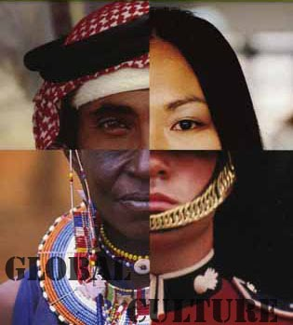
Cultural Identity
  What do you notice about this photograph?
Notes:
Ask the students to notice at least 10 things about the photographic style, position, contents, associations, and composition of the image.

Slide 3
Language Objectives
Students will be able to define and discuss issues related to cultural identity.
Content Objectives
Students will be able to use analytic tool to explore public policy.
Vocabulary:
Culture
Cultural identity
Public Policy

Slide 4
What is CULTURE?
Sort words to show whether this are material or non-material components of culture.
toys
values
food
Material
emotions
art
language
tools
ideas
dress / clothes
beliefs
Abstract
utensils
fears

Slide 5
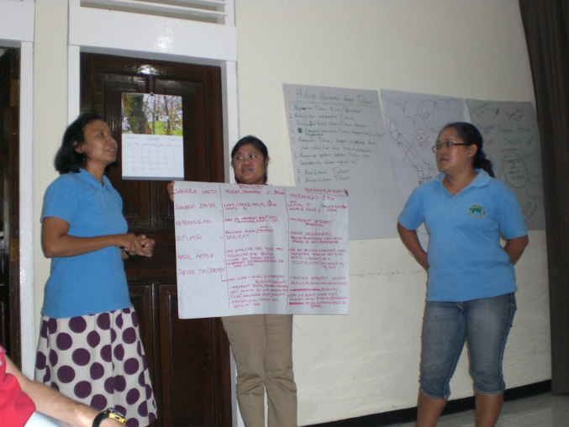
WHAT ABOUT YOUR CULTURE?
Get into “cultural groups” - One group can be others
List material and non-material components of your culture.
Be prepared to present these components to your class.

Slide 6
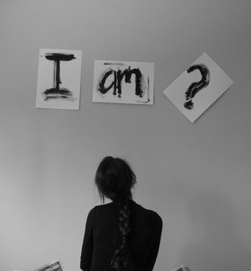
What is CULTURAL
IDENTITY?
How a person describes themself
Activity: “I am From” Poem

Slide 7
Where are you from?
I am from the old Formica kitchen table.
From linoleum and the old brown sleeper sofa.
I am from the little tan house that grew each time our family grew.
The huge old willow tree, bringing us joy in the summer when we’d swing from the branches, and anger in the fall when forced to clean up its fallen limbs.
I am from thick, curly hair and color changing eyes.
I am from a farmer’s son and a factory worker’s daughter.
I am from loud talking and fights that turn into jokes.
From staying out late Saturday and church on Sunday morning.

Slide 8
I am from “don’t kick the driver’s seat” and “stop hitting your sister!”
and “The Song that Never Ends”
I’m from cutting your own Christmas tree
From the United States, but also from England, Scotland, Whales, Ireland, Germany, France, Poland, Italy, France, Spain, and Sweden.
From garden grown tomatoes and hamburger helper.
I am from grandma’s three miracles
From homes made by hand and photos of soldiers
Post cards hidden in closets and photos worn from generations of children who wonder
Where they are from.

Slide 9
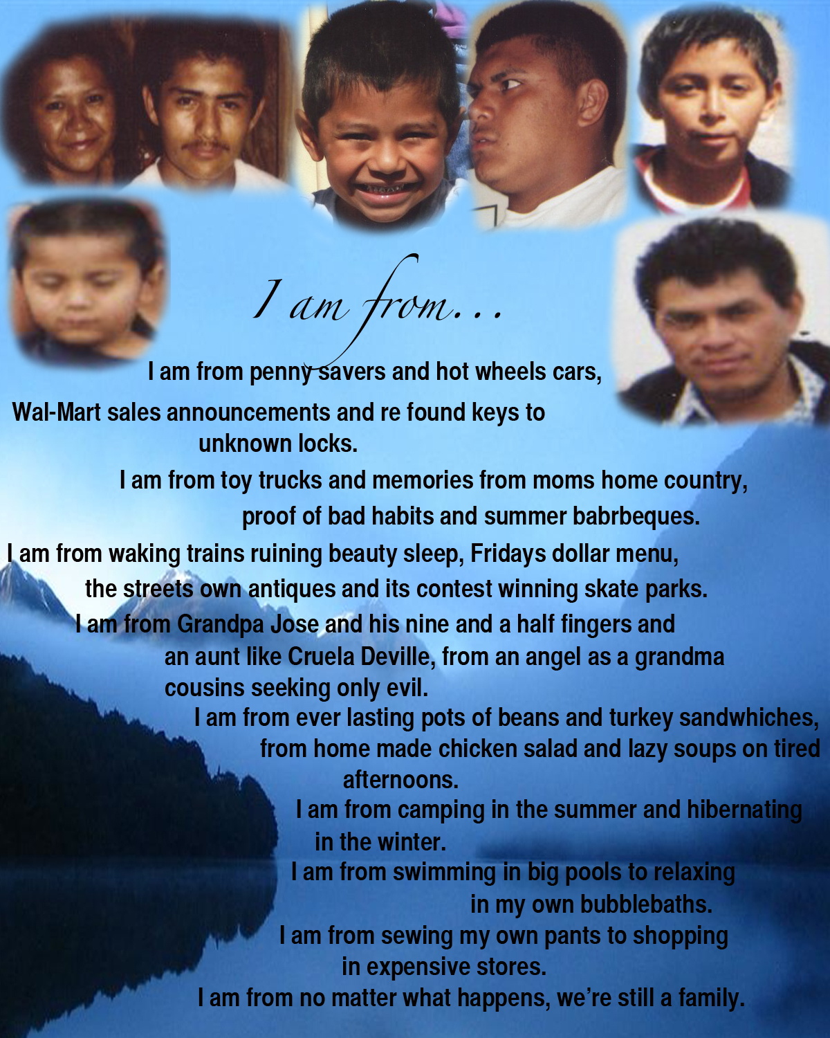
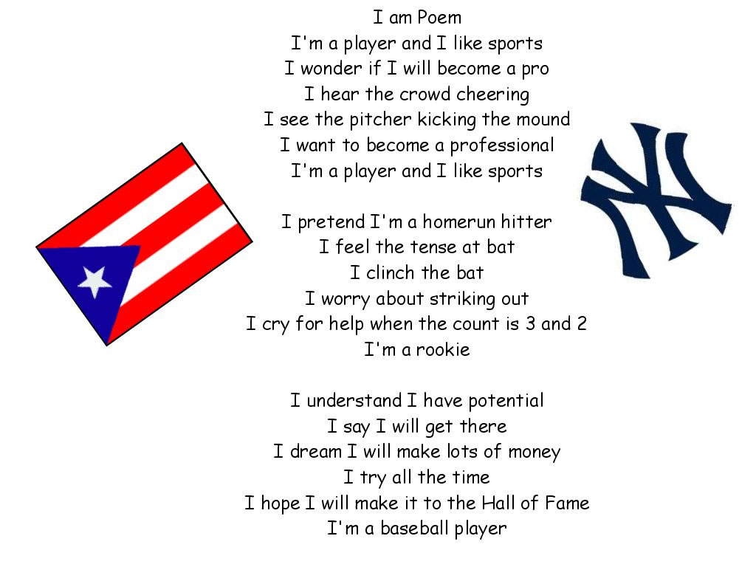
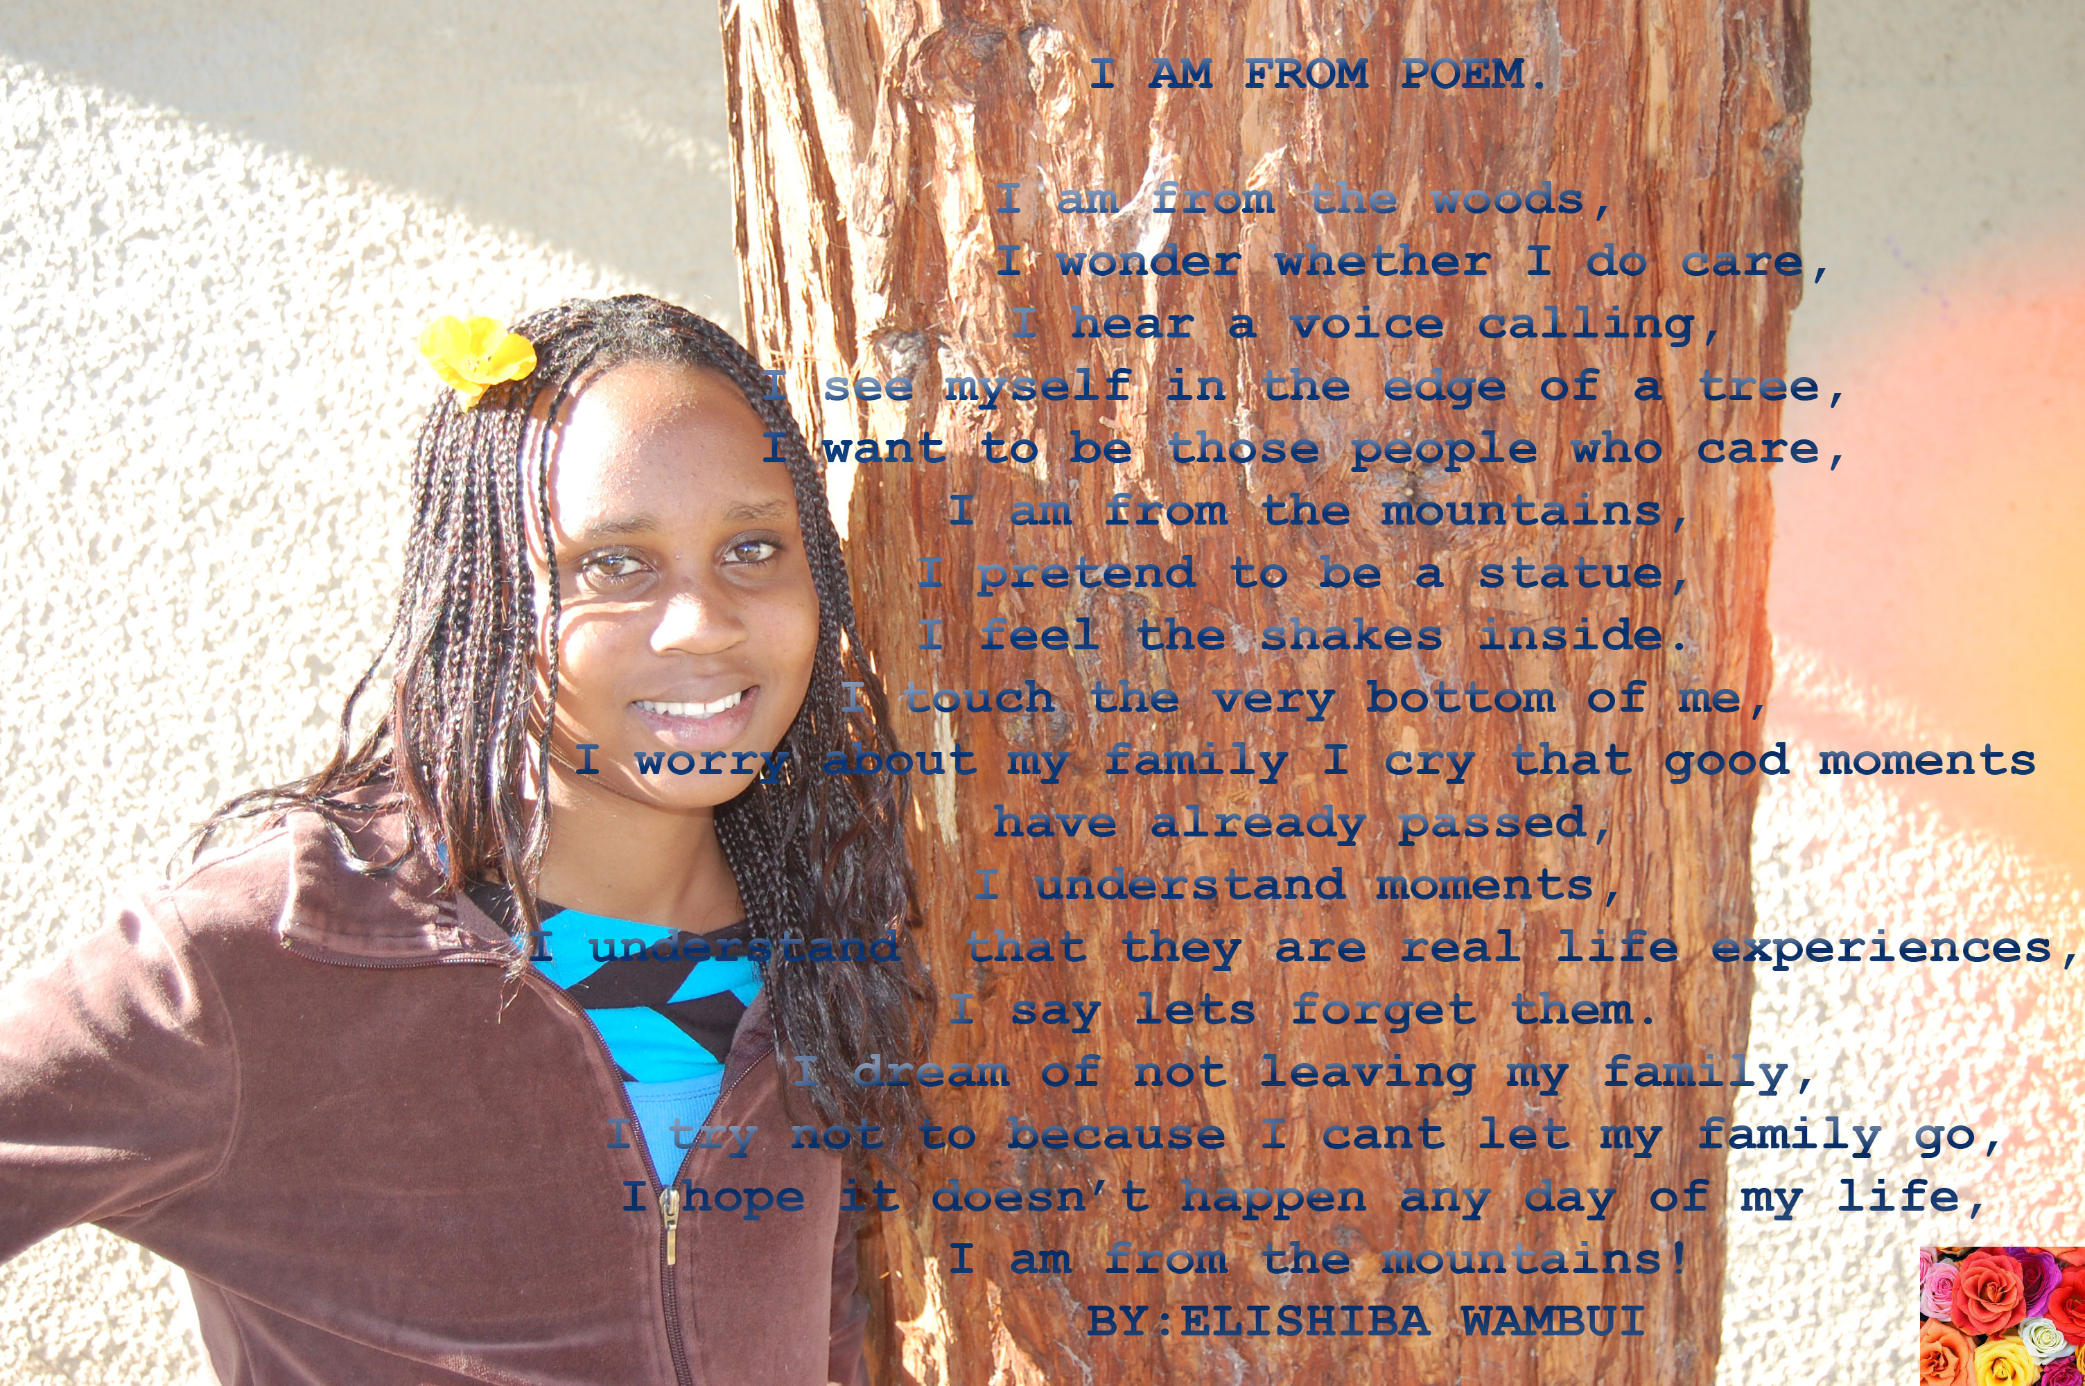
Now you try
Fill in the template
Hand in for the teacher to check spelling
Copy onto good paper and add decoration

Slide 10
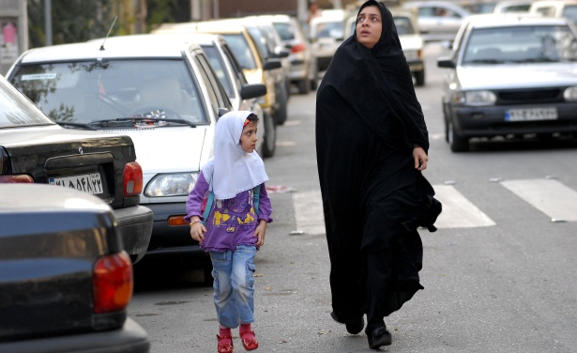
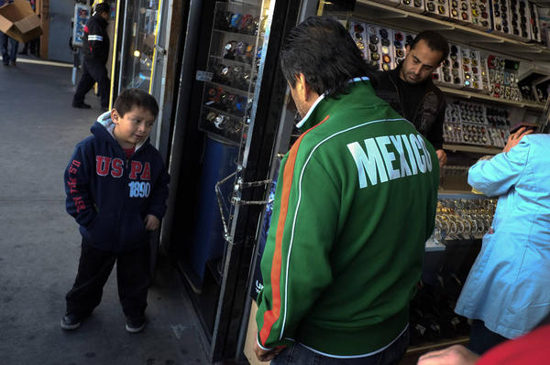
What happens when your cultural identity is not the same as your parents?

Slide 11
What is being done?
What still needs to be done?
Step 1: Defining the Social Problem
Step 2: Gathering Evidence of the Problem
Step 3: Identifying the Causes of the Problem
Step 4: Evaluating Existing Public Policy
Step 5: Developing Public Policy Solutions
Step 6: Selecting the Best Public Policy Solution

Slide 12
Step 1: Defining the problem
Give me one sentence to explain the problem.
What is the SPECIFIC location of the problem?
List three undesirable social conditions that result from this problem.
Write a short phrase that summarizes the social problem.
Back to Steps

Slide 13

Step 2: Gathering Evidence
Create a Student Survey to Collect Data.
What are three questions you can ask?
Do they pass the “Mall Test”?

Slide 14
Step 3: Identifying the causes
What might the causes of this problem be?
Was your data collection helpful?

Slide 15
STEP 4: Evaluating existing public policy
State the major existing policy.

Slide 16
Step 5: Developing Public Policy
What is something YOU can do?
What is something the school can do?

Slide 17
Step 6: Selecting best Public Policy Solution
Is the policy feasible?
Is the policy effective?

Slide 18
Sources
Websites and Worksheets
  PPA Websites
  “I am From” Poem Template
Photos
  “Four Faces”
  “Student Presenting”
  “I am?”
  “Mother and Daughter” “Father and Son”

