Slide 1
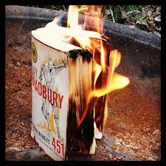
Banned Books in the United States Today???
Yes, it can still happen at a school near you!
--Michele Heintz (mheintz2@syrdiocese.org)
Notre Dame Jr./Sr. High School
Utica, NY 2013

Slide 2
Steps of the PPA (Public Policy Analyst)
1. Define the problem.
2. Gather evidence.
3. Identify the causes.
4. Evaluate an existing policy
5. Develop Solutions
6. Select a solution

Slide 3
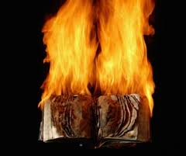
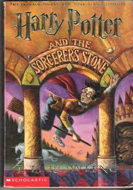
So What’s the Problem?Click HERE to access the PPA on how to define a problem There can be a lack of access to controversial “literature” TODAY in the U.S.A.

Slide 4
Prove it!
Clean versions of song lyrics
Clean
Original
Movie Ratings
G, PG, PG-13, R, NC-17
Banned and Challenged Books
2007 Dear Board of Education,
American Library Association
Map of Banned Books
Click here to access the PPA on how to gather evidence.

Slide 5
Your turn! Which books have you read were banned or challenged?
1. Using the internet, find 10 books that you think your classmates may have read, that have been either banned or challenged.
2. Devise a survey for your classmates to calculate what percentage of the class has indeed read your books?
www.opinionpower.com
3. Make a poster-size pie chart or another visual aid that will display your results.

Slide 6
WHY? Pourquoi? Por qué?
What has caused this need to censor what we read, watch, and even listen to? Click here to Identify causes of the PPA process.
Read the following articles that address the core philosophies behind censorship. Will you agree or disagree with what is proposed? Let’s see!!!
Article 1
Article 2
Article 3

Slide 7
To Ban or Not to Ban?!
Fill in PPA worksheet number 3 with information from the articles we just read.

Slide 8
