Slide 1
Applying Public Policy Analysis to Low Graduation Rate of ELLs
Maria Fielteau
T.R. Proctor High School
ESL Department
mfielteau@uticaschools.org

Slide 2
The 6 Steps of the Public Policy Analyst (PPA)
1. Define the Problem
2. Gather the Evidence
3. Identify the Causes
4. Evaluate an Existing Policy
5. Develop Solutions
6. Select the Best Solution
(Feasibility vs. Effectiveness)

Slide 3
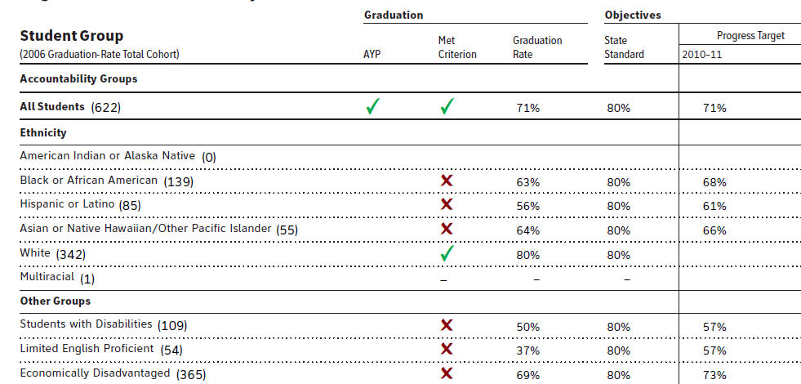
Gathering Evidence
See the T.R. Proctor High School report card.

Slide 4
Compare Graduation Rates
Compare ELL graduation rate in our school to the school’s total graduation rate.
Compare ELL graduation rate in our school to the State’s standard graduation rate for ELLs.
What do you notice?
Does the evidence indicate a problem?

Slide 5
Why do you need the high school diploma?
Think – pair- share

Slide 6
Brainstorm the Causes
Whose fault is it?

Slide 7
Brainstorm the Causes
Whose fault is it?
? Poverty level
? Language proficiency
? Educational background
? Parental involvement
? Ineffective teachers
? Genetic predisposition
? Health issues
? Wrong zip code (hint: 90210 is a better one)
? State policy

Slide 8
Examine Existing Policy for Graduation Requirements
What do you need to graduate from high school?
Let’s make a list as a class:
Credits
Regents examination
http://schools.nyc.gov/NR/rdonlyres/215FF06B-DCA3-442B-89DF-18E674DC867E/0/Acpolicygened.pdf

Slide 9
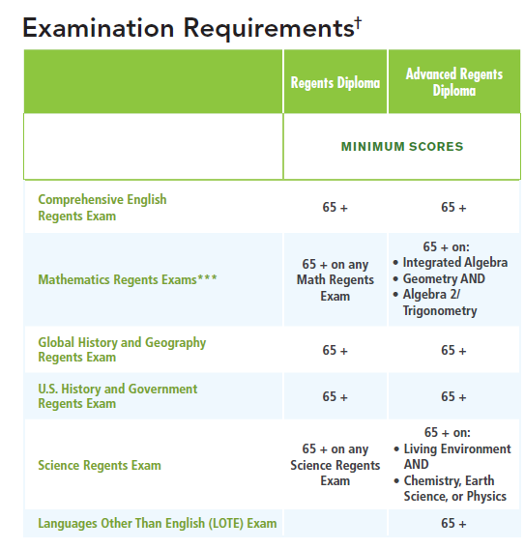
Graduation Requirements

Slide 10
Compare the Policy for Different Groups
What are the requirements for Regular Education students?
What are the requirements for Special Education students?
What are the requirements for ELLs?
What do you notice?
What is your opinion about that?

Slide 11
Develop the Solutions
Work in 4 groups to develop possible solutions to address low graduation rate of ESL students
Present your solutions

Slide 12
Select the Best Solution
Evaluate the proposed solutions individually (Feasibility vs. Effectiveness)
Complete worksheet http://www2.maxwell.syr.edu/plegal/TIPS/worksheet6.doc
Rate the solutions and vote as a group to chose the best one.

Slide 13
Resources
http://schools.nyc.gov/NR/rdonlyres/215FF06B-DCA3-442B-89DF-18E674DC867E/0/Acpolicygened.pdf
http://schools.nyc.gov/NR/rdonlyres/531C5296-BC35-43E0-BD29-2D7E29BAB2C7/0/AcpolicySWD.pdf
http://www2.maxwell.syr.edu/plegal/ppae/step3a.html
http://www2.maxwell.syr.edu/plegal/TIPS/worksheet6.html
https://reportcards.nysed.gov/files/2010-11/AOR-2011-412300010024.pdf
http://insideschools.org/high/graduation-requirements

