Slide 1
Meat Inspection Act, 1906
Justin DeLong
Proctor High School
Utica, NY

Slide 2
Unsanitary Conditions in the Meat Processing Plants, early 20th Century

Slide 3
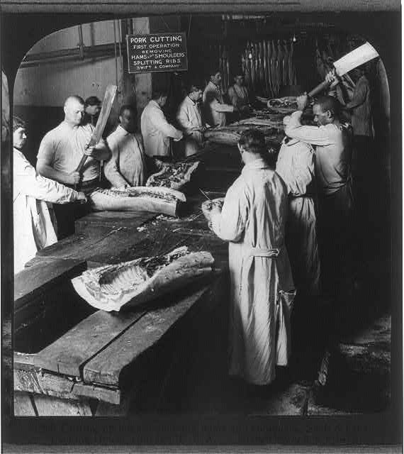

Slide 4
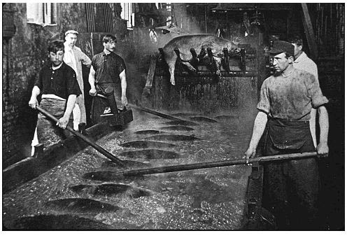

Slide 5
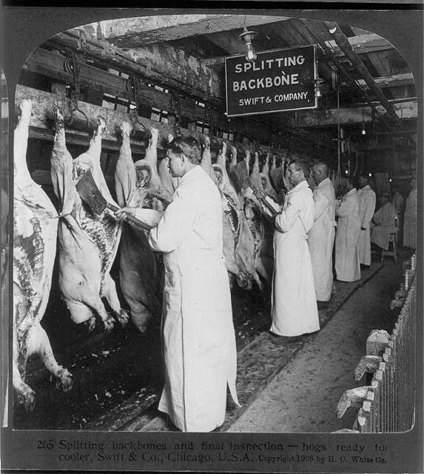

Slide 6
The 4 Steps of the American History Public Policy Analyst (AHPPA)
1. Define the Problem
2. Gather the Evidence
3. Identify the Causes
4. Evaluate the Policy

Slide 7
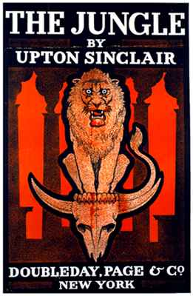
Muckraker Upton Sinclair wrote the Jungle about the workers and unsanitary conditions in the Meat Packing Plants.

Slide 8
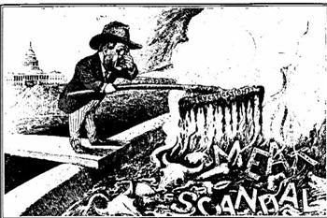
Theodore Roosevelt

Slide 9
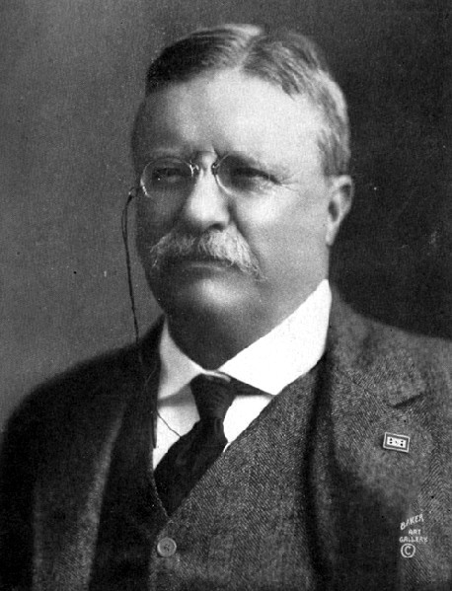
Progressive President Theodore Roosevelt (1901-1909)

Slide 11
Review the steps and guidelines describe in the link below. Evaluate the Policy using the American History Public Policy Analyst (AHPPA) format.

