Slide 1
The Rise of Type II Diabetes in Young Adults
Ryan Cooney
Notre Dame High School
rtcooney@syrdiocese.org

Slide 2
Steps of the PPA
Worksheet # 1: Defining the Social Problem
Worksheet # 2: Gathering Evidence for the social problem
Worksheet # 3: Identifying the Causes for the problem
Worksheet # 4: Evaluating Current Public Policy
Worksheet # 5: Developing Solutions
Worksheet # 6: Selecting the Best Solution

Slide 3
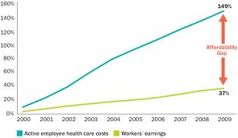
Public Health Problems
STEP 1 of the PPA
Rising Health Care Costs
Deteriorating Health of Individuals
Hospitalizations

Slide 4
Diabetes is a Chronic Condition
•Rise in chronic diseases – Longer life spans and greater prevalence of chronic illnesses has placed tremendous demands on the health care system. It is estimated that health care costs for chronic disease treatment account for over 75% of national health expenditures. In particular, there has been tremendous focus on the rise in rates of overweight and obesity and their contribution to chronic illnesses and health care spending. The changing nature of illness has sparked a renewed interest in the possible role for prevention to help control costs.

Slide 5
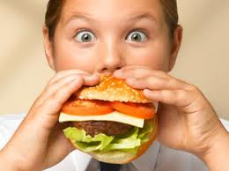
Incidence in USA
STEP 2 of the PPA
215, 000 under age 20 currently diagnosed
1 in 400 kids
3,600 new cases/year
Higher rates in minorities

Slide 6
Causes of Teenage Type 2 Diabetes
Using the PPA format, your task is to create a list of at least 3 causes of the rising rates of Type 2 diabetes.
Use the Worksheet #3 to complete thus task.

Slide 7
Causes of Teenage Type 2 Diabetes
Increased caloric intake.
8x more fast food restaurants than grocery stores near homes and schools.

Slide 8
Fast Food A Major Culprit
25% of Americans eat at least one fast food meal per day.
dosomething.org
Teens between the ages of 13 and 18 purchased 800 to 1,100 calories in an average fast food visit.

Slide 9
Current Public Policy
STEP 4 of PPA
The Healthy, Hunger-Free Kids Act requires that the U.S. Department of Agriculture (USDA) issue new nutritional standards for school meals and for competitive foods and beverages sold through vending machines and elsewhere.
The new law authorizes an increase in federal funding by 6 cents per lunch for schools that meet USDA's updated nurtitional standards, the largest reimbursement increase above inflation in more than 30 years.
The new law authorizes some $50 million for training and technical assistance to help school food service workers prepare nutritious meals.

Slide 10
Possible Solutions
STEP 5 of the PPA
Recommendations :policy changes to improve teens' food environments, including:
Creating a program to bring fresh produce directly from farms to schools;
Offering incentives to draw more healthful grocers to underserved neighborhoods; and
Zoning food outlets more strategically, especially around schools (Los Angeles Examiner, 7/27).
Read more: healthonline.com

